Slide 1

Economic Empowerment of Women: Challenges and Good Practices in
Rural Areas in Japan
Asako Osaki
26 May 2017
@ASEM Conference on
Women’s Economic Empowerment

Slide 2

Main Points
Ongoing efforts for women’s empowerment
Challenges of women in local and rural areas
Entrepreneurship as driver for women’s economic empowerment in rural areas
Post-disaster reconstruction in Tohoku
Factors contributing to success of entrepreneurship support projects

Slide 3
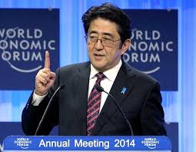
Under the leadership of
Prime Minister Abe
“Society in which women can shine”
Abenomics is Womenomics ! (2013)
World Assembly of Women (2014,2015,2016)
National Action Plan for SCR 1325 ‘Women, Peace, and Security’ (2015)
Act on Promotion of Women’s Participation and Advancement in the Workplace (2016)
Development Strategy for Gender Equality and Women’s Empowerment (2016)
Notes:
The Act on Promotion of Women's Participation and Advancement in the Workplace

Slide 4
Challenges: Urban-rural gap
Background:
Tokyo-centric economy
Aging population
Lack of work options and employment opportunities
Population outflow (prominently to Tokyo)
50% municipalities may disappear?
Regional revitalization efforts but
young women are leaving

Slide 5
WHY are young women leaving?
Patriarchal values: Strong gender norms and division of labour; seniority
Low enrollment rate in tertiary education (Tokyo 72%, Iwate 33.1%, Fukushima 35%)
Lack of access to decision-making (Prefectural assembly: Tokyo 19.5%, Ehime 2.1%, national average 12.8%)
Lack of work options (clerical work, low-paid care work, agriculture/seafood processing)
→ Lack of role models
To Tokyo, but…

Slide 6
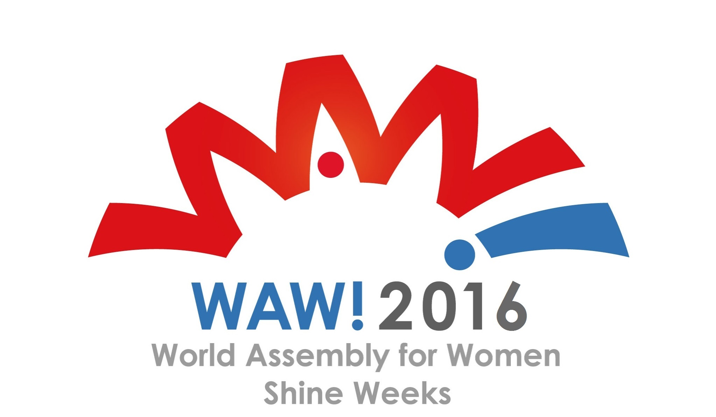
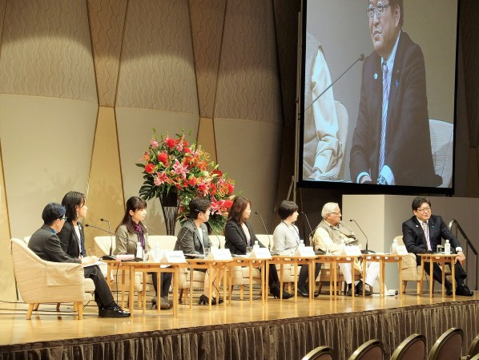
WAW!2016
(December 2016)
Innovation from Local Communities: Towards Society where Women can “Truly” Shine
Gender and age discrimination
Gender-based division of labour: care for child/elderly and chores, clerical work
Lack of child care services
Low self-esteem and lack of
confidence
Low % of women in local
decision-making bodies
Notes:
Tokyo 19,5%
Aomori 6.3%
Ehime 2.1% 1 out of 45
NATIONAL AVERAGE 12.8%

Slide 7
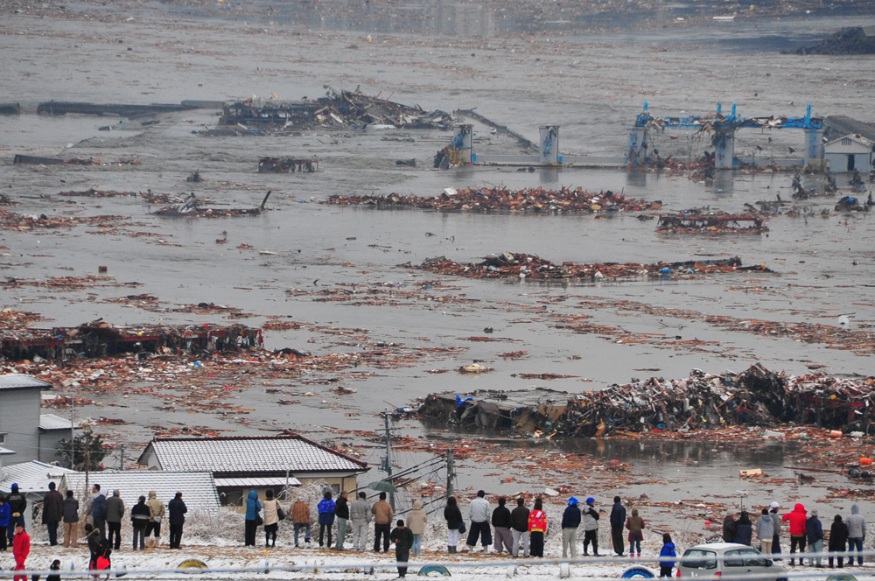
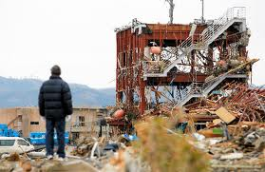
２０１１．３．１１

Slide 8

EMPOWERMENT of Women
Special Protection
Promoting Full Participation
Non-Japanese speaking women
Pregnant women
Breastfeeding mothers
Single mothers
Victims of violence
Adolescent girls
Policy advocacy
Networking women’s organizations
Women’s entrepreneurship
Women’s employment
PARTHERSHIPS with
LOCAL WOMEN’S GROUPS
SPECIALIZED ORGANIZATIONS
Notes:
Why entrepreneurship?
Contributes to women’s empowerment (self-realization, economic empowerment, voice in the household)
Contributes to re-vitalizing disaster-affected communities (serving the needs of community members, tourists/aid workers, wider market)
Break the barrier for gender bias

Slide 9


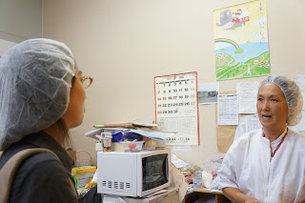


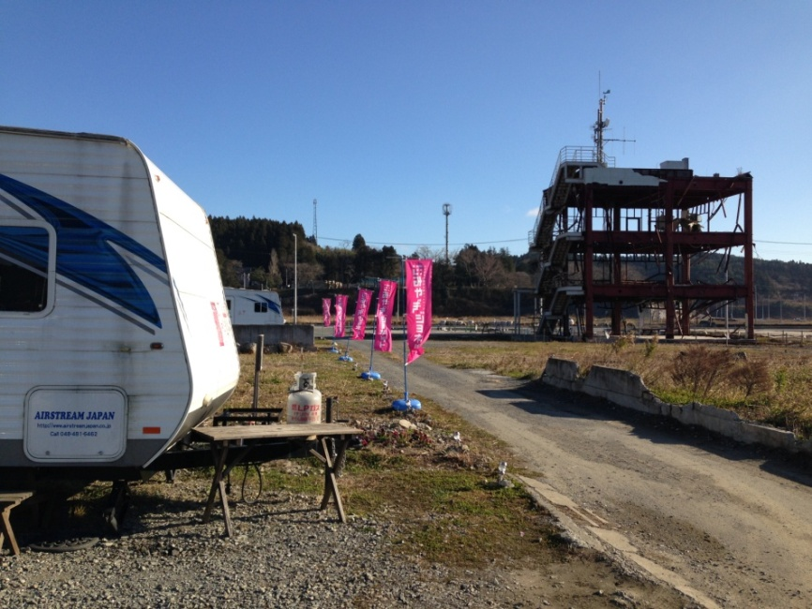
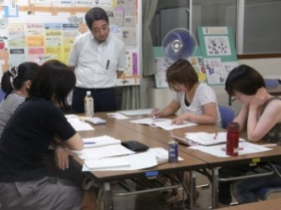
2011～2015
Notes:
Natural disaster was a tragic event but the reconstruction process was an empowerment process for rural women
Iwate 8.3% →14,6%

Slide 10
Case Studies on
Economic Empowerment of Women in Post-Disaster Reconstruction in Tohoku and the Asia-Pacific (2015)
(MOFA, Japan) http://www.mofa.go.jp/mofaj/files/000088221
Objectives:
Present good practices in the promotion of economic empowerment of women in the post-disaster situations through entrepreneurship development in Japan and the APEC
Discuss and analyze factors contributing to the success of the projects

Slide 11
Support to Women’s Entrepreneurship in Disaster Affected Areas implemented by Local Women’s NPO in Iwate
Aim：
To prepare women to become entrepreneur/employee
Workshop Programs：
Introductory Course on Entrepreneurship or on IT (6 months
Introductory PC seminar
Follow-up Course on demand for further consultation
Boosting Forum – Presentation of concrete plans

Slide 12
Support to Women’s Entrepreneurship in Disaster Affected Areas implemented by Local Women’s NPO
Methodology ：
Methodology responsive to the specific needs of women
Encourage and develop self-confidence
Raise awareness of their skills, experience, and network as resources
Train logical thinking skills
Train how to identify ideas/plans
Provide comprehensive skills necessary for job hunting (e.g., writing resume, interview skills, suitable outfit etc)

Slide 13
Support to Women’s Entrepreneurship in Disaster Affected Areas implemented by Local Women’s NPO
Capacity-building ：
Participants recognize their needs, resources and motives
Participants develop self-esteem/confidence through meeting other women
Knowledge and skills to access resources and social services
Starting work, managing one’s life
The follow-up course was a powerful tool

Slide 14
Support to Women’s Entrepreneurship in Disaster Affected Areas implemented by Local Women’s NPO
Mentoring ：
Mental and technical readiness to start business
Psychological affirmation for business
Impact on local community ：
Became tax payers, job providers, off the welfare-recipients
Often created community, social spaces for residents (e.g., restaurant, café)

Slide 15
Support to Women’s Entrepreneurship in Disaster Affected Areas implemented by Local Women’s NPO
Gender Sensitive Approach
Gender Neutral Approach
Basic empowerment (confidence-building, ownership, decision-making)
Technical skills and knowledge or business
Follow-up services (mentoring)
Gender-sensitive instructors and in-house staff catered to meet individual needs
Business training
Start-up funds
Men and Women have different needs
Gender-based roles (particularly, care work)
Access to resources and information
Skills-set
Social Capital
Notes:
Two Approaches for Entrepreneurship Development to date
Gender-neutral approach: Provision of business training and start-up funds
Women-specific approach: Basic empowerment, business training, mentoring, starting ‘small’
→ Men and women have different needs (gender-based roles, access to resources/information, readiness for taking ‘ownership’, skill-set, social capital etc)

Slide 16
Entrepreneurship (not employment)
Entrepreneurship: Policy, Law, and Program
Gender-sensitive entrepreneurship programme
Provision of financial/credit services
Strategic use of ICTs and technological innovation
Girls and Young Women in Rural Communities
EMPOWERMENT (confidence, education, participation, decision-making, leadership)
Role models
Entrepreneurship
Digital empowerment/ STEM

