Slide 1
International Girls in ICT Day
Laura Kangas, Europe Girls in ICT Coordinator
International Telecommunication Union
ASEM Conference Women’s Economic Empowerment: Creating Equal Opportunities in the World of Work
Vilnius, Lithuania 26 May
1

Slide 2
About ITU
The United Nations Specialized Agency for Information and Communication Technologies (ICTs)
193 Member States, 750+ Sector Members
Founded in Paris in 1865 as the International Telegraph Union
2015 marked 150 years of experience and innovation
Three sectors:
  Radiocommunication
  Standardization
  Development
2

Slide 3
Gender equality and the empowerment of women and girls through ICTs
ITU Resolution 70 (Rev. Busan, 2014) "Mainstreaming a gender perspective in ITU and promotion of gender equality and the empowerment of women through information and communication technologies”
Highlights the role of ICTs to advance gender equality and women’s empowerment in many ways, notably by encouraging girls to choose a career in the field of ICTs, and by fostering the use of ICTs for the social and economic empowerment of women and girls.
Encourages Member States and Sector Members to review their policies related to the information society to ensure the inclusion of a gender perspective in all activities
Calls for the celebration of International Girls in ICT Day on 4th Thursday of April every year
Why? To create a global environment that encourages girls and young women to consider studies and careers in the ICT sector
Over 7,200 events in 160 countries, empowering over 240,000 girls and young women globally

Slide 4

Promoting innovation & entrepreneurship for youth
WTDC-14 Regional Initiatives for Europe region:
EUR5 EUR5 Entrepreneurship, innovation and youth
To foster the creation of an enabling environment and build capacities at the regional level, aimed at growth of entrepreneurship and increased innovation in the ICT ecosystem, while encouraging empowerment of young women and men and creating new opportunities for them in the ICT sector. Strengthened cooperation with diverse stakeholders, including academia and private sector will be necessary

Slide 5

Sustainable Development Goals
17 Goals to Transform our World

Slide 6
Girls in ICT Day and SDGs:
Digital skills
SDG 4.3: By 2030, ensure equal access for all women and men to affordable and quality technical, vocational and tertiary education, including university
SDG 4.4: By 2030, substantially increase the number of youth and adults who have relevant skills, including technical and vocational skills, for employment, decent jobs and entrepreneurship
Equality
SDG 5.1: End all forms of discrimination against all women and girls everywhere
SDG 5.5: Ensure women’s full and effective participation and equal opportunities for leadership at all levels of decision making in political, economic and public life
SDG 5.b: Enhance the use of enabling technology, in particular information and communications technology, to promote the empowerment of women
SDG 10.2: By 2030, empower and promote the social, economic and political inclusion of all, irrespective of age, sex, disability, race, ethnicity, origin, religion or economic or other status

Slide 7
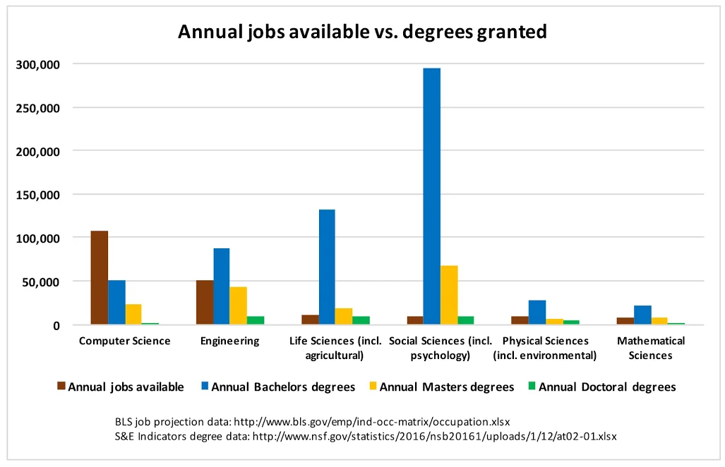
Girls in ICT Day and SDGs: Employment
SDG 8.2: Achieve higher levels of economic productivity through diversification, technological upgrading and innovation, including through a focus on high-value added and labour-intensive sectors
SDG 8.3: Promote development-oriented policies that support productive activities, decent job creation, entrepreneurship, creativity and innovation, and encourage the formalization and growth of micro-, small- and medium-sized enterprises, including through access to financial services
SDG 8.5: By 2030, achieve full and productive employment and decent work for all women and men, including for young people and persons with disabilities, and equal pay for work of equal value
SDG 8.6: By 2020, substantially reduce the proportion of youth not in employment, education or training

Slide 8
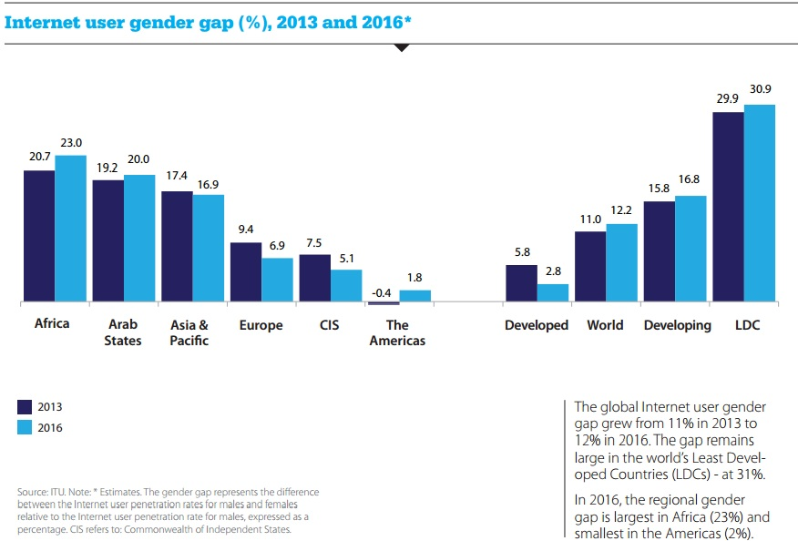
Why do we need a Girls in ICT Day?
Gender gap in 18 European countries
8

Slide 9
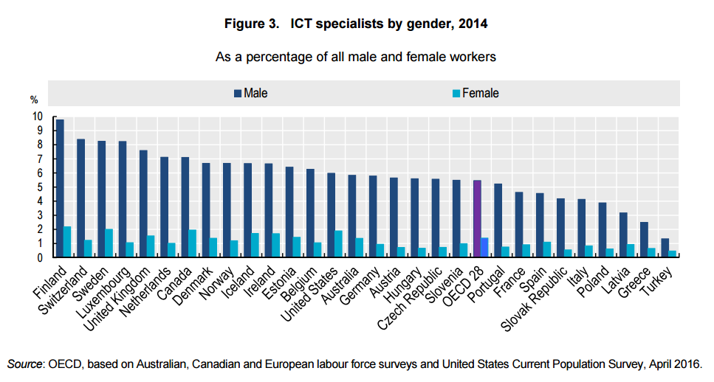
Why do we need a Girls in ICT Day?
In Europe
16 % of the workforce of 8 million in the ICT sector female
9 % of developers in Europe are women
19% of ICT entrepreneurs are women
19.2 % of employees in the ICT sector have female bosses
54 % of women in ICT jobs occupy lower paid and lower skill-level positions, only 8 % high-skill software engineering positions
9
Notes:
Source: OECD (2016) Skills for a digital world, available at: http://www.oecd-ilibrary.org/docserver/download/5jlwz83z3wnw-en.pdf?expires=1485942789&id=id&accname=guest&checksum=15711028AE0DDD0781E3CE23A6464039
5,5% of male workers in OECD countries are ICT specialists, 1,4% of female workers.
The sector is characterised by particularly high vertical and horizontal segregation, as well as a gap between women's educational qualifications and their position in the ICT sector;
Entrepreneurs - (compared with 54 % in other service sectors)
Bosses – (compared with 45.2 % of employees elsewhere)

Slide 10
Why do we need Girls in ICT Day?
EDUCATION:
Less than one in 20 girls considers a career in science, technology, engineering or mathematics (STEM) compared to one in five boys
20% of graduates in the ICT field are women, 3% of all female graduates have a degree in ICT – the share has decreased the last years
Around half of female STEM graduates do not go on to work in STEM roles
60% of school students in the EU never use digital equipment in their classroom

Slide 11
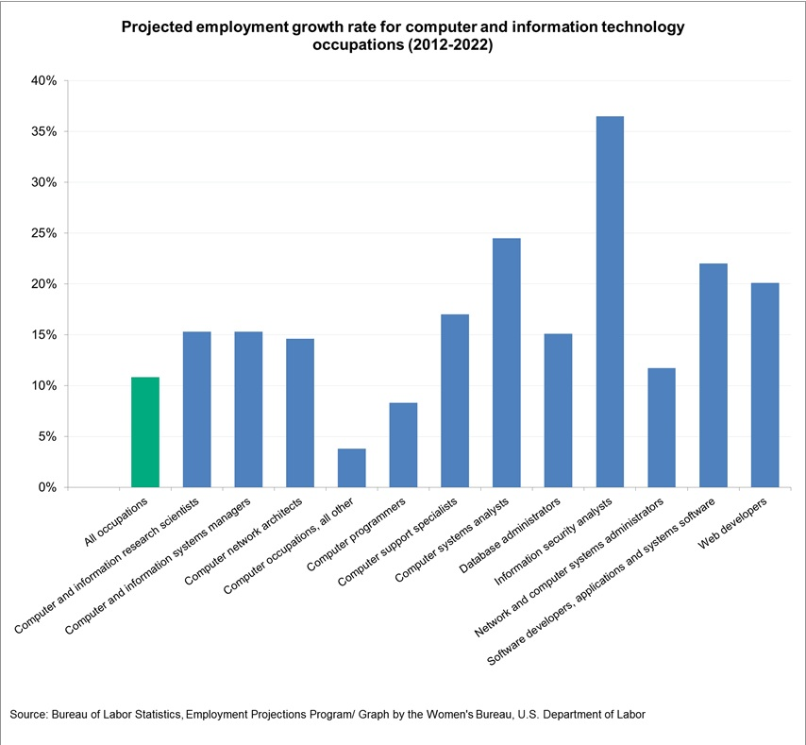
…but that’s where the jobs are!
Estimated shortfall of over two million skilled ICT professionals worldwide
900 000 unfilled positions in the ICT sector in Europe by 2020
Sector creates around 120 000 new jobs every year
Equal participation of women would lead to a gain of around EUR 9 billion EU GDP each year
Notes:
Source:EC: REPORT on gender equality and empowering women in the digital age. Committee on Women’s Rights and Gender Equality
Chart available at : https://www.dol.gov/wb/stats/Computer_information_technology_2014.htm

Slide 12
Digital skills are increasingly important
Digital literacy has become prerequisite for employment opportunities in nearly all sectors
95% of workers in large businesses and 85% in medium-sized businesses use the Internet as part of their jobs
over 40% of those using software at work every day do not have the skills required to use digital technologies effectively
Workers with no computer experience earn around 10% less than those with the most basic computer skills
In Europe, twelve million more digitally unskilled women than men
ICT creators are shaping our societies
Notes:
Source: OECD (2016) Skills for a digital world policy brief available at: http://www.oecd.org/employment/emp/Skills-for-a-Digital-World.pdf
Source: Digital Scoreboard for Europe,

Slide 13


What can we do?
Encouraging girls and women into ICT studies
Recruiting women
Retaining & promoting women

Slide 14
Encouraging girls and women into ICT studies
Include Computer Science in the school curriculum
Train teachers and support parents
Provide female role models
Involve students in hands-on STEM-related activities
Create learning environments that foster inclusiveness for female students in STEM
Notes:
First four points from Accenture (2015) Continuing to Power Economic Growth: Attracting more young women into Science and Technology 2.0
Fifth point from: http://www.theunitedstateofwomen.org/blog/stem-girls-rock-get-girls-women-stem-education-careers/

Slide 15
Organize a Girls in ICT Day event!
Girls in ICT Day events are organized independently or in partnerships by ITU Member States, international organizations, companies, civil society, academia or schools. A typical event would invite Girls to discover the world of ICTs through hands-on activities and information
What to organize?
Hackathons and
contests
Mentoring sessions and presentations from inspiring women in ICT
Workshops and hands-on activities:
  Robotics
  App development
  Coding
  Virtual Reality
  Creating websites
Discovery tours of the company’s facilities
ICT career and study fairs

Slide 16
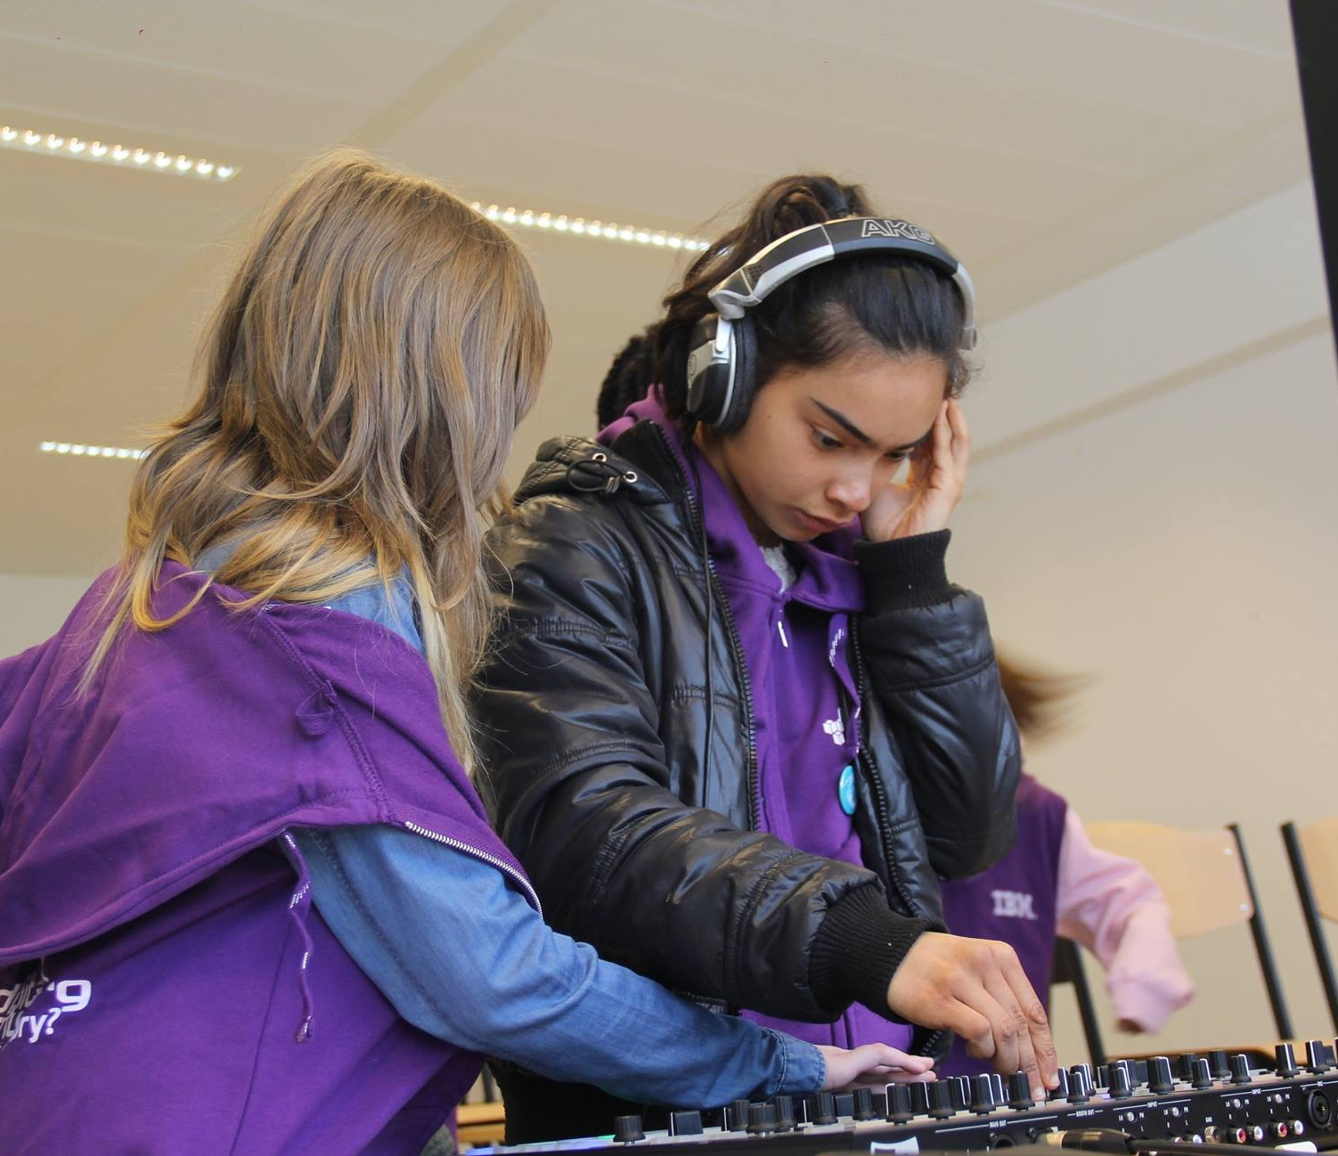
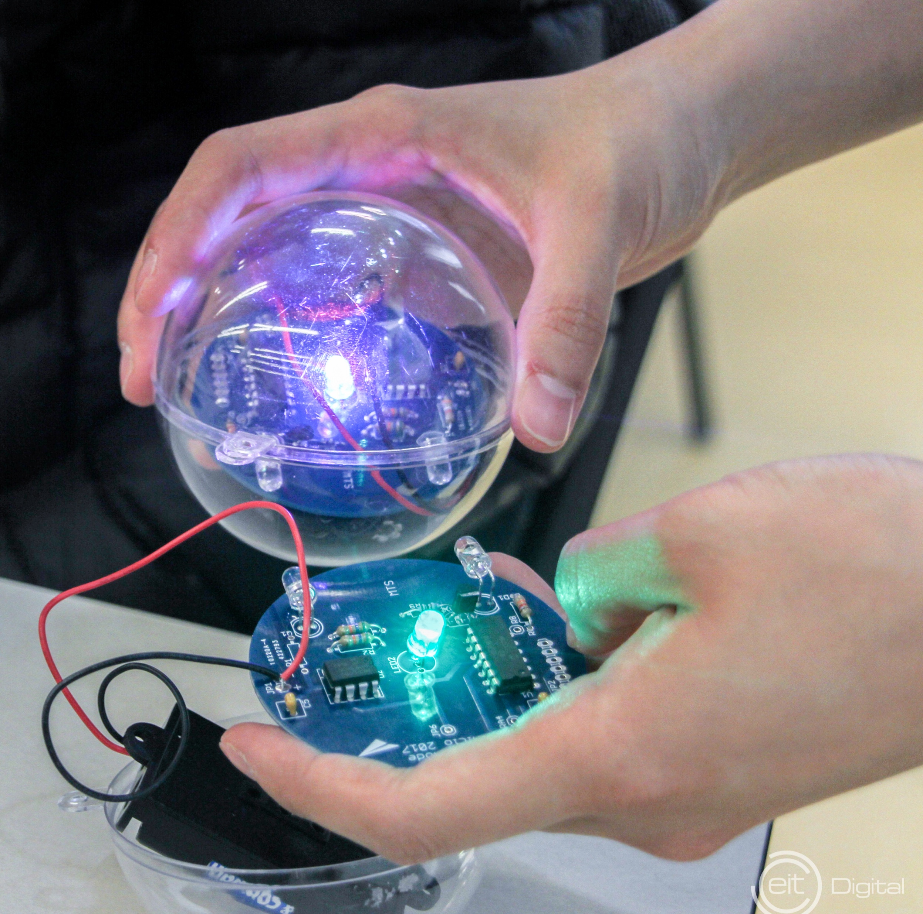
Best practices from Europe
Girl Tech Fest Brussels 2017, (Digital Leadership Institute): over 100 activities reaching 250 participants, encouraging girls toward study and career paths in ESTEAM: STEM plus Entrepreneurship and Arts
Girls in ICT Stockholm 22017 (Inicio & EIT Digital), hands-on workshops on electronics and smart cities, role models and a mini-fair for 100 girls
Girls in ICT Serbia (Ministry of Trade, Tourism and Telecommunications), award ceremony for blogging competition, Minecraft workshop
Notes:
Girls in ICT Day in Europe celebrated in at least 36 countries .

Slide 17
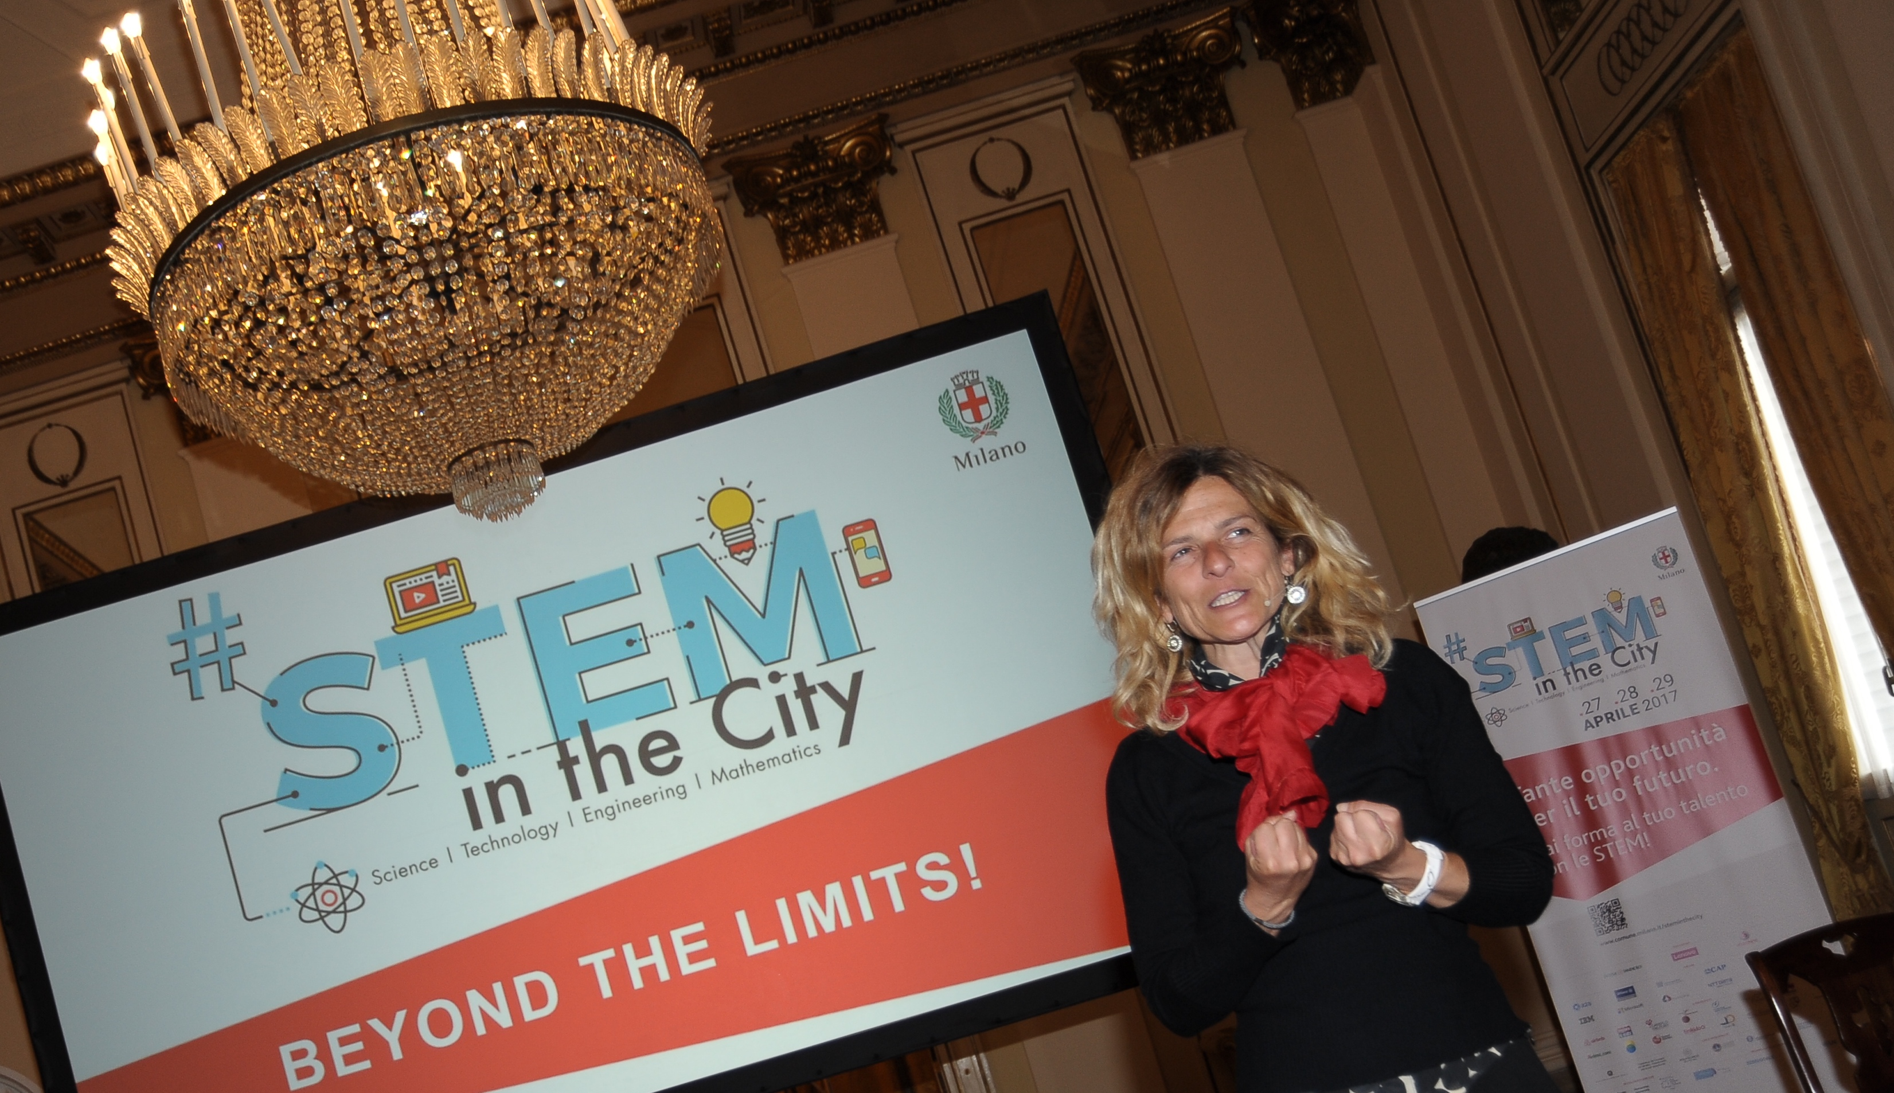
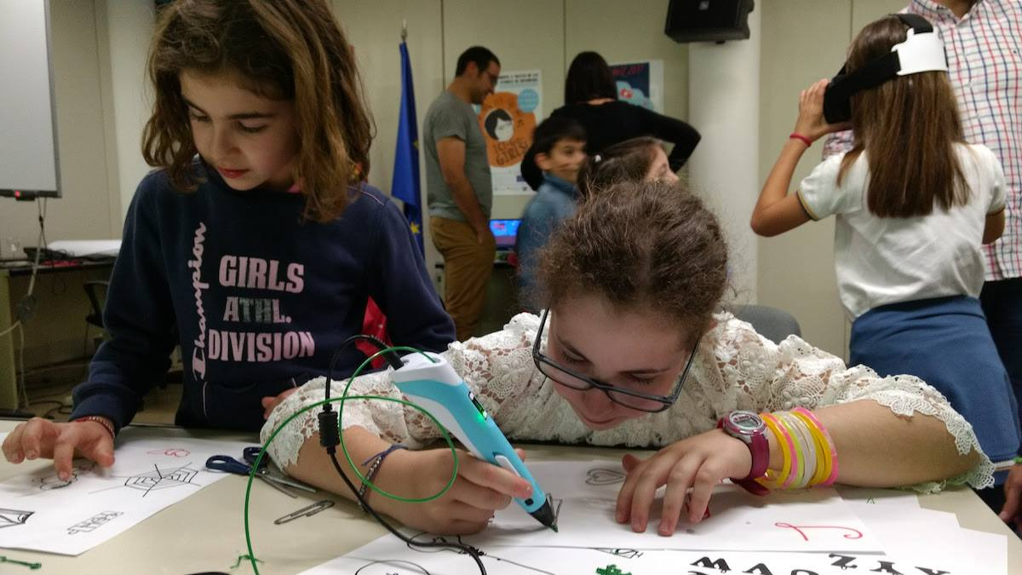
Best practices from Europe
STEM in the City Milan (Municipality of Milan), 84 activities throughout April - public events, training activities, role models, hackathons reaching over 3000 participants
ICT Go Girls (CESGA, Spain): Virtual conference, demonstrations of 3D printing, robotics, Virtual Reality, coding classes, Pixel art, guided tour at the Centre
Gender Centre: Girls in ICT (Republic of Sprska, Bosnia and Herzegovina), jointly with Lanaco and Innovation Centre Banja Luka, award show for competition on developing ICT solutions for the challenges in the local communities, workshops, conference with motivational speakers

Slide 18
Best practices from Europe
Microsoft DigiGirlz events in 11 European countries & Cisco TechPowersGirls in 13 countries
Other private sector examples: Ericsson, Nokia, FDM Group, IBM
Girls’ Day celebrations: Germany (over 100.000 girls), the Netherlands (11.000 girls), Slovakia (over 1000 girls)

Slide 19
Girls in ICT Day Vilnius
Regional Preparatory Meeting for WTDC-17 for Europe (RPM-EUR) & Regional Development Forum for Europe (RDF-EUR) 26-28 April 2017
ICTs for Sustainable Development
sharing national and regional strategies and policies strengthening multi-stakeholder support and partnerships
ICTs for Empowering Women:
Dr Danguole Rutkauskiene, Head of Young Computer User’s School at Kaunas University of Technology and Head of Working Party at National Digital Coalition, Lithuania
Girls in ICT Day side event:
30 girls from schools across Lithuania, robotics workshop, Virtual Reality demonstrations, virtual conference connecting to Switzerland and Lebanon, mobile quiz game, role models
Notes:
Session 4: New Collaborative Paradigms for ICT4SDG (SDG 4, 5, 17 / WSIS AL C1, C3, C11)
This session will focus on sharing national and regional strategies and policies strengthening multi-stakeholder support and partnerships for the implementation of ICT4SDG actions. It will also provide a platform for exchange of experiences, including successes, challenges and lessons learned, with a view to accelerating the implementation of the 2030 Agenda through ICTs.

Slide 20
Next actions and more information
Report on Europe Girls in ICT Day 2016 available on & 2017 to be published https://www.itu.int/en/ITU-D/Regional-Presence/Europe/
Event postings on Girls in ICT Portal www.itu.int/GirlsinICT
Videos available and more to come on ITU YouTube Channel, Girls in ICT Day 2017 Playlist
WSIS Forum 2017 12-16 June https://www.itu.int/net4/wsis/forum/2017/
Thematic workshops:
- Women’s empowerment through ICTs organized by ITU & Partners (TBC)
- How technology is being used to accelerate girls’ inclusion and access to education (particularly STEM) and improve pedagogical practices to enable critical thinking to support sustainable gender empowerment organized by e Worldwide Group
- Women Engineers & Scientists in the digital economy and industry 4.0 organized by INWES - The International Network of Women Engineers & Scientists

Slide 21


Thank you!
www.itu.int/en/ITU-D/Regional-Presence/Europe
eurregion@itu.int
21

