Slide 1

Economic Costs of Violence Against Women
Women’s Economic Empowerment: Creating Equal Opportunities in the World of Work – Asia-Europe Meeting
Nata Duvvury
National University of Ireland, Galway
25-26 May 2017
Vilinus

Slide 2
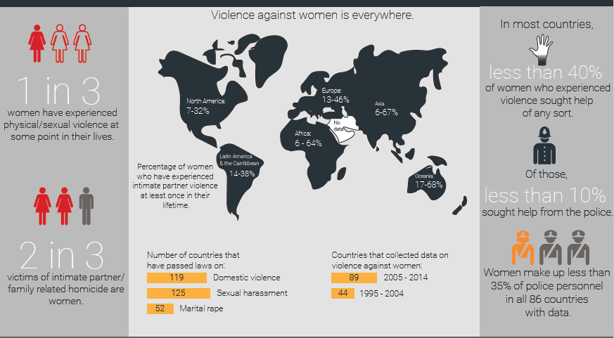
Global Prevalence of Violence
Source: UN Women (2015) World’s Women

Slide 3
Violence Against Women: an Economic Issue?
In much of the discourse and policy advocacy on violence against women focuses on its rights violation dimension.
The argument is normative that response is required because it is fundamentally wrong
Equally women and families bear significant costs that are invisible or ignored with significant implications for the economy

Slide 4
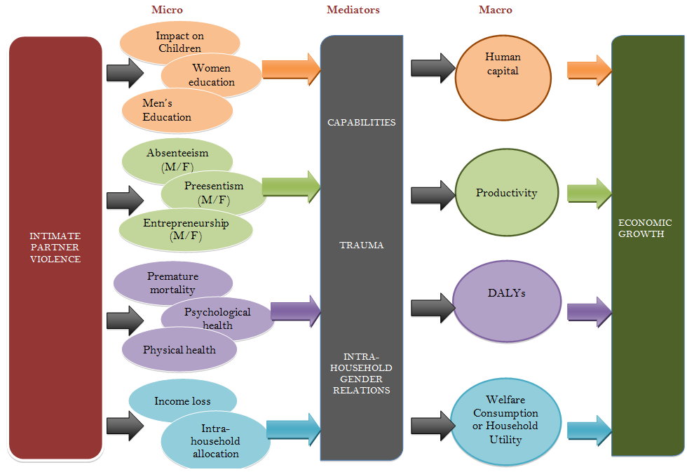
simple and direct methodology used to estimate the direct costs of services, out of pocket expenditures by women for accessing services and establishing the foregone income due to absenteeism from paid work and inability to undertake domestic work
To calculate loss of income due to absenteeism, need to find establish the average number of days missed per incident. Total days lost in an economy are calculated by estimating number of incidents that result in missing work and multiplying average number of day of missed paid work. The total person days lost is then multiplied by the mean daily wage rate to estimate the monetary value of income foregone at the national level. Similar can be used also to estimate the cost of missing unpaid domestic work, in which mean daily wage rate is replaced by an imputed value for the domestic work.
For example, study in Vietnam using this methodology estimated that the out-of-pocket-expenditures, missed paid work and unpaid domestic work came to $1.71 billion or 1.41 percent of GDP (Duvvury, et al., 2012)

Slide 5
Economic Impact: Violence deepens poverty and costs Development and Growth
Every incident of violence has immediate impacts and long-run consequences
Some of these impacts involve actual expenditure or can be monetised and thus are costs
Costs are at household and community levels – impacting families, businesses, neighborhoods and society at large

Slide 6
Costing studies and key findings
About 56 costing studies of which 43 are from high income countries
4 from upper middle income, 8 from low middle income countries and 2 from low income
These studies have a significant difference in perspective
High income studies focus on costs involved in service provision, where help seeking higher and services are more available – so focus on costs of different services as well as costs of pain and suffering
Middle and low income countries focus more on productivity loss through absenteeism or presenteeism or the gap in earnings between those abused or not

Slide 8
Aggregate costs of violence

Slide 9
Macro economic loss
Taking only absenteeism, we introduced the loss across the major economies of the Vietnam economy as depicted in the Social Accounting Matrix, a macro-economic tool
Using prevalence rate, and incident rate from the survey data we were able to estimate loss of income in each sector of the Vietnamese economy.
Introducing this loss into the SAM we were able to estimate how the loss in sector affected other sectors through their interdependence

Slide 10

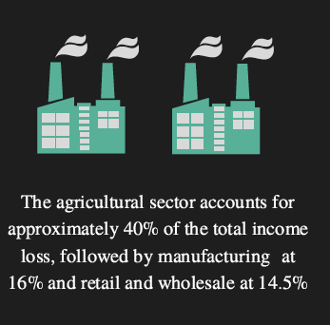
Income loss was about 1% of GDP
Loss of income spread across rural and urban sectors
Most affected are urban labour with tertiary education and rural labour with secondary education

Slide 11
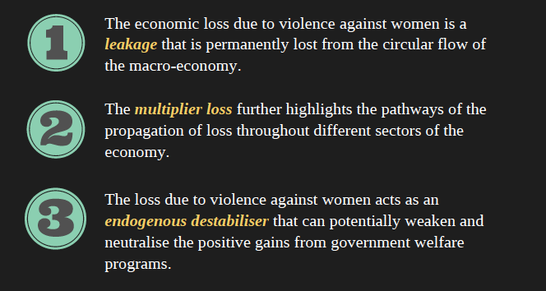
Policy Implications

Slide 12
Conclusions
We need to establish more rigorously the macro economic impacts of violence, moving beyond focus on costs of service provision
We need to focus the link between violence and its impacts on unpaid care work as there is a dynamic circular interaction between the two – a way of illuminating the invisible costs of violence
Economic empowerment without effective response to violence against women will lessen the impact of such interventions.

