Slide 1


ECONOMIC BENEFITS OF GENDER EQUALITY IN THE EU - STEM
Helena Morais Maceira
Vilnius - 26 May 2017

Slide 2


Outline
What?: the economic case for gender equality
Why?: robust evidence to inform policy making - STEM
Conclusions

Slide 3
Rationale
Gender equality is a prerequisite for sustainable human development
Gender equality has been a long standing policy commitment
Inequalities persist in several policy areas
These inequalities affect negatively individuals and society as a whole

Slide 4
Approach
Identify and generate robust evidence
on macroeconomic and social impacts
generated by improvements in
gender equality
Robustness
Uniqueness

Slide 5
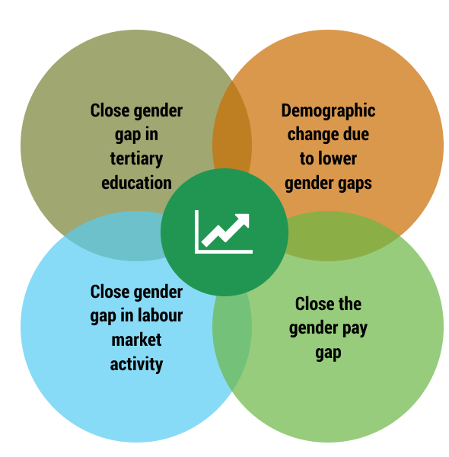
Gender equality boosts economic growth

Slide 6
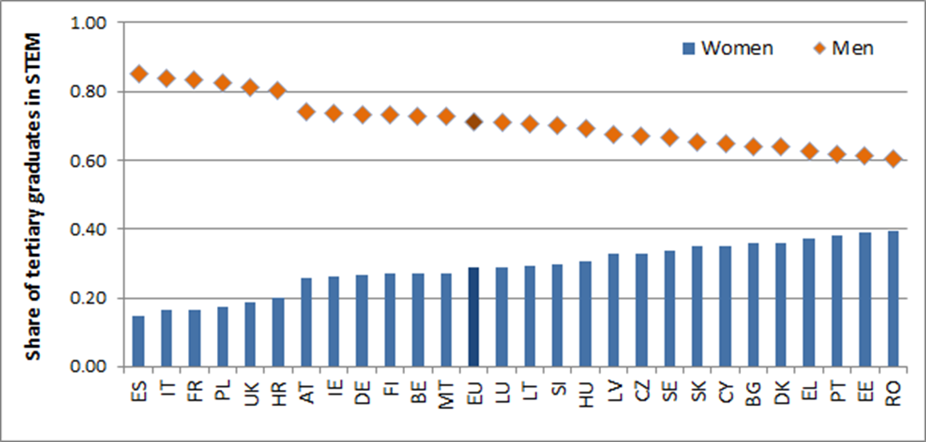
STEM subjects dominated by men
Share of women and men among tertiary graduates in STEM, 2014

Slide 7
Effect of narrowing the gender gap in STEM on GDP per capita
• Improvement in GDP per capita by 2.2 to 3.0%
• Improvement in GDP by €610 to €820 billion
• Improvement in GDP per capita by 0.7 to 0.9%
• Improvement in GDP by €130 to €180 billion

Slide 8
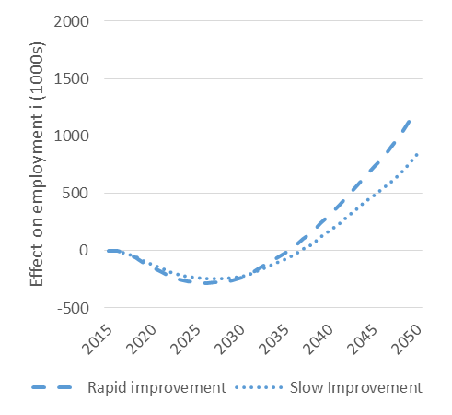
Effect of narrowing the gender gap in STEM on employment
1.2 million jobs

Slide 9
Gender Equality in STEM- Macroeconomic impact in the EU
Spill-overs on labour market
Improve long-term competitiveness of the EU economy
Addressing labour market shortages by an increase in labour supply
Foster economic growth via both higher productivity & increased labour market activity
Reduce occupational segregation

Slide 10
Conclusions: STEM and Women’s Economic Empowerment
Improve women's employment prospects & career progression
Increase in wages for women
Reduce wage gaps
Increase women’s economic independence

Slide 11



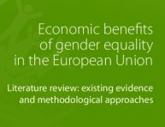



Thank you!
More about the study….
http://eige.europa.eu
www.facebook.com/eige.europa.eu
www.youtube.com/eurogender
http://eurogender.eige.europa.eu

