Slide 1

Economic benefits of gender equality in the EU
ASEM Conference
Women’s Economic Empowerment:
Creating Equal Opportunities in the World of Work
25-26 May, 2017
Gender Equality Commission Council of Europe
5-7 April 2017

Slide 2

Methodological steps
300 resources
9 pathways
International expert group
5 pathways

Slide 3

E3ME modelling - baseline
Future situation following today’s trend
Cedefop labour market projections
Eurostat population projections
DG Ecfin’s 2015 Aging report
DG Ecfin’s AMECO database
Goes up to 2050

Slide 4
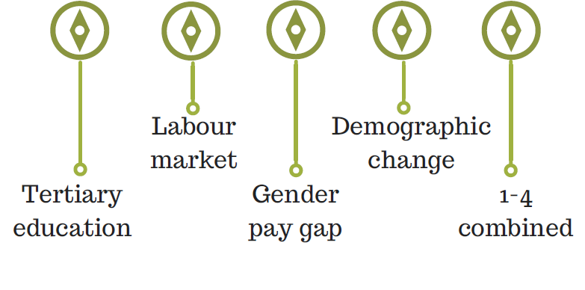
Pathways

Slide 5
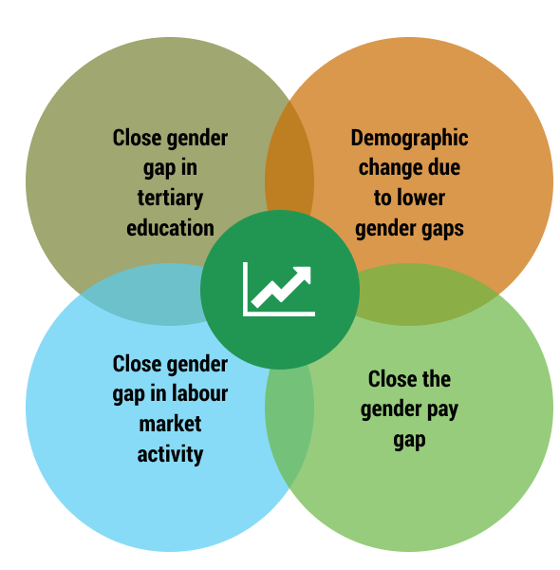
Gender equality boosts economic growth

Slide 6

Labour market activity
Burden of unpaid care work
Less participation in the labour market
Lower career profile
EU Employment rate 64.3% -75.9%
EU gender gap in activity rates 15%

Slide 7
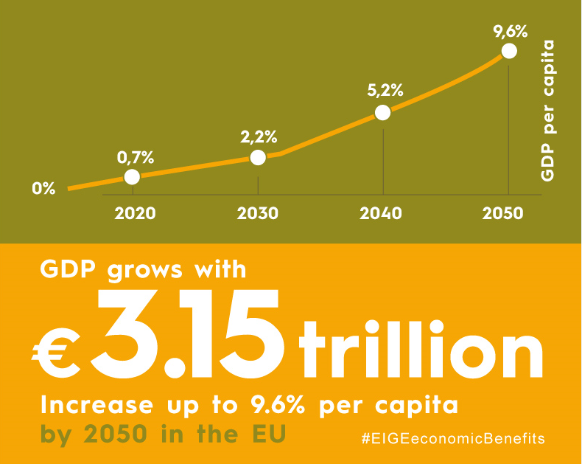
Gender equality boosts GDP

Slide 8
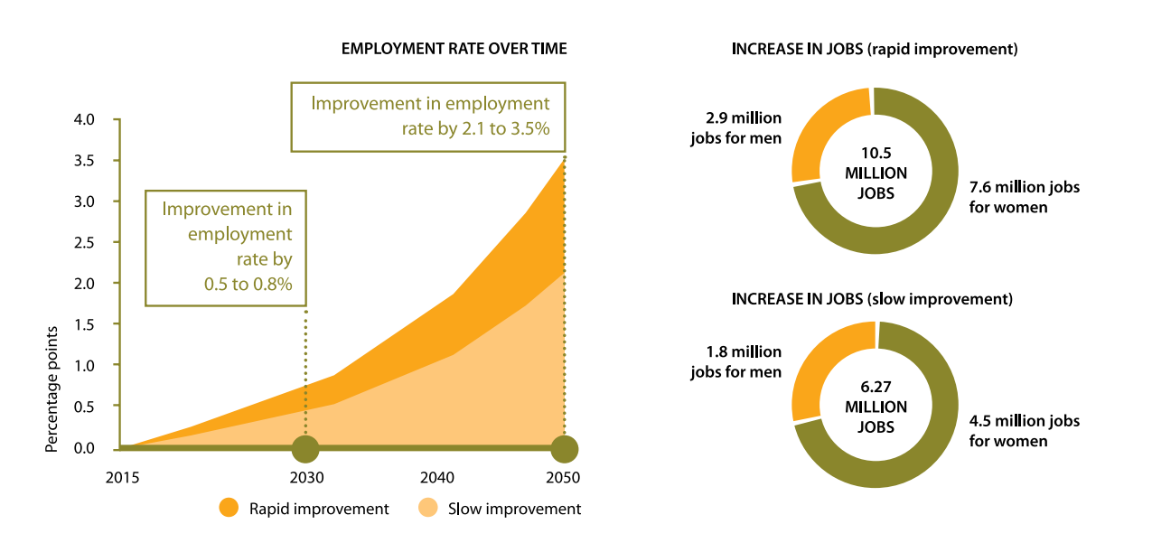
Gender equality creates jobs

Slide 9
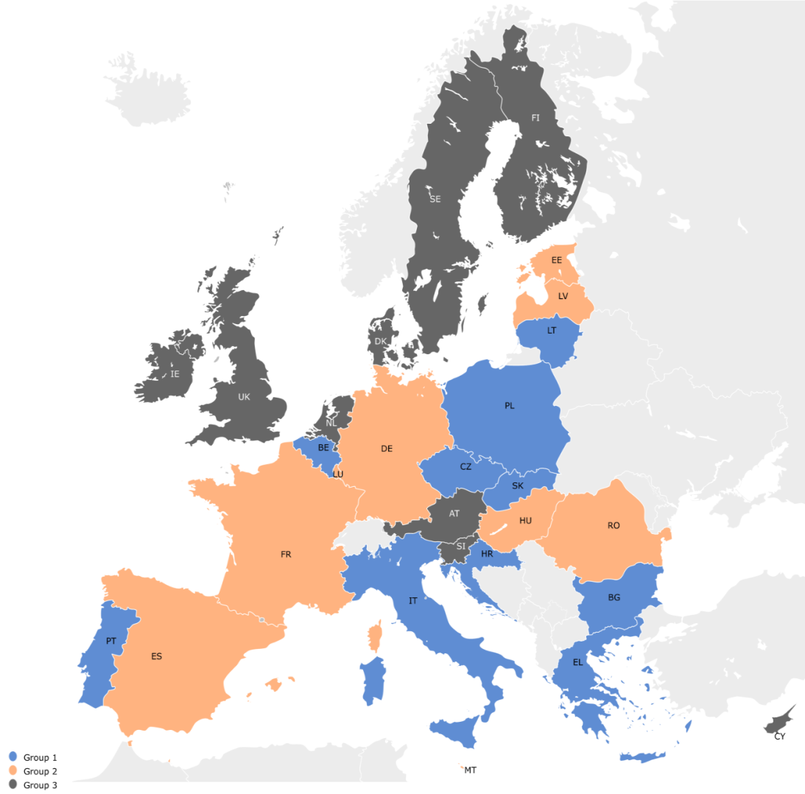
Countries that increase gender equality will reap bigger benefits
In 2030
Group 1: up to 4% GDP
Group 2: up to 4% GDP
Group 3: up to 3% GDP
In 2050
Group 1: up to 12% GDP
Group 2: up to 14% GDP
Group 3: up to 7% GDP

Slide 10
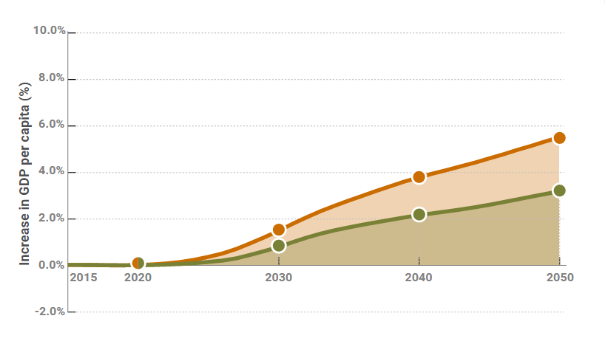

Closing the gender gap in activity rate boosts GDP
GDP per capita increase of 3.2% to 5.5% by 2050

Slide 11
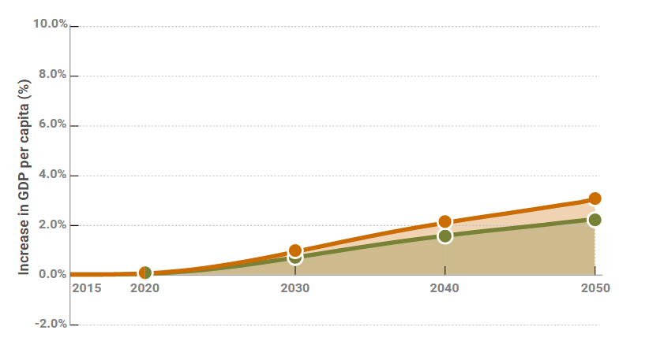
Closing gender gaps in STEM education boosts GDP

Slide 12
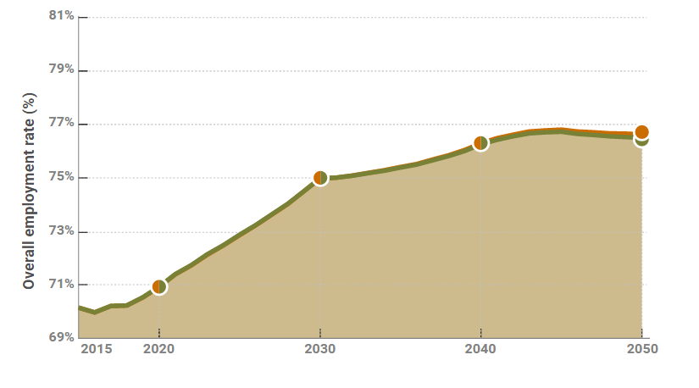
Closing gender gaps in STEM education creates more jobs
1.2 million jobs

Slide 13
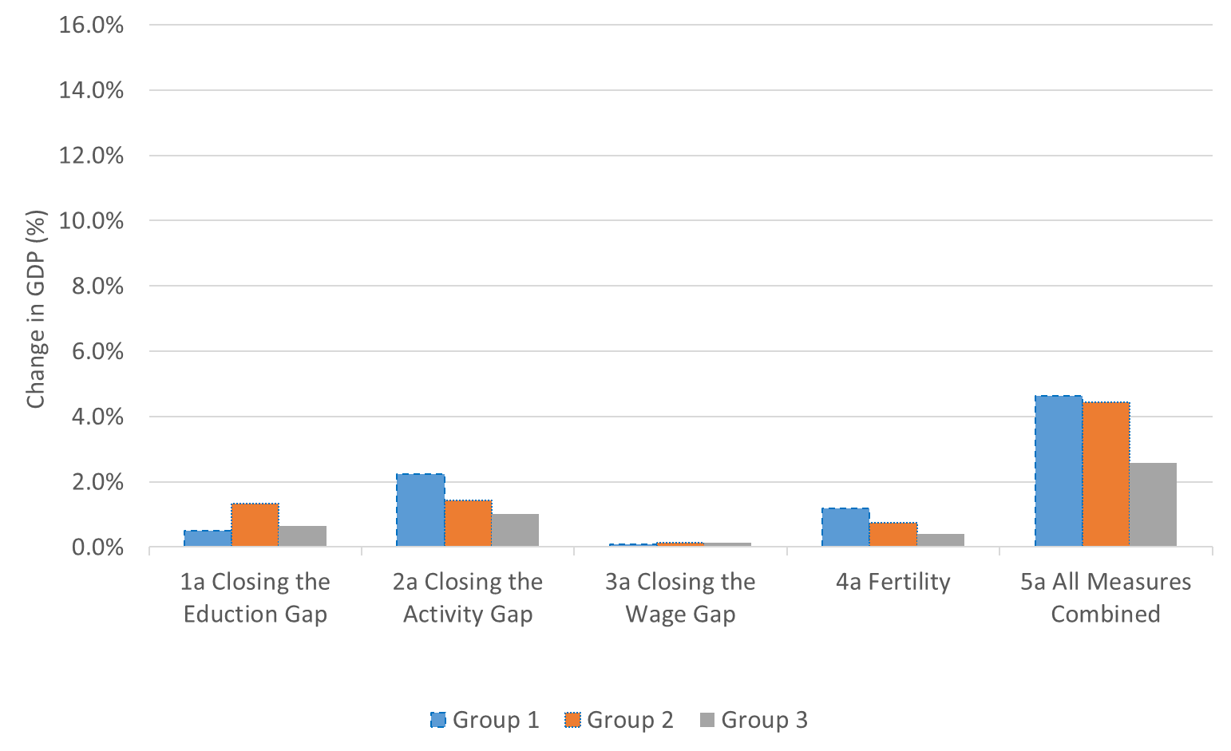
Impact on GDP by MS in 2030
Group 1 includes: SK, HR, IT, CZ, PL, LT, EL, BG, PT, BE;
Group 2 includes: ES, HU, MT, FR, RO, EE, DE, LV, LU;
Group 3 includes: SI, IE, AT, NL, UK, FI, CY, DK, SE.

Slide 14
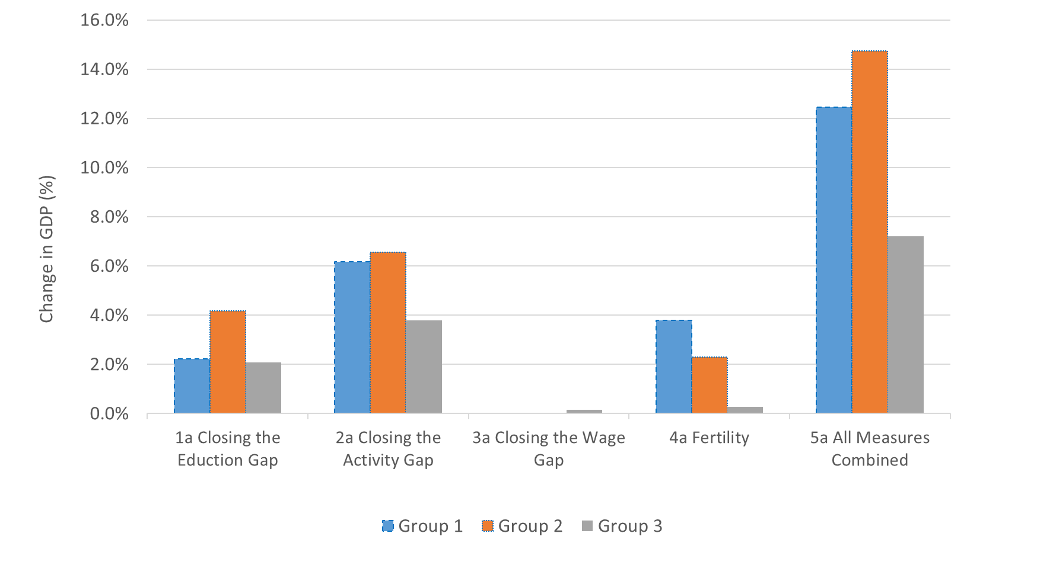
Impact on GDP by MS in 2050
Group 1 includes: SK, HR, IT, CZ, PL, LT, EL, BG, PT, BE;
Group 2 includes: ES, HU, MT, FR, RO, EE, DE, LV, LU;
Group 3 includes: SI, IE, AT, NL, UK, FI, CY, DK, SE.

Slide 15
Conclusions
Gender inequalities are dragging down women’s economic opportunities and affecting the entire EU economy
Gender equality is a highly relevant policy to promote economic growth
To reach the goal of smart, sustainable and inclusive economic growth, the EU must improve existing and introduce further gender equality measures and invest in gender mainstreaming

Slide 16







eige.europa.eu twitter.com/eurogender facebook.com/eige.europa.eu youtube.com/user/eurogender eige.europa.eu/newsletter eurogender.eige.europa.eu
Thank you

