Slide 1




Experience and Implication of
South Korea’s Work-Family Balance Policies
Korean Women’s Development Institute

Slide 2



Ⅰ
Background for Promoting Work-Family Balance Policies in South Korea

Slide 3

0. Introduction
● South Korean government has been promoting Work-Family Balance policies such as childcare policies for working parents, to increase women’s employment rate and low birth rate.
● It is important to provide sufficient social support for childbirth and childcare of working parents and to promote family-friendly society
● Also, gender equal division of household labor within families is essential

Slide 4

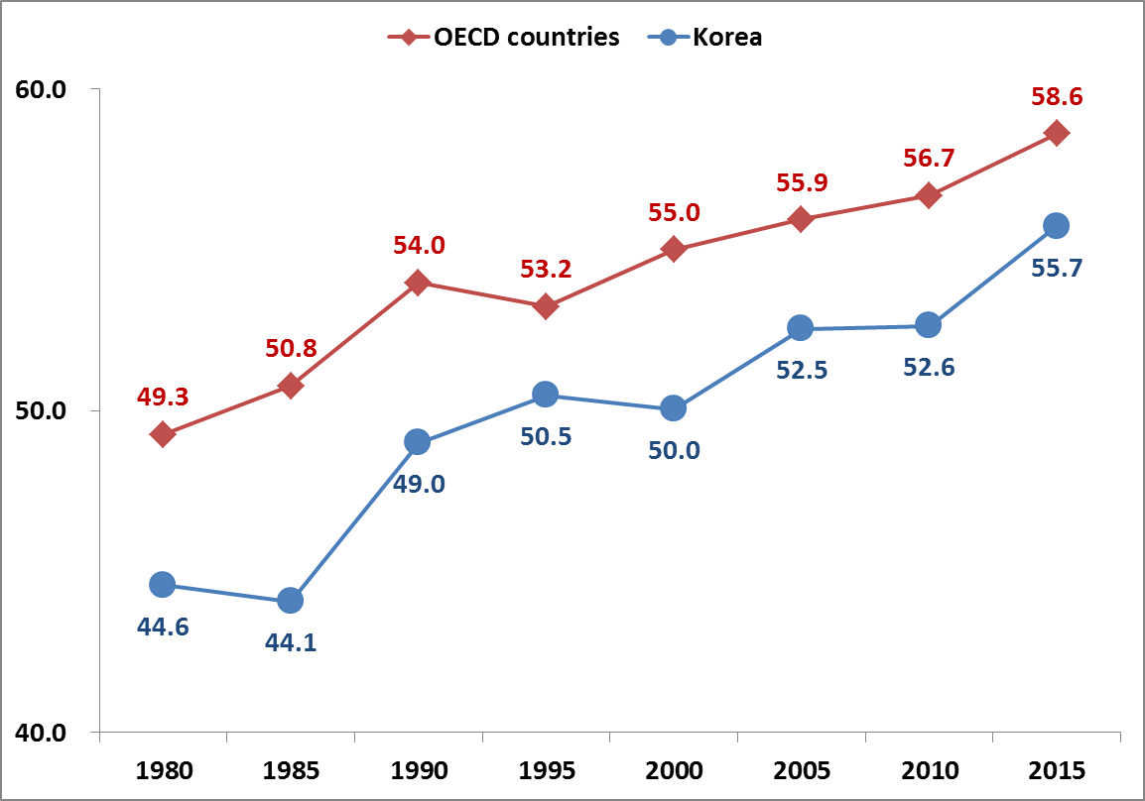
1. Women’s Employment Rate in South Korea(Since 1980)
● Employment rate of Women aged between 15-64 has been increasing since 1980 in South Korea.
● However, it is still below the OECD average.
Women’s Employment rate in South Korea
Source : OECD.Stat

Slide 5
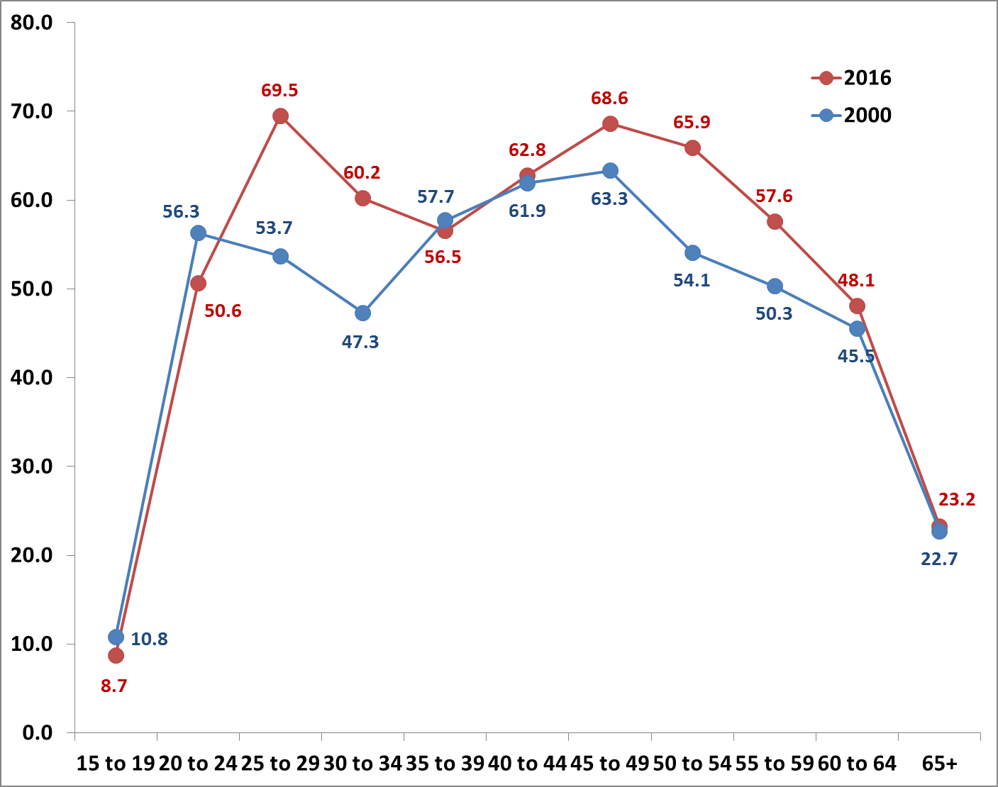
2. Women’s Employment Rate by Age Group (year 2000 and 2016)
● Korean women in their 30s have experienced career interruption.
※ Age group with the lowest employment rate : age 30~34 in 2000 moved to age 35~39 in 2016
● Due to women's late age of marriage and interrupted career after marriage,
the age group with the lowest employment rate changed, M-shaped curve still remains.
South Korea’s women’s employment rate by age group
Source : Statistics Korea, KOISI

Slide 6
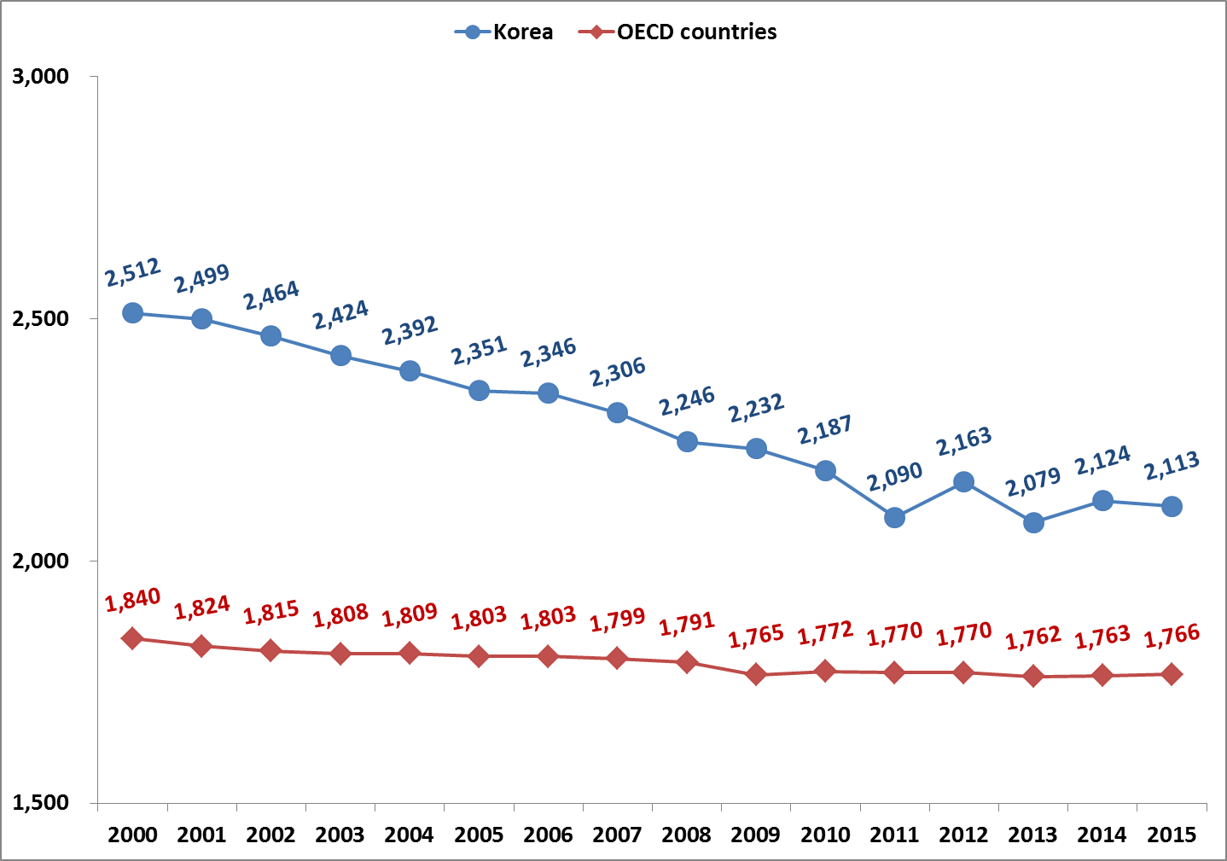
3. Culture of Working Long hours
● South Korea is one of the countries with longest working hours among OECD countries.
Average annual hours worked
Source : OECD.Stat.

Slide 7
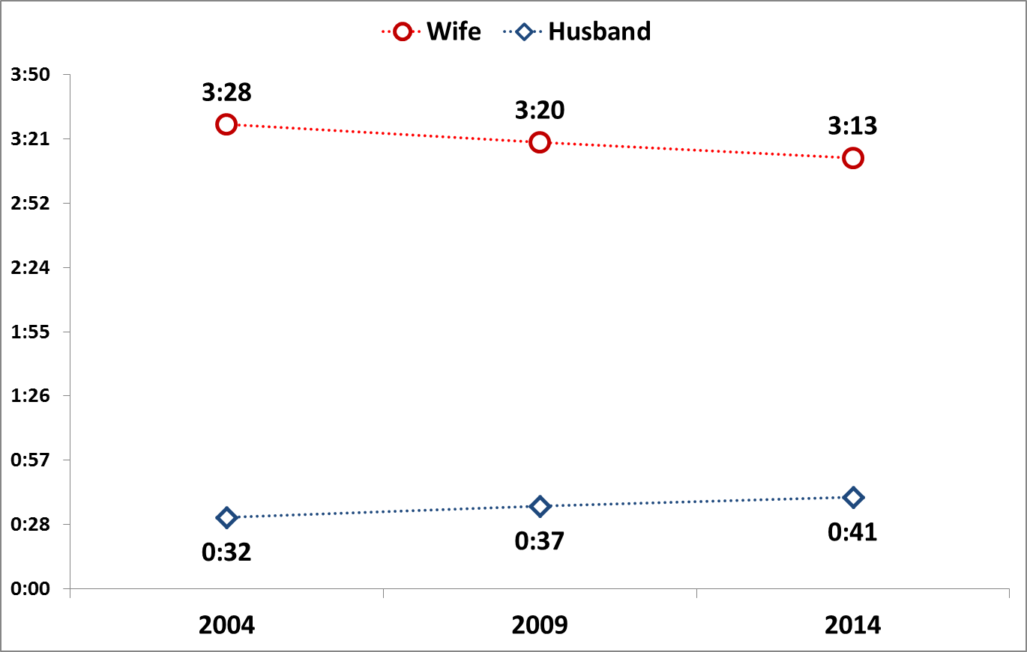
4. Imbalanced Gender Division of Household Labor
● Although Korean women’s social participation has been increased, the gender division of household labor remains imbalanced. And women still continue to shoulder the burden of household labor.
● Housework is taken cared mostly by wives between both working married couples.
Housework Hours Between
Working Married Couple
Source: Statistics Korea. Time Use Survey

Slide 8

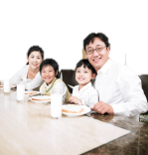
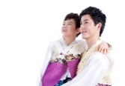


14_84
5. Work-Life Balance is the Issue for Men, not only Women
Working men’s hours spent with children
Family dinner on weekdays
Men’s Family Life
in South Korea
Average
1.65 hours
2-3 times a week
(49.4%)
Source : Korean Women’s Development Institute, 2014

Slide 9
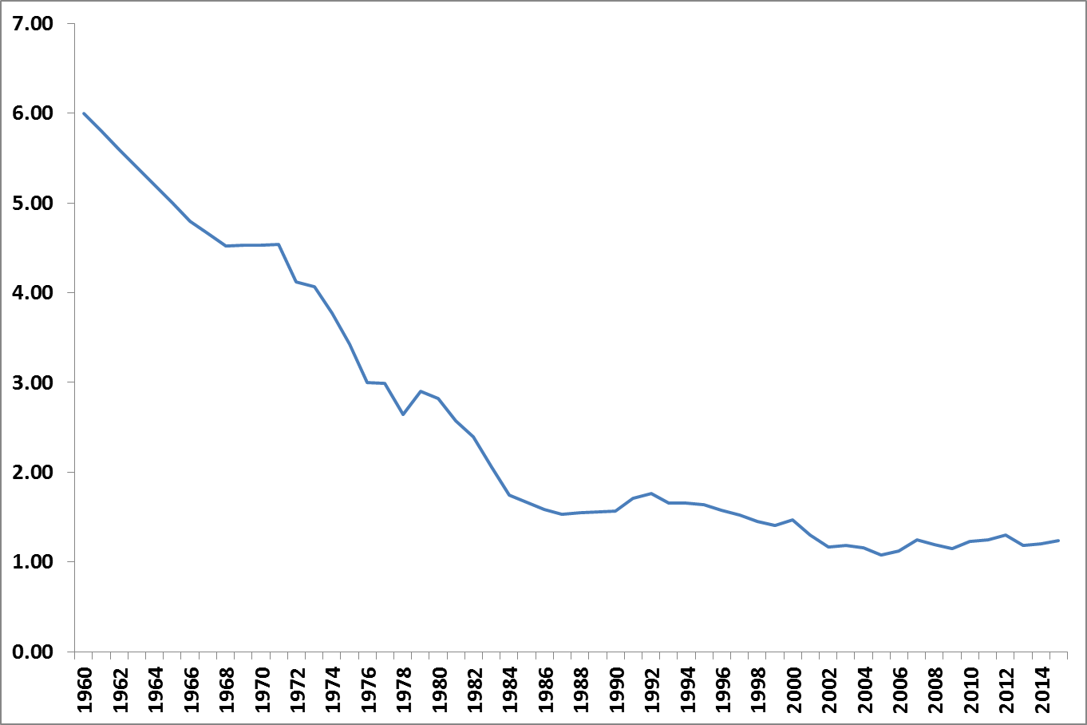
14_84
6. Decrease in Total Fertility Rate
● Total Fertility Rate of South Korea has been constantly decreasing.
● Low birth rate and aging population led to a decrease in working age population.
South Korea’s Total Fertility Rate (TFR)
Source: Statistics Korea. Vital Statistics

Slide 10

3. Childcare Leave
Childcare Leave Policy Implementation Rate by Size of Company
● Childcare leave has been implemented and is guaranteed in large companies first at this stage.
● However it needs to be expanded to mid-sized companies where more women are working.
Childcare Leave Policy Implementation Rate
by Size of Company (2015)
(%)
Source: Survey on work-life balance policy implementation 2015

Slide 11
Ⅱ
South Korea’s Experience on work-family balance policies

Slide 12

1. Legal basis for South Korea’s Work-family Balance Policies
Act on the Equal Employment for Both Sexes
(Enacted in 1987.12)
Act on Equal Employment and Support for Work-family Reconciliation
(Enacted in 2007.12)
Childcare leave for working mothers
Childcare centers Support
Childcare leave for both mothers and fathers
Support for Worker’s Family care
Creation of foundation for supporting work-family reconciliation

Slide 13
2. Major Work-family Balance Policies in South Korea
Maternity Leave before and after the birth
90 days of maternity leave during pregnancy (at least 45 days of maternity leave after childbirth should be given)
120 days of maternity leave in case of multiple births (at least 60 days of maternity leave after childbirth should be given)
Paternity Leave
If a worker requests leave on grounds of his spouse’s childbirth, the employer shall grant him 3 days leave or more within 5 days (paid leave for first 3 days)

Slide 14
2. Major Work-family Balance Policies in South Korea
Childcare Leave
An employee (male or female) can take a childcare leave who has a child aged not more than 8 years or a child in the 2nd or lower grade of an elementary school, last up to 1 year (included in the work longevity)
For workers in childcare leave, the government supports 40% of their regular monthly pay (subject to a floor of KRW 500,000 and a ceiling of KRW 1 million)
If a mother and a father takes a childcare leave in consecutive order for the same child, 100% of their regular monthly wage is paid for the first 3 months of the childcare leave of the farther
It applies the same if the order of leave is reversed
It is usually a father who takes the leave later
For a second child, parental leave subsidy will rise from KRW 1.5 million to KRW 2 million (starting from July 2017)

Slide 15
2. Major Work-family Balance Policies in South Korea
Reduction of Working Hours for Childcare Period
During the childcare period, workers can apply for reduced working hours (15-30 hours a week)
Childcare leave and reducing working hours can be used together or separately
Family Care Leave
Workers can take family care leave to take care of his/her family on account of illness, accident, old age, etc.
Employees can use family care leave for up to 90 days per year

Slide 16
2. Major Work-family Balance Policies in South Korea
Flexible Working hours System
Part-time work system, Convertible work system, Elastic work system, Remote work system etc.
Company Childcare Centers
Workplaces with more than 500 employees or 300 female workers are required to provide on-site chilcare centers

Slide 17
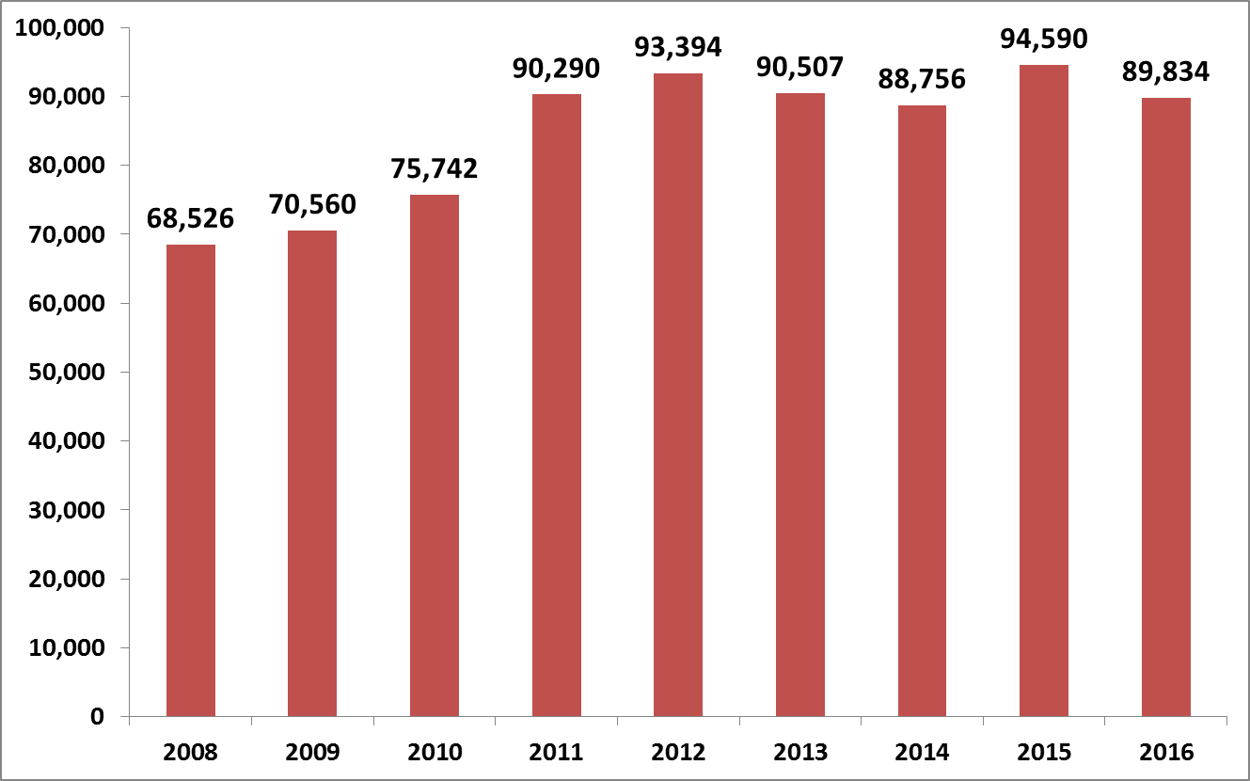
14_84
2. Use of Major Work-family Balance Policies in South Korea
● Since 2011, more than 90,000 female workers use maternity leave before and after the childbirth every year
Numbers of Workers taking maternity leave before and after the childbirth, South Korea
Source: MOEL. Employment Insurance DB

Slide 18
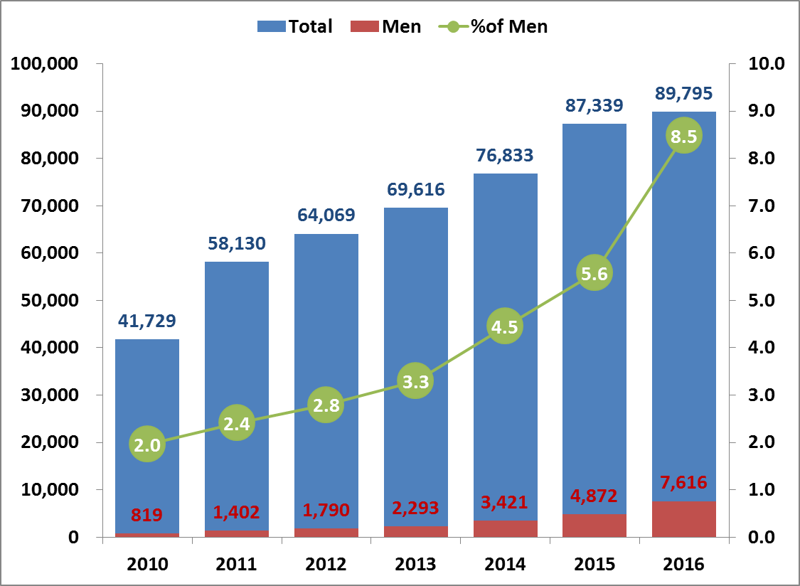
14_84
2. Use of Major Work-family Balance Policies in South Korea
● Between 2010-2016, total number of workers taking childcare leave increased more than 2 times
● In the same period, male workers taking childcare leave increased more than 9 times
Numbers of Workers taking childcare leave, South Korea
Source: MOEL. Employment Insurance DB

Slide 19
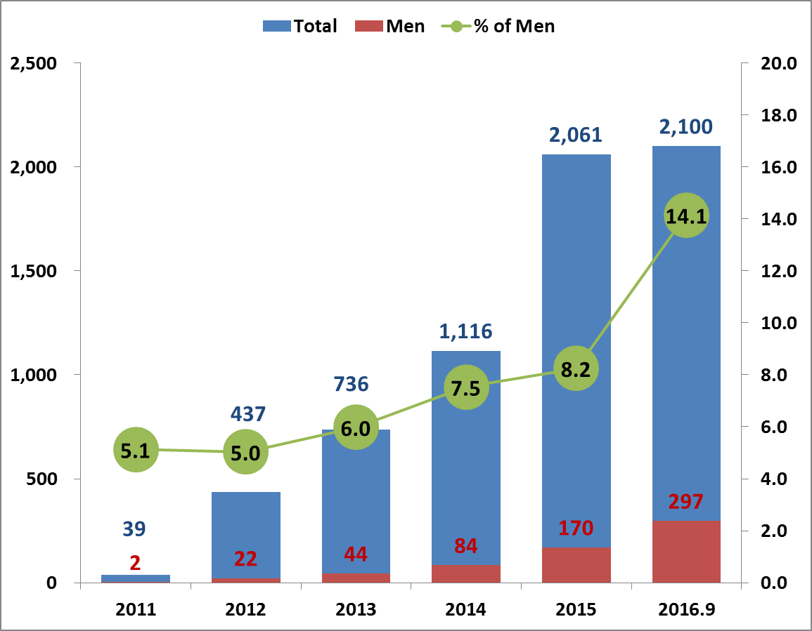
14_84
2. Use of Major Work-family Balance Policies in South Korea
● Number of workers using reduction of working hours for childcare period is also increasing since 2011, when it was first adopted
● At the same period, number of male workers taking reduced working hours has also increased
Numbers of Workers using reduced working hours, South Korea
Source: MOEL(2017). Press released.

Slide 20

3. South Korea’s Efforts to Promote Work-family Balance Policy
Create and encourage Family-friendly corporate culture
● Companies support is needed for better implementation of Work-family Balance Policy
● South Korean government adopted ‘Family-friendly Company Indicator’
Certification is given to family-friendly companies and organizations through evaluation
Indicators are applied to private companies, public institutes, Central government, Local government, Universities etc.
Dec. 2016, total 1,828 (Conglomerate: 285, SME: 983, Public Institutes: 560)

Slide 21
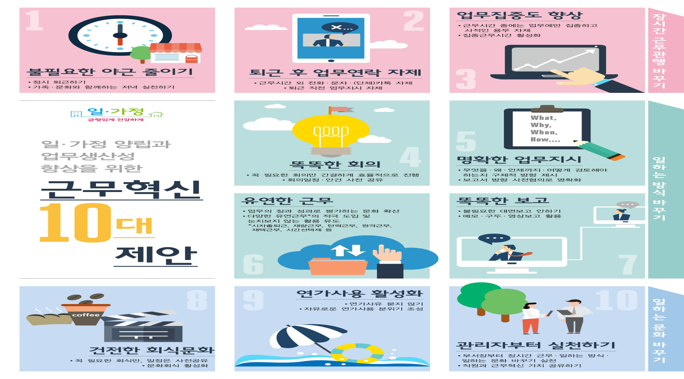
3. South Korea’s Efforts to Promote Work-family Balance Policy
Work-family balance campaign against working overtime etc.

Slide 22
Ⅲ
Implications from South Korea’s Experience

Slide 23
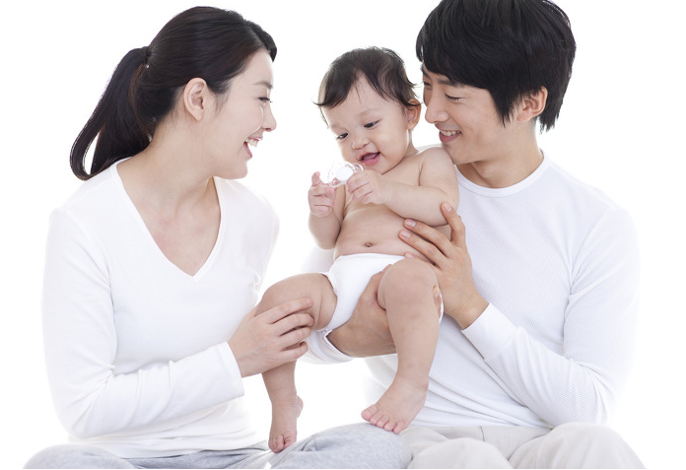
1. Increase in men’s participation in childcare and family life
● Encourage and increase fathers’ childcare leave use and policy reformation is needed for parents to use childcare leave at the same time
● Increase in men’s housework participation to create an environment for women to continue her career

Slide 24
2. Support and participation from companies
Spread Work-family Balance Policy in SMEs
● Current Work-family Balance Policy implementation is focused on large conglomerates. However, most of the female workers in South Korea is working in Small and Medium-sized Enterprises (SMEs)
● South Korean government is putting its efforts to create an environment for both male and female workers to fully enjoy Work-family Balance Policy through various supports (supervision on policy application, strengthening penalties, substitute childcare workers etc.)
Source: MOGEF Family-friendly Business Webpage

Slide 25

3. Work-family Balance, Everyone’s Issue
For every women and men to maintain work-family balanced life
Ease the double burden of household chores and paid work for women workers
Systematic change in roles of men and women for both men and women to carry out household chores and paid work
Cooperation among companies, government and society is critical to create work-family friendly corporate culture and enhance participation of men

Slide 26
