Slide 1


Half-Empty or
Half-Full?
Lim Hwee Hua
May 2017

Slide 2
THREE ATTITUDES
PERSPECTIVE
PERSEVERANCE
PATIENCE

Slide 3

PERSPECTIVES
Half Empty?
POLITICAL
CORPORATE
Half Full?

Slide 4
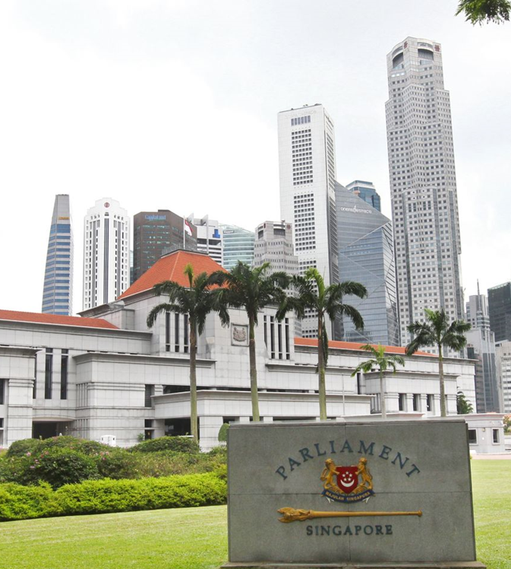
POLITICAL
REPRESENTATION
SINGAPORE
Till 1984 0 (0%)
1984 3 (4%)
2015 22 (24%)
CEDAW
target 30%
Nordic average
more than 40%
2009 - First female cabinet minister appointed (5%)
2017 - Two female ministers in a 22-strong cabinet (9%)

Slide 5

CORPORATE
REPRESENTATION
SINGAPORE
Female participation on large, listed corporate boards:
2011 6%
2016 ~ 10%
Absolute number stagnated
Female labour force participation rate of 60% vs 76% for males
Senior business roles held by women in APAC:
2016 23%
2017 25%
Businesses with no women in senior roles:
2016 25%
2017 36%

Slide 6

PERSEVERANCE
Create opportunities
              Formulate the right policies
              Build a pipeline
              Overcome unconstructive social norms
              Recognise that changing mind sets and stereotypes is more than a gender issue
              CEOs have significant influence over ambition levels

Slide 7

Courage

Slide 8
Courage
Set stretched goals
Step forward
Press for change

Slide 9

About
Quotas
9

Slide 10

CONCLUSION
Be positive about any progress
Persevere despite difficulty
Be courageous
10

Slide 11
THANK YOU
PAY IT FORWARD
11

