Slide 1
Address on Session One of the First ASEM Conference on Women's Economic Empowerment
TAN LIN
Vice-President of the All-China Women's Federation
May 25th, 2017, Vilnius, Lithuania

Slide 2
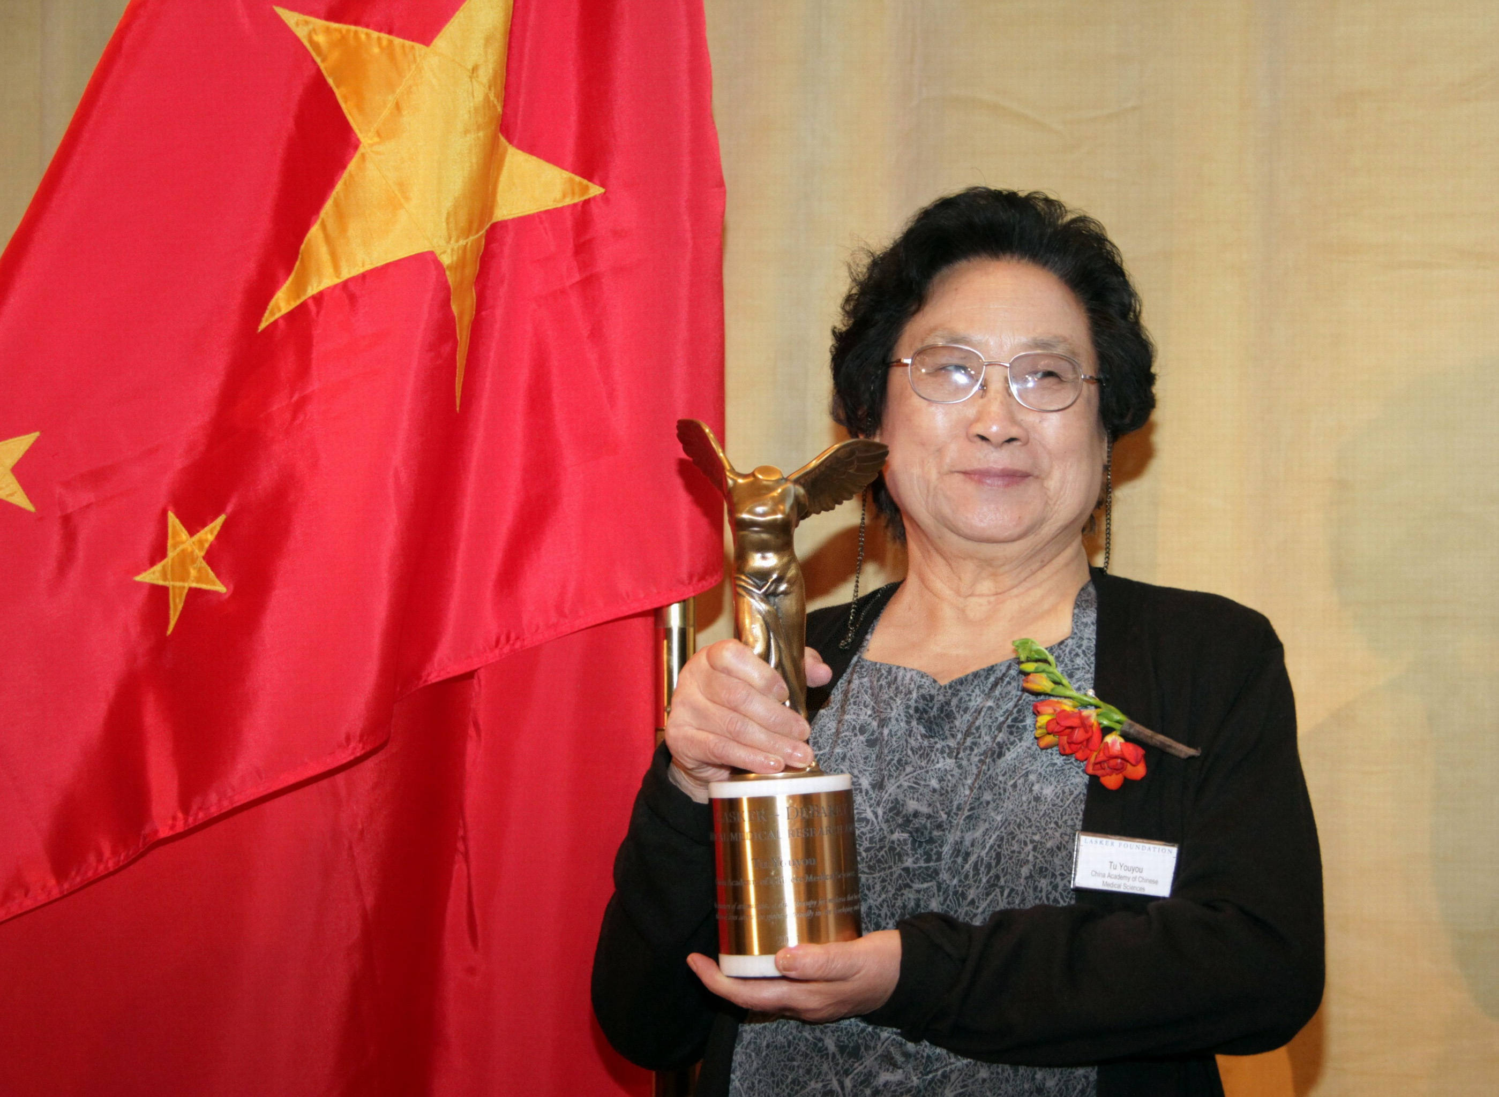

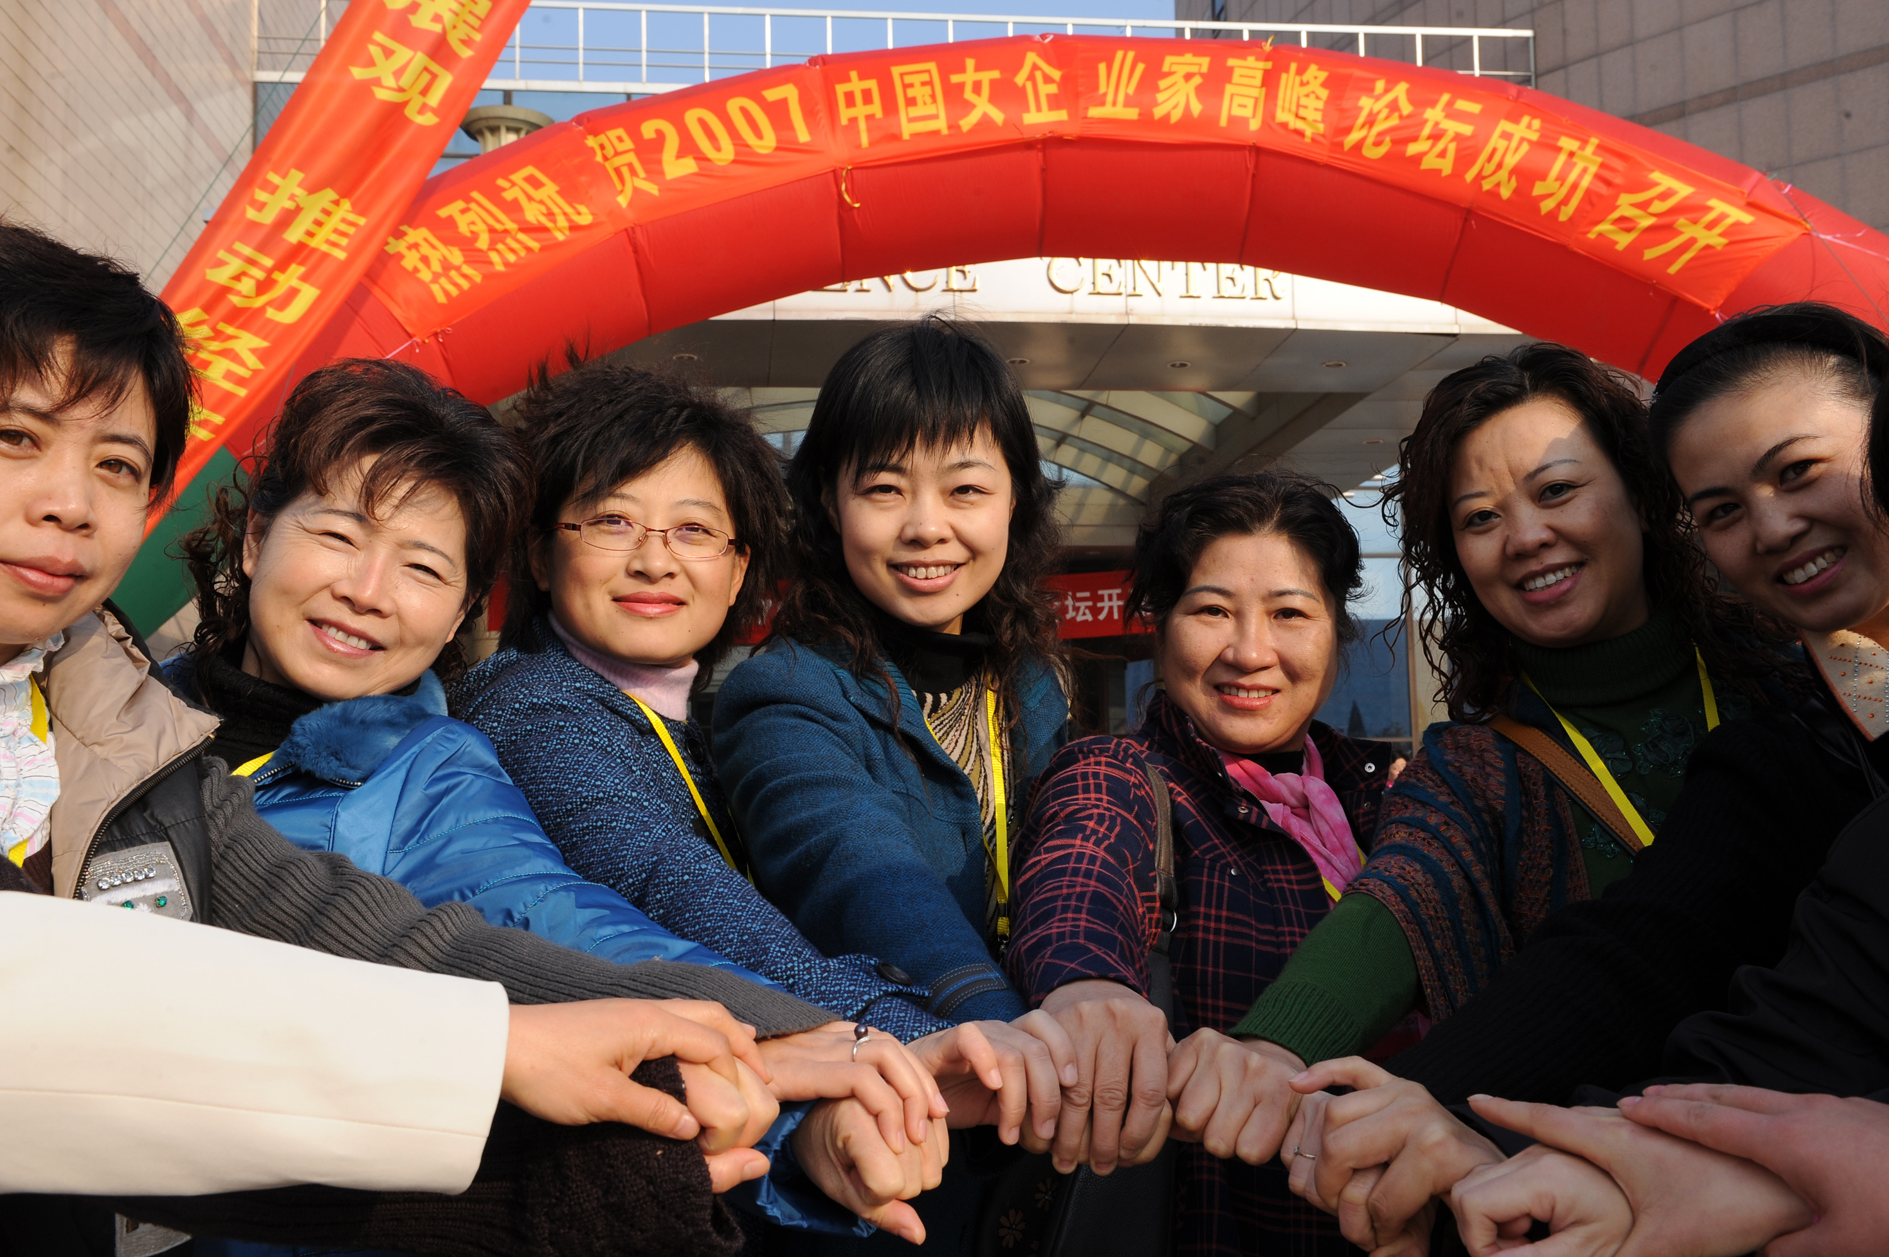
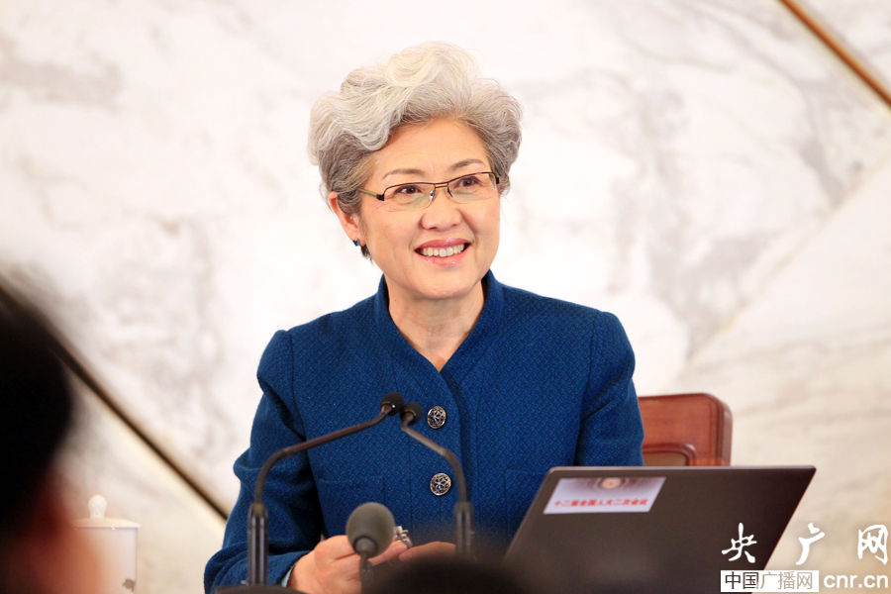
Women Hold up Half the Sky
Women's employment sectors and fields of work are expanding
Women's employment structure becomes more balanced
More and more women are taking jobs in technology and knowledge-intensive industries
Women shine in every field in China.
Chinese women are weaving the "Chinese Dream" with wisdom, courage, determination and devotion.

Slide 3
Ⅰ. Creating Favorable Legal and Policy Environment
The government firmly put forward the goal of "promoting women's all-round development" in the 13th Five-Year Plan for National Economic and Social Development.
Formulating and implementing 3 rounds of National Programs for Women's Development.
Setting up gender equality evaluation mechanisms to assess policies, laws and regulations, so as to improve gender awareness of policy makers.

Slide 4
Ⅱ. Enhancing Women's Employment and Entrepreneurship
Policy of subsidized micro-credit scheme for women
--30.19 billion yuan of loans have been issued
--27.1 billion yuan of interest paid by central and local government
--5.75 million women received the loans and tens of millions of women started their own businesses
Various professional skill training and guidance programs for women
Establishment of diverse specialized cooperatives and associations
Mentor programs for female college graduates

Slide 5
Ⅲ. Supporting Women's Participation in Innovative Development
Digital literacy training
E-Commerce training
Start-up centers and incubators for businesses with new technologies
In China, women account for 55% of Internet entrepreneurs and 43% of the Internet employees.

Slide 6
Ⅳ.Implementing Targeted Poverty Alleviation for Women
"Leave no one behind" is not only the requirement of sustainable development, but also Chinese government's commitment.
The All-China Women's Federation conducts poverty alleviation actions for women focusing on seven priorities, namely, publicity and education, skills training, subsidized micro-credit loans, handicraft and weaving, role models, free health checking and public charity projects,helping women to get out of poverty.

Slide 7


Asia-Europe Meeting
The "Belt and Road" Initiative

Slide 8
Thank you all!

