Slide 1

Family-friendly policies for a better Future of Women at Work:
An ILO approach
25-26 May 2017
Mykolas Romeris University, Vilnius, the Republic of Lithuania
Manuela Tomei,
Conditions of Work and Equality Department,
ILO Geneva

Slide 2

Work-family reconciliation is one of the toughest challenges for working women worldwide
Please think about women who work at paid jobs in [country name] today. What do you think is the BIGGEST challenge these women face? – First most frequently mentioned
Source: ILO-Gallup 2017
Notes:
Key finding: Globally, both men and women mention balancing work and family as the top challenge that working women face.
Gallup interviewers asked men and women to name, in their own words, the top challenge facing women who work at paid jobs in their countries:
Please think about women who work at paid jobs in [country name] today. What do you think is the BIGGEST challenge these women face?
While the responses were unprompted, the interviewers coded the responses into one of the ten categories, created based on responses from the most common themes that came up during cognitive interviews and survey pre-tests. The ten categories in which the responses were grouped are:
balance between work and family or home/no time to spend with family;
lack of affordable care for children or relatives;
unfair treatment at work/abuse/harassment/discrimination;
lack of flexible work hours/appropriate, suitable work hours;
lack of good-paying jobs;
unequal pay for doing similar work as men (or work of equal value);
family members don’t approve of women working;
lack of transportation/lack of safe transportation;
people prefer to hire or promote men;
lack of skills, experience, or education.
Work-family balance is one of the toughest challenges for working women worldwide
Many women and men would like for women to be able to both work and take care of their families, but achieving this balance is a significant challenge for working women. In fact, people in the vast majority of countries mention “balance between work and family” as one of the top challenges – if not the top challenge – facing women who work at paid jobs in their countries. If Gallup were to group together responses such as “lack of flexible work hours” and “lack of affordable care for children and relatives” with “balance between work and family,” the total percentage mentioning some aspect of work and family needs would rise exponentially. With rare exceptions, women and men in most regions of the world identify the same top challenges for working women in their countries.

Slide 3
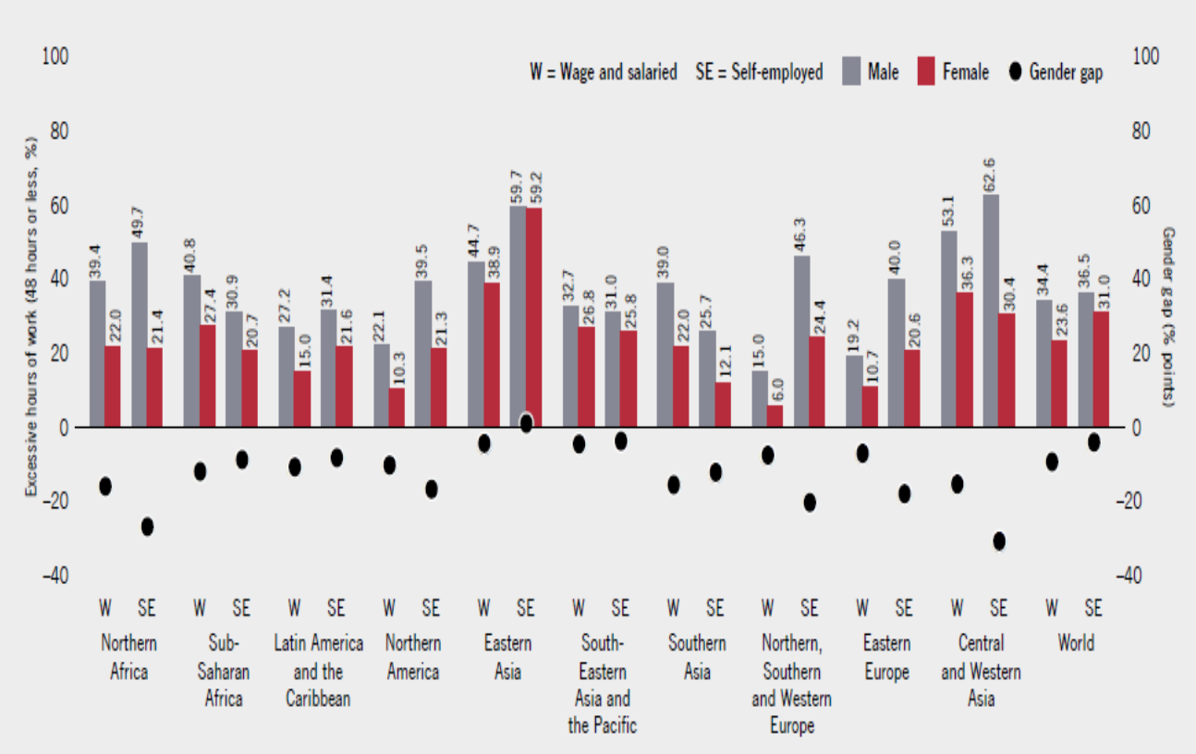
Men are more likely to work very long hours in paid employment
Persons working more than 48 hours per week and gender gap, 100 countries (latest year)
Notes:
Excessive hours of work
While excessively short hours can be problematic, at the other extreme of the spectrum, long working hours (defined as more than 48 hours per week) negatively affect workers with impacts on their health, mental well-being and work-family balance. Across the 100 countries surveyed, more than one third of men in employment (35.5 per cent) and more than one fourth of women in employment (25.7 per cent) work more than 48 hours a week. Excessive hours are most common in Asia, notably in Eastern Asia and in Western and Central Asia, where close to one half of men and women employed work more than 48 hours a week. Two main findings are worth highlighting. First, men tend to work longer hours than women, whether in wage and salaried employment (where there is a gender gap of over 10 percentage points) or in self-employment (gender gap of 5.5 percentage points). Second, the proportions of people working both long hours and short hours are higher among the self-employed, which means that self-employed people are likely to work either more than 48 hours or less than 35 hours a week. This suggests that working hours tend to be more polarized for self-employed than for wage and salaried workers whose working hours tend to cluster around standard working hours, in line with national regulations. It has also implications for workers’ healthy harmonization of work and family life and the equal distribution of unpaid household and care work between women and men.
Country examples: Working shorter or compressed hours with the same full-time salary: two experiments about the future of work in Sweden and China
Starting in February 2015, nurses in an elderly care home in Gothenburg have been experimenting with a shorter working day scheme to assess the effects on efficiency and work quality. Workers in a controlled trial switched from an eight-hour to a six-hour working day with the same wage. The results show an increase in productivity and lower turnover. Nurses also report higher levels of well-being and job satisfaction. While the retirement house had to hire new staff members in order to compensate for the shorter hours and the new shift patterns, the returns in terms of higher staff performance and well-being along with increased quality of care seem to offset the higher costs of the initiative, according to the management. This experiment is inspiring other public sector workplaces in Sweden to adopt shorter working days, including in the health sector for doctors. In addition, some small businesses have started adopting shorter working days (Crouch, 2015).
Similarly, Chongqing, a municipality of around 30 million people in the south-west of China, is set to implement an official four-and-a-half-workday week scheme to boost the local economy. The initiative is to grant both public and private sector workers on a 40-hour-contract Friday afternoons off with the same pay. The purpose is to increase domestic consumption and private spending in leisure activities, in particular tourism. The Hebei and Jiangxi provinces, which together account for a population of almost 115 million, are considering a similar scheme (Macauley, 2015).

Slide 4
…but when paid and unpaid care work are taken together, women work longer hours everywhere
Notes:
Across the world, the vast majority of unpaid household and care work is performed by women. As a result, when all activities, whether paid or not, are taken into account, women’s working days become longer than men’s
On average, women carry out at least two and a half times more unpaid household and care work than men in countries where the relevant data are available. In developed countries, even when women are employed, they continue to perform 1.30h more of unpaid work per day than men.
The figure shows Time spent on paid and unpaid work in 46 developing and developed economies for employed persons by sex (latest year available)
Focusing on employed women (either in self-employment or wage and salaried employment), the average working day is even longer. In developed economies employed women work 8 hours and 9 minutes, compared to the 7 hours and 36 minutes worked by men. In developing economies, women in employment spend 9 hours and 20 minutes in paid and unpaid work, whereas men spend 8 hours and 7 minutes in such work (United Nations, 2015).
Based on related time-series data from 23 countries and territories on time spent on unpaid work by employed women and men, the gender difference has decreased over time (1). This is mostly due to the reduction in time spent on housework for women, as opposed to significant reductions in their time spent on childcare (2). The reduction in time spent on unpaid work could be attributed to a number of factors, including higher women’s labour force participation, smaller family size, the growing economic capacity of women to outsource domestic work, and the use of time-saving infrastructure and technologies that reduce the time required for fetching water or household tasks. To a lesser extent this reduction is also the result of an increase in the amount of time spent by men on childcare (ibid.).
Women, however, continue to work longer hours per day than men when both paid work and unpaid work are taken into consideration.
As a consequence, women are more likely than men to work short hours whether voluntary or against their choice (namely “time-related underemployment”). Across the world, women represent less than 40 per cent of total employment, but make up 57 per cent of those working on a part-time basis. Estimates based on 100 countries show that more than one third of employed women (34.2 per cent) work less than 35 hours per week, compared with 23.4 per cent of employed men. We find the highest gender gap in short hours in Northern, Southern and Western Europe at almost 30 per cent, where 44% of women work less than 35 hours against almost 15 per cent of men.
Note 1. Calculations are based on figures for the earliest and latest years available for Austria, Belarus, Bulgaria, Canada, Costa Rica, Denmark, Estonia, Finland, France (and also Réunion), Hungary, Italy, Japan, Kyrgyzstan, Netherlands, Norway, Romania, South Africa, Spain, Sweden, Switzerland, the former Yugoslav Republic of Macedonia and United States of America. This is based on the dataset compiled by the UN (2015) from Eurostat (2011), OECD (2014), UNECE (2014), UNECLAC (2014).
Note 2. A 2004 study showed that, in 16 countries over the period 1971–1998, time spent on childcare by parents has actually increased over time, although the increase is largely due to the greater amount of time spent in interactive activities such as play, as opposed to mere child-minding (Gauthier et al., 2004).

Slide 5
ILO Framework on family-friendly policies
Gender equality and women’s economic empowerment
Care services
(child-,elderly-, sick-,disabled- care)
Family friendly working arrangements
(adequate and predictable work schedules, flexitime, quality part-time etc.)
Social security benefits
(e.g. tax breaks, family benefits)
Leave policies
(e.g. paternity, parental, other family leave)
Maternity protection
Basic infrastructure, transportation, health care
Taxation policies that encourage women’s LFP
Notes:
The ILO has put forward a comprehensive set of international labour standards which provide an integrated framework for addressing work-family challenges. The ILO Workers with Family Responsibilities Convention, 1981 (No. 156), requires that signatories make it an aim of national policy that all workers with family responsibilities - both women and men- can engage in employment without discrimination or, as far as possible, without conflict between work and family obligations. Therefore, non-discrimination and effective gender equality in the labour market should be an explicit objective of national policy.
Work-family measures are national, community and workplace policy solutions intended to facilitate workers’ access to decent work by explicitly and systematically addressing and supporting their family responsibilities. To this end, the Convention puts forward a set of policy devices including social care services, family-friendly working time and work organization arrangements, social security benefits, measures aimed to reduce unpaid care work, workforce reintegration/activation policies as well as gender-responsive awareness-raising and education (Arts. 4-7).
COUNTRY EXAMPLES
Introduction or extension of non-contributory maternity benefits to women workers in the informal economy or low-income women in general
C.183, R.202, R.204
e.g. Argentina and South Africa (domestic workers), Brazil (all women), Namibia (domestic workers and small enterprises), non-contributory (tax-funded) cash transfer schemes (in Togo, UR Tanzania, India Ethiopia, Zambia)
Extension of the duration of paid maternity leave in law and increase of the benefit level
C.183, R.191
e.g. China (from 90 to 98 days), Colombia, Ghana (from 50 to 100%), Botswana (from 25 to 50%)
Moving away from employer liability to social insurance or mixed systems
C.183, R.191
e.g. Angola, Burundi (Mixed), Mozambique (social insurance), UR of Tanzania , Namibia, Côte d’Ivoire (social insurance); Rwanda (moving from employer liability to mixed system of funding with ILO technical assistance)
Introduction of paternity leave and/or parental leave to promote co-responsibility and needs of families
C.156, R.191
Paternity leave: e.g. Paraguay (from 3 to 15 days), Moldova (14 days); Mexico (5 days), Bolivia Equatorial Guinea (3 days); Bahrain (one day); Myanmar extended paternity leave (from 6 to 15 days, paid at 70 per cent of previous earnings by social insurance) Islamic Republic of Iran (2 weeks). Portugal increased the duration of compulsory leave from 10 to 15 days, out of a total allocation of 20 days. Viet Nam (5 working days)
Parental leave: e.g. Chile (up to 26 weeks), Republic of Korea and Japan (12 months for fathers), France (6 months for second carer), shared parental leave in the cases of Cuba, Mexico, Bolivia and Uruguay
Strengthening the provisions of care services
C.156, R.202, R 165
Rep. Korea (Child and LT-care); Costa Rica (childcare); Uruguay (Integrated National Care System); Germany
Providing family-friendly working arrangements
C.156, R 165
Facilitation of part-time work (Korea and Turkey, under certain conditions), telework (Saudi Arabia, Italy), job sharing (Saudi Arabia)
EU WORK-LIFE BALANCE DIRECTIVE proposal, following and INTEGRATED approach including:
- Paternity leave: 2 weeks paid at sick leave level;
Paid non transferable parental leave: 4 months each parent paid at sick leave level;
Carers’ leave: 5 days per year per worker paid at sick leave level;
Right to request flexible working time arrangements.

Slide 6
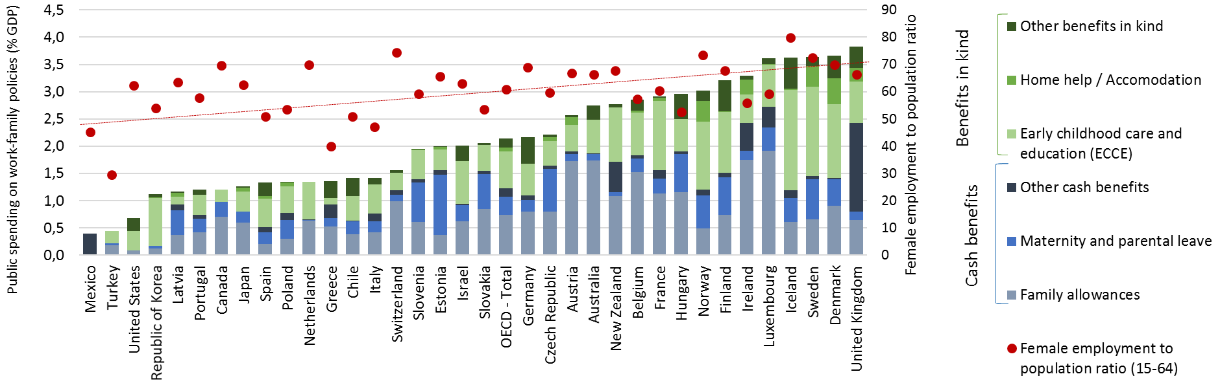
Level and type of public spending on work-family policies matters for women’s employment…
35 OECD countries, 2016
Source: OECD Gender and Family database
Notes:
The Figure shows the relationship between total government family policy spending (as a percentage of GDP) and the rates of women’s employment in 35 OECD countries in 2016. While family policies, from parental leave to child care services and subsidies, have an effect on their own, it is their combination that drives female employment rates up. For instance, childcare combined with parental leave and flexible working time arrangements is associated with higher female full-time employment rates, while receipt of child allowances/family benefits is not (see figure 13). An adequate combination of family policies requires a strong State commitment, and openness and cooperation from employers (Eurofound 2016).

Slide 7
Zooming on maternity protection and leave policies: lessons learned
Moving away from employer liability to social insurance or public funds is crucial for making maternity protection a reality
Introduction or extension of non-contributory maternity benefits to women workers in the informal economy or low-income women
Short leave periods push women out of the labour force, but very long leave can also jeopardize women’s participation in the labour force
Fathers’ take up rates are higher when leave is of adequate duration; entitlements are individual, non-transferable and compulsory; and can be used in a flexible manner (e.g. fragmented, part-time, etc.).

Slide 8
Case studies
Germany
Uruguay (Integrated National Care System)
Maternity leave: 14 weeks, 100%, mixed system
Parental leave: 12 months with 2 months’ bonus, flexibility in use
Childcare: Universal right
Measures to support greater flexibility to adjust career breaks for family needs
Maternity leave: 14 weeks, 100%, social insurance, self-employed are covered
Paternity leave: 7 days
Childcare: Institutionalized care services as a system
Part-time work with payment by social insurance for both parents until 6 months
Notes:
GERMANY
Participation rates for 0-2 year olds in formal childcare and pre-school services in 24 OECD countries, 2006 and 2013. Between 2006 and 2013, the average participation rate in 30 OECD countries increased from 28 to 33 per cent, with the biggest increases in Germany (15.7 percentage points) and Korea (23.2 percentage points). Germany has invested heavily in the provision of childcare facilities and since August 2013, every child between the age of 1 and school entry age has the legal right to early childhood support in a day-care centre or day nursery, so there is no gap between the end of well paid leave and childcare. This is combined with the reform of parental leave in 2007. Parental leave has now been reduced to 12 months. Its overall duration increases to 14 months, however, if both parents take at least two months of the paid parental leave. The benefit shifted from a means-tested flat rate to an income replacement modality at 67 per cent of previous earnings. The proportion of fathers taking leave increased from 3 per cent in 2006 to 28 per cent in 2012, with 83 per cent of these using their individual two-month entitlement.
URUGUAY
Uruguayan Integrated National Care System (SNIC), which aims at being »Uruguay’s fourth pillar of the social protection system, along with health, education and social security. Mothers’ (and fathers’) labour force participation is also an explicit policy objective in Uruguay’s SNIC.
The SNIC aims at providing universal care services coverage for three year olds and growing coverage from 0–2 year olds, including the extension of parental paid leave and the possibility of part-time work over the newborn’s first six months for both mothers and fathers
Law Nº19161, approved in November 2013, extended Maternity leave from 13 to 14 weeks and Paternity leave from three to seven days for workers in the private sector. This law created the possibility for mothers or fathers to work parttime with payment, from the end of Maternity leave until their child reaches six months.
In Uruguay, the Centros de Atención a la Infancia y a la Familia (CAIF) are community-based childcare centres operating in poor neighbourhoods. Managed by social organizations but fully funded by the state, they serve children 2–3 years of age, while public kindergartens serve children 4–5 years of age (Rossel, Nieves Rico and Filgueira 2015). The differing quality standards between CAIF centres and public kindergartens have prompted the Uruguayan SNIC to aim at guaranteeing uniform levels of quality in early childhood education irrespective of the nature of the provider. Indeed, issues of quality in ECDC service provision are increasingly part of the agenda (Marco 2014).

Slide 9
In conclusion…
  Family-friendly policies contribute to gender equality when they promote :
    women’s access to decent paid work and
    an equal share of unpaid care between women and men
  Measures should be context-specific and based on social dialogue and women’s representation
  Family-friendly policies require strong State’s commitment and cooperation from employers and trade unions
  They are not a cost but a “social investment”, a condition to achieve the 2030 Sustainable Development Agenda

Slide 10

Thank you

