Slide 1
Gender challenges in education, STEM and occupational segregation in the labour market
Asia Europe Meeting (ASEM)
Conference on Women’s Economic Empowerment
Vilnius, Lithuania
26 May 2017
Mari Kiviniemi
Deputy Secretary General, OECD

Slide 2

Years of schooling over the 20th century
Source: Barro and Lee, 2013.

Slide 3
Gender difference in performance (15-year-olds)
Boys perform better
Score-point difference (boys-girls)
Girls perform better
Source: OECD (2016), PISA 2015 Results (Volume I): Excellence and Equity in Education, OECD Publishing, Paris.

Slide 4
Girls lack confidence in science, even if they are as proficient as boys
Sciences
OECD average
Source: OECD (2015) The ABC of Gender Equality in Education ,Figure 3.8

Slide 5
Girls lack confidence in mathematics, even the high achievers
Mathematics
OECD average
Source: OECD (2015) The ABC of Gender Equality in Education ,Figure 3.9

Slide 6
Expectations of a science career
OECD average
Students who expect to work as...
Source: OECD (2016), PISA 2015 Results
Notes:
Note: Belgium refers only to French and German-speaking communities

Slide 7
Women graduates by field of study
Percentage of tertiary qualifications awarded to women
in tertiary-type A and advanced research programs, by field of education (2012, OECD average)
Source: OECD (2015) Education at a Glance 2015

Slide 8
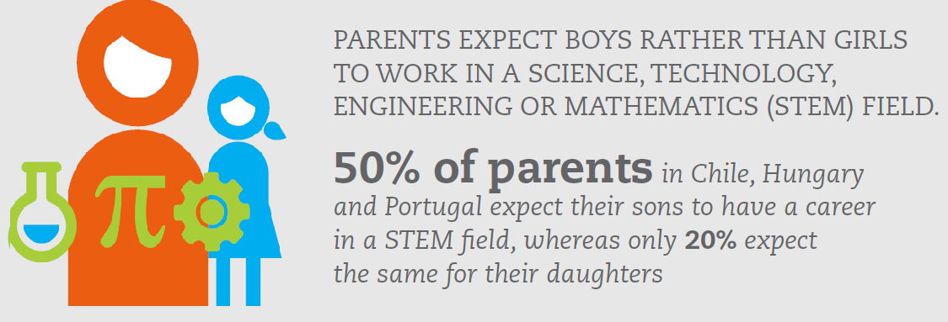
Women are conditioned from a young age to have gendered expectations about careers

Slide 9
The gender gap in labour force participation is relatively large in Asia…
Labour force participation rates (%) by gender, and gender gap in the labour force participation rate (percentage point), 15-64 year olds, 2015 or latest available year
Note: Data for China refer to 2010
Source: OECD Employment Database, http://www.oecd.org/employment/emp/onlineoecdemploymentdatabase.htm

Slide 10
The gender pay gap in Japan and Korea is above the OECD average …
Gender gap in median earnings for full-time employees (%), all ages, 2014 or latest available year
Note: Data for France refer to 2012, and for Sweden to 2013. The gender wage gap is calculated as the difference between the median earnings of men and of women relative to the median earnings of men. Earnings refer to gross earnings of full-time wage and salary workers, though definitions vary slightly from one country to another. See the OECD Employment Database (http://stats.oecd.org/index.aspx?queryid=64160) for more detail.
Source: OECD Employment Database, http://www.oecd.org/employment/emp/onlineoecdemploymentdatabase.htm

Slide 11
There is a leaky pipeline in female careers
Female share of managerial employment and female share of the labour force, all ages, 2015 (or latest available year)
Note: Data for the United States refer to 2013, and for Australia to 2014. For the United States: percentage of employees that hold jobs classified in International Standard Classification of Occupations (ISCO) 88 category one (as legislators, senior officials and managers) that are female. For all other countries: percentage of employees that hold jobs classified in International Standard Classification of Occupations (ISCO) 08 category one (as managers) that are female.
Source: OECD Employment Database, http://www.oecd.org/employment/emp/onlineoecdemploymentdatabase.htm; ILO (2016) ILOSTAT database, http://www.ilo.org/ilostat

Slide 12
… and the glass ceiling remains.
Female share of seats on boards of publicly listed companies, 2016 or latest available year
Note: Data for European countries refer to H1 2016, and for all other countries to Q3 2015. Data for European countries refer to the proportion of seats held by women on boards for the largest 50 members of the primary blue-chip index in the country concerned, and for all other countries to the proportion of seats held by women on boards for companies covered by the MSCI's 'global director reference universe'
Source: EC (2016) Database on women and men in decision-making; MSCI (2015) Women on Boards: Global trends in Gender Diversity on Corporate Boards

Slide 13
What can be done to close gender gaps in field of study and in the labour market?
Attracting:
Address gender stereotyping at home, at school and in the media
Build self-confidence among girls and interest boys in reading
Help students look ahead, give better information and hands-on experience on educational and career pathways.
Promote female role models in STEM fields and men in caring professions.

Slide 14
What can be done to close gender gaps in field of study?
Retaining:
  Make workplace cultures more conducive to balancing work and family life by providing family-friendly supports such as childcare, parental leave and flexible working.
  Actively promote that both fathers and mothers make use of such measures.
  Facilitate a return to regular employment careers after caring periods.
  Make gender diversity a corporate priority. Leadership is important: Senior management should lead by example; make middle managers accountable for change, e.g. for staffers taking parental leave.

Slide 15
OECD Recommendation and Monitoring
The 2013 and 2015 OECD Recommendations on Gender Equality in education, employment, entrepreneurship and public life set out measures that governments should consider to address gender inequalities.
The OECD is monitoring the implementation of the Recommendation in member and partner countries.
⇒ The OECD will release a report 7-8 June 2017.

Slide 16




Thank you
 | OECD work on gender and gender equality www.oecd.org/gender
 | OECD Gender Data Portal www.oecd.org/gender/data
 | OECD Social Institutions and Gender Index (SIGI) www.genderindex.org/
 | @OECD_Social

