Slide 1
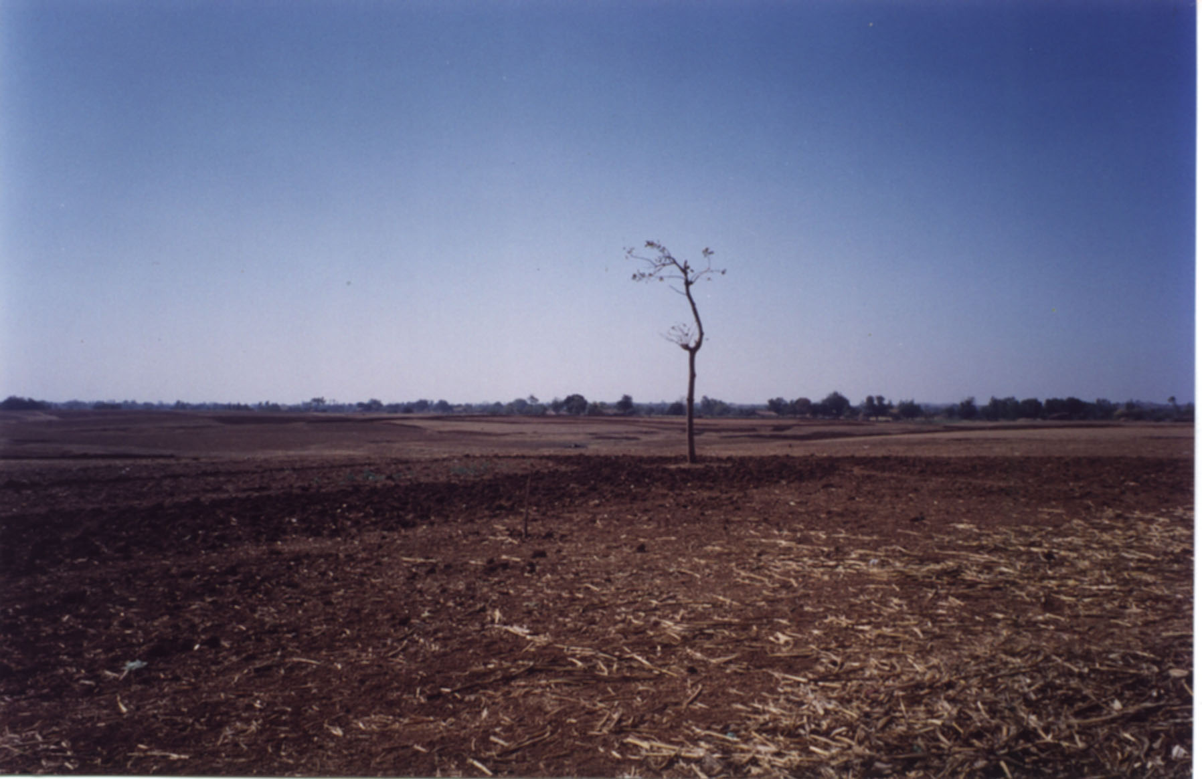
Gender Equity and Water
Sara Ahmed, PhD
Gender and Water Specialist
ASEM, Vilnius, May 2017

Slide 2
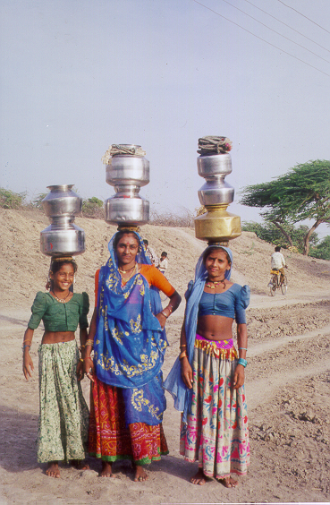
She wakes me in the early
morning for grinding flour,
At night I have to weave,
She sends me to fetch water
very early in the morning,
Oh grandfather, life is very
difficult for me.
My pot has never filled up in
the well,
Water is so deep that my rope
cannot reach,
The sun rises and sets also, but
Today I was unable to collect
even a single pot of water.”
(Folk song sung by Arvindbhai, Gujarat)
Notes:
Water as cultural marker – purity and pollution
As a political marker – competing dev. paradigms and resource allocations
As a social marker of changing gender roles
As an economic marker – poverty, health and livelihoods

Slide 3
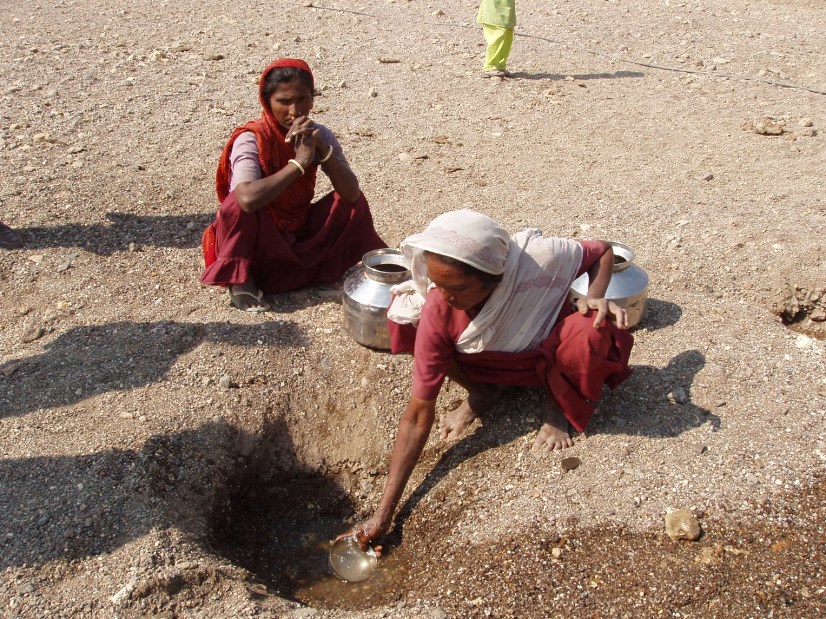
“There is a common saying these days that the seasons have become forgetful. In the dry season it rains and rains; during the wet season, there is drought.
And drought lives in our stomachs.” [Shallow well, virdha, in Gujarat]

Slide 4
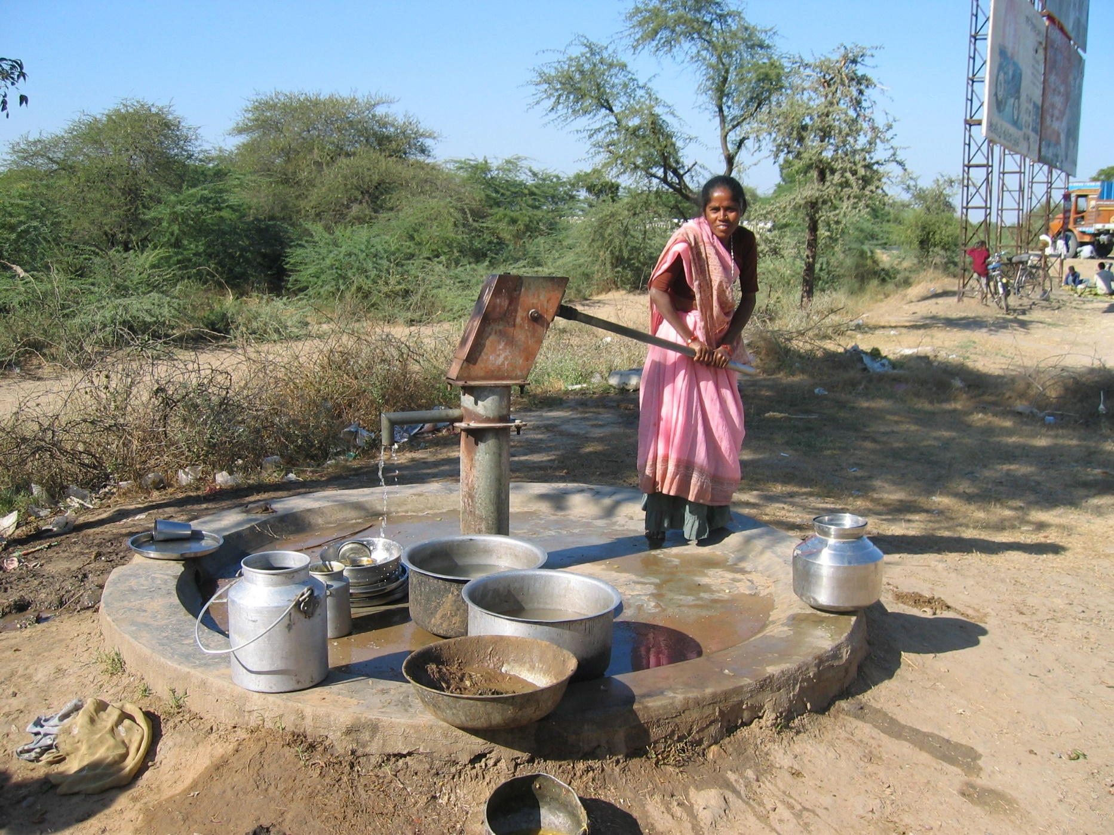
Water has never been a ‘free good’ for the poor, particularly women, who bear a disproportionate burden with respect to their access to and control over water resources and sanitation facilities.
Notes:
Men may collect water only during extreme scarcity periods when one has to travel out, use transport and plastic containers to collect water

Slide 5
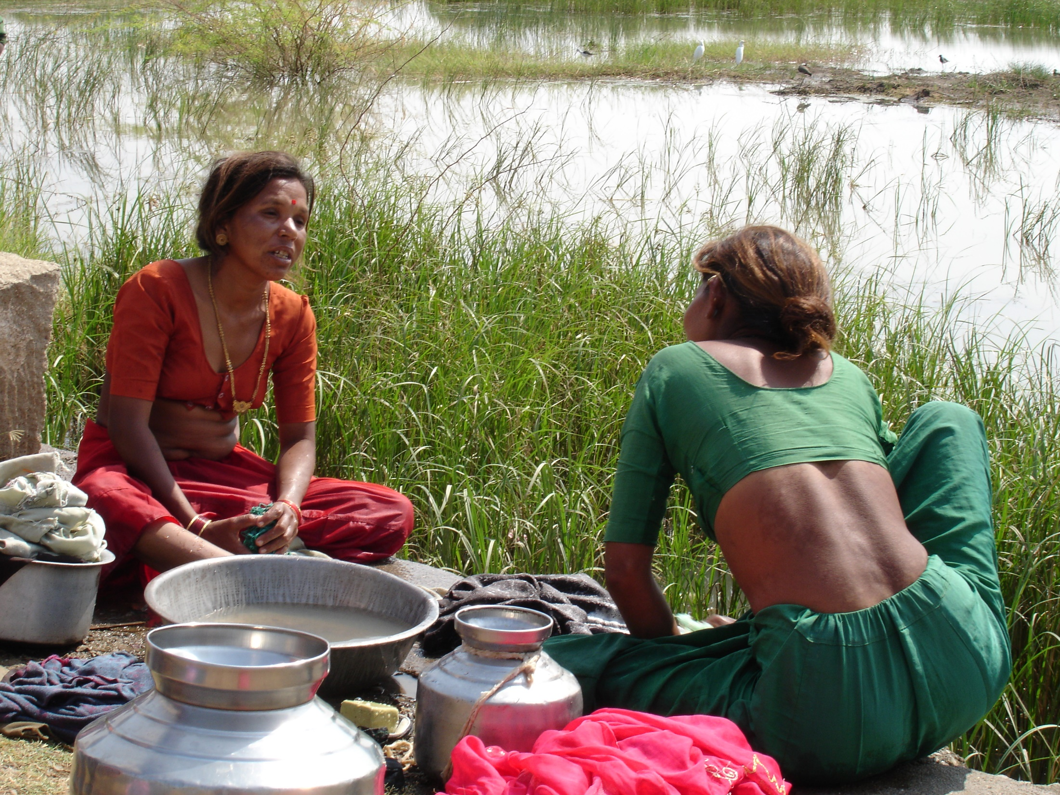

Slide 6
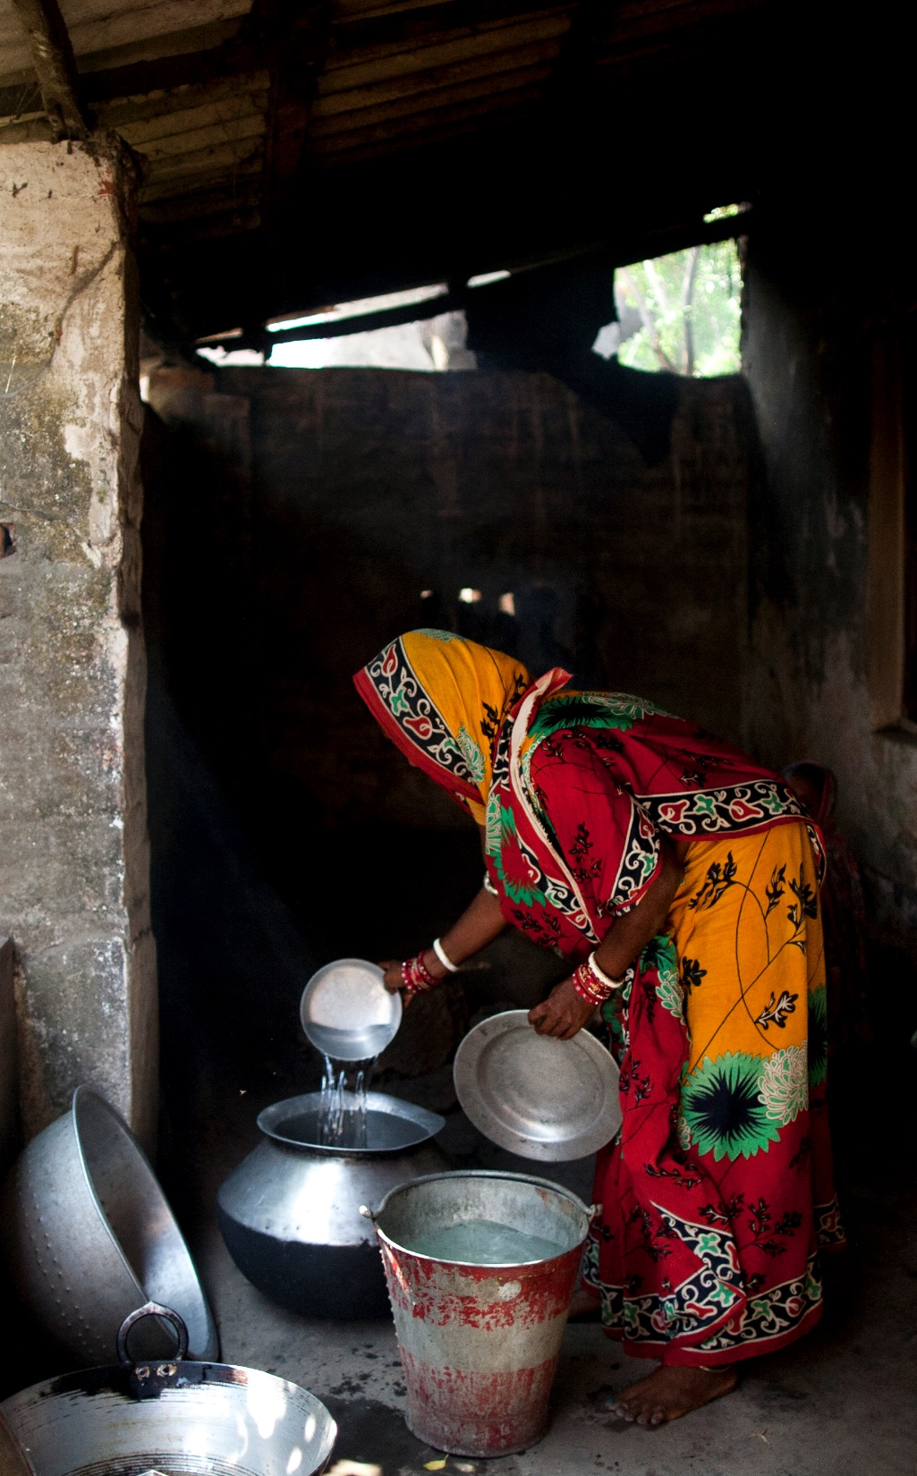
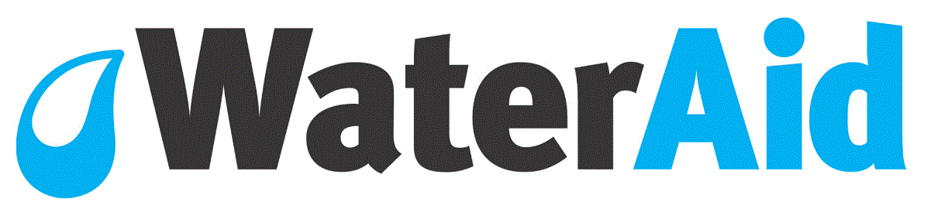
Drinking water scenario in India
75.8 million Indians lack access to safe water, highest in the world
10.28% of all habitations were affected by poor water quality as per lab testing done in 2015-16*
India loses 2-4% of its gross domestic product each year because of unclean water
In terms of distance, India defines sources that lie within 500 metres of the premises as “near”. This means 22% of rural households are far from water
Notes:
*(MDWS, 2016)
http://www.livemint.com/Opinion/P0Z53BOwcPw4SjMRnm028L/The-long-walk-to-water.html

Slide 7
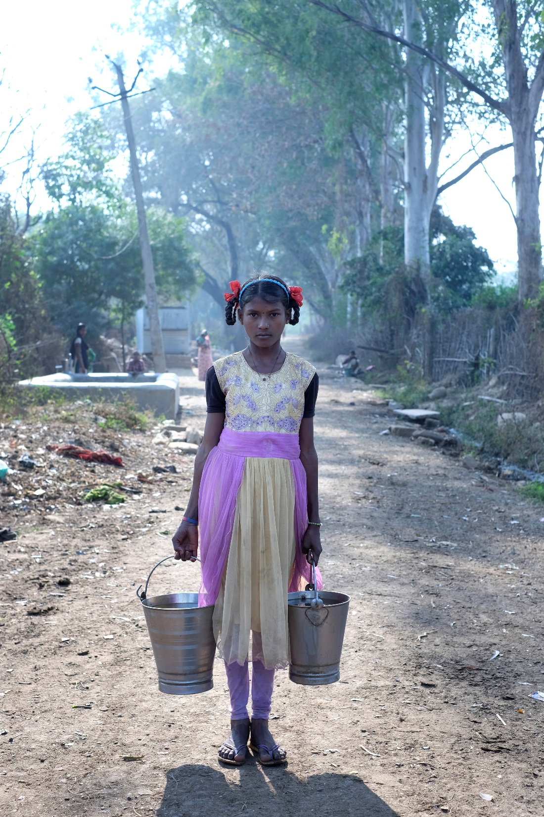
The crisis
Lack of access to drinking water in schools affects the learning environment
Adolescent girls unwilling to use school toilets that lack water or are dirty and often drop out
Woman and girls are at a higher risk for infections due to their frequent contact with unsanitary water
With 167 maternal deaths /100,000 live births and 28 newborn deaths /1,000 live births, India has one of the highest rates of maternal and infant mortality
1 out of 5 newborn deaths could be prevented by ensuring access to clean water
About 68,000 children die from diarrheal diseases each year – malnutrition
Notes:
Sample Registration Survey. Maternal Mortality Ratio. Available at: http://www.censusindia.gov.in/vital_statistics/mmr_bulletin_2011-13.pdf

Slide 8
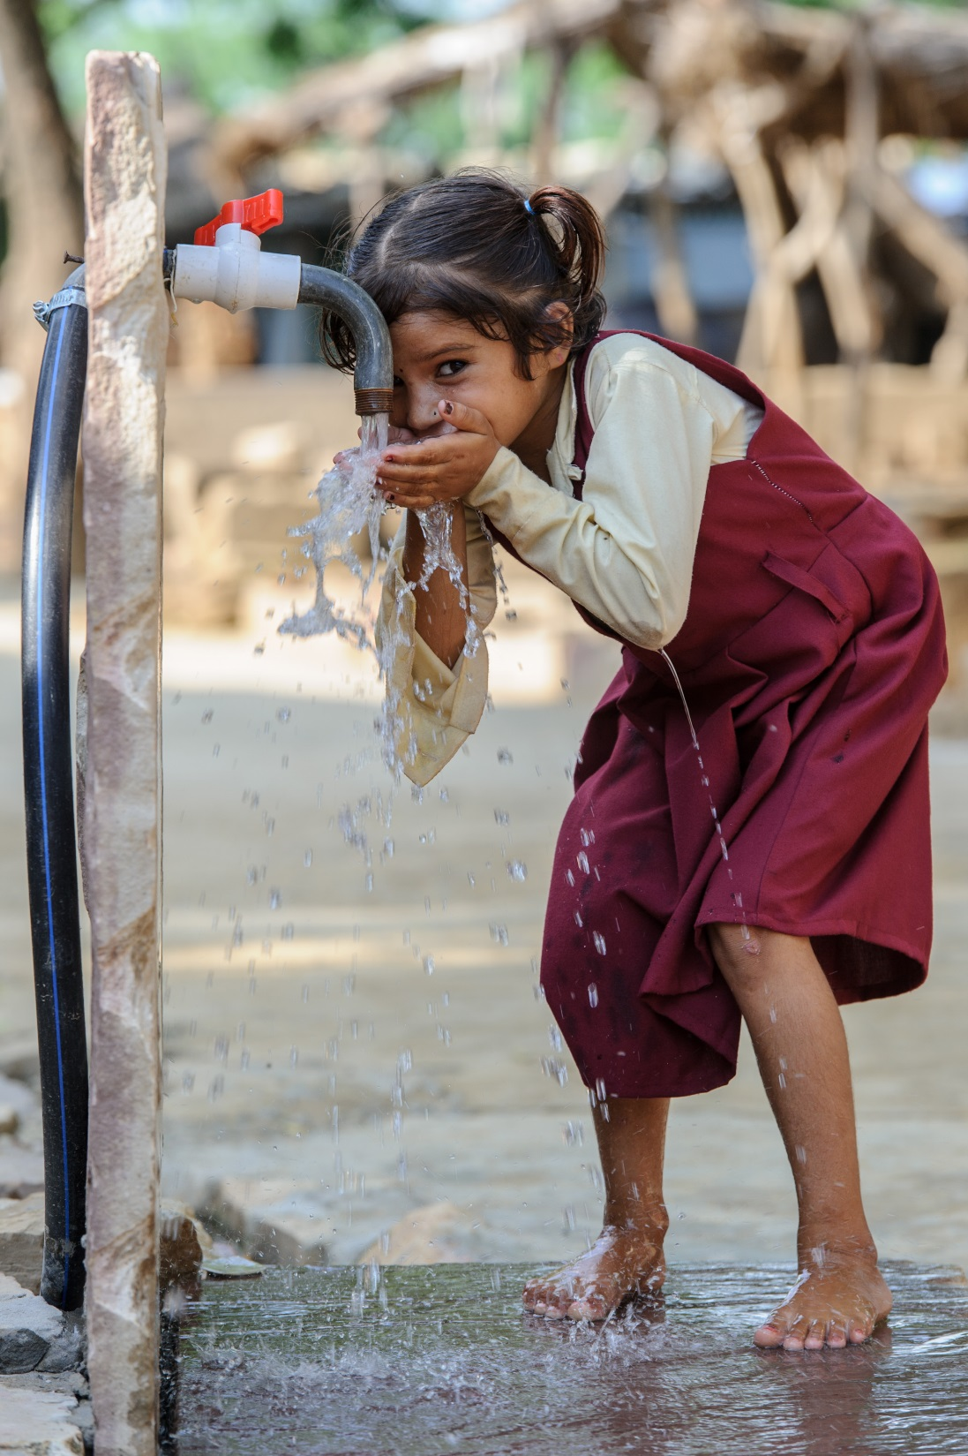
WaterAid’s approach
Catalyse change for the most marginalised (including women and girls) enabling them to analyse causes of marginalisation and act on the knowledge to realise their right to WASH
Influence government and leadership at all levels to strengthen systems to be more accountable, which will ensure robust performance tracking, and effective delivery of sustainable and inclusive WASH services
Advocate for tracking of gender disaggregated data to be able to analyse far reaching consequences of poor access to WASH on women and adolescent girls
Establish WASH as an integral component for planning and action in health, nutrition and education sectors by evidence-based advocacy
Notes:
WaterAid’s response is to use water as an entry point towards larger development - women who can reduce the downtime of water points have brought in wider development
Women in lead roles and central to decision making -Integrated Water Resources Management (IWRM) initiatives without women’s participation had generally prioritised agriculture and livelihood, with women in the lead drinking water found its prominence
Women’s collective to build their knowledge on their entitlements and rights and demand them

Slide 9
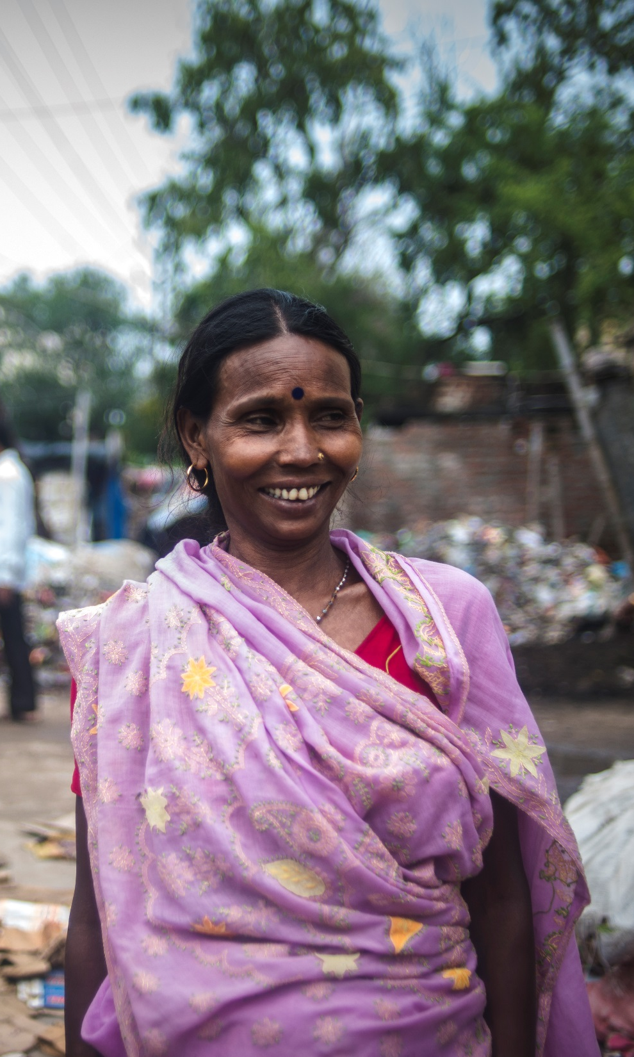
Women leading the change
A women's group in the Mainpura community in north-west Patna, Bihar worked with WaterAid India to secure better access to water and sanitation.
"The situation here was very bad. There were no roads and we had to walk into water up to our knees. We didn't have clean water in the area or any toilets. We had to collect water from a hand pump which was located at a distance of 1.5 kms,” shared Hemandi Devi, a local leader.
WaterAid helped form a Slum Water and Sanitation Committee (SWSC). Meetings were held to facilitate a strategy to improve their lives.
What started with the upkeep of hand pumps, turned into a women's leadership drive that led them to demand and negotiate a piped water supply connection and construction of roads.
"Because of all these changes, women now get more respect in the community,’’ she added.
Notes:
﻿

Slide 10
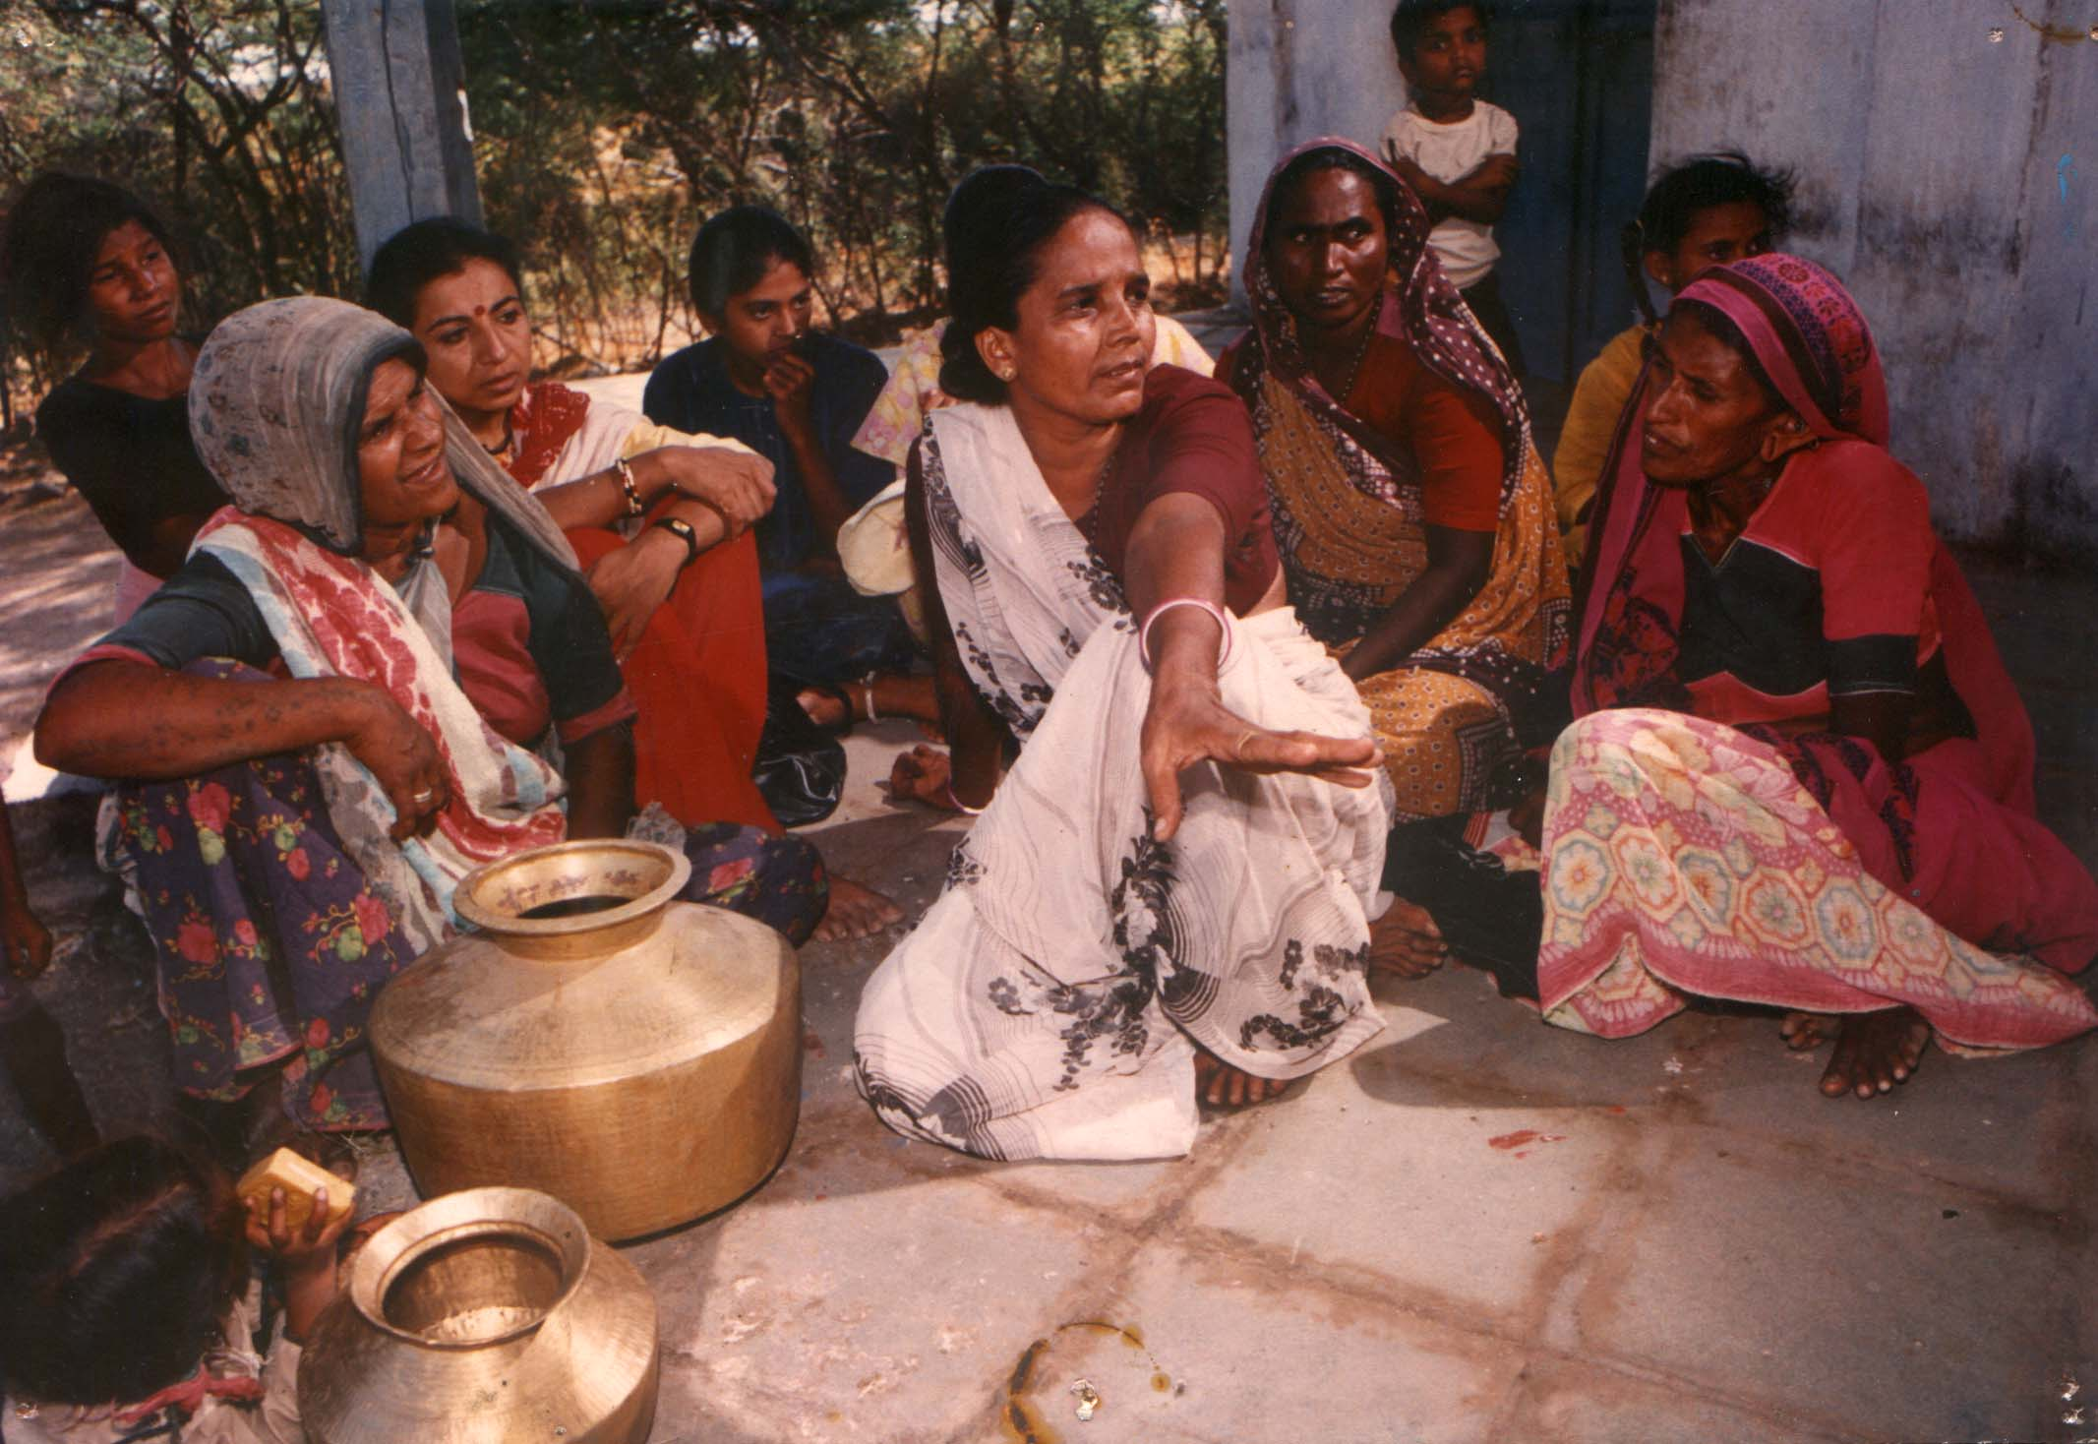
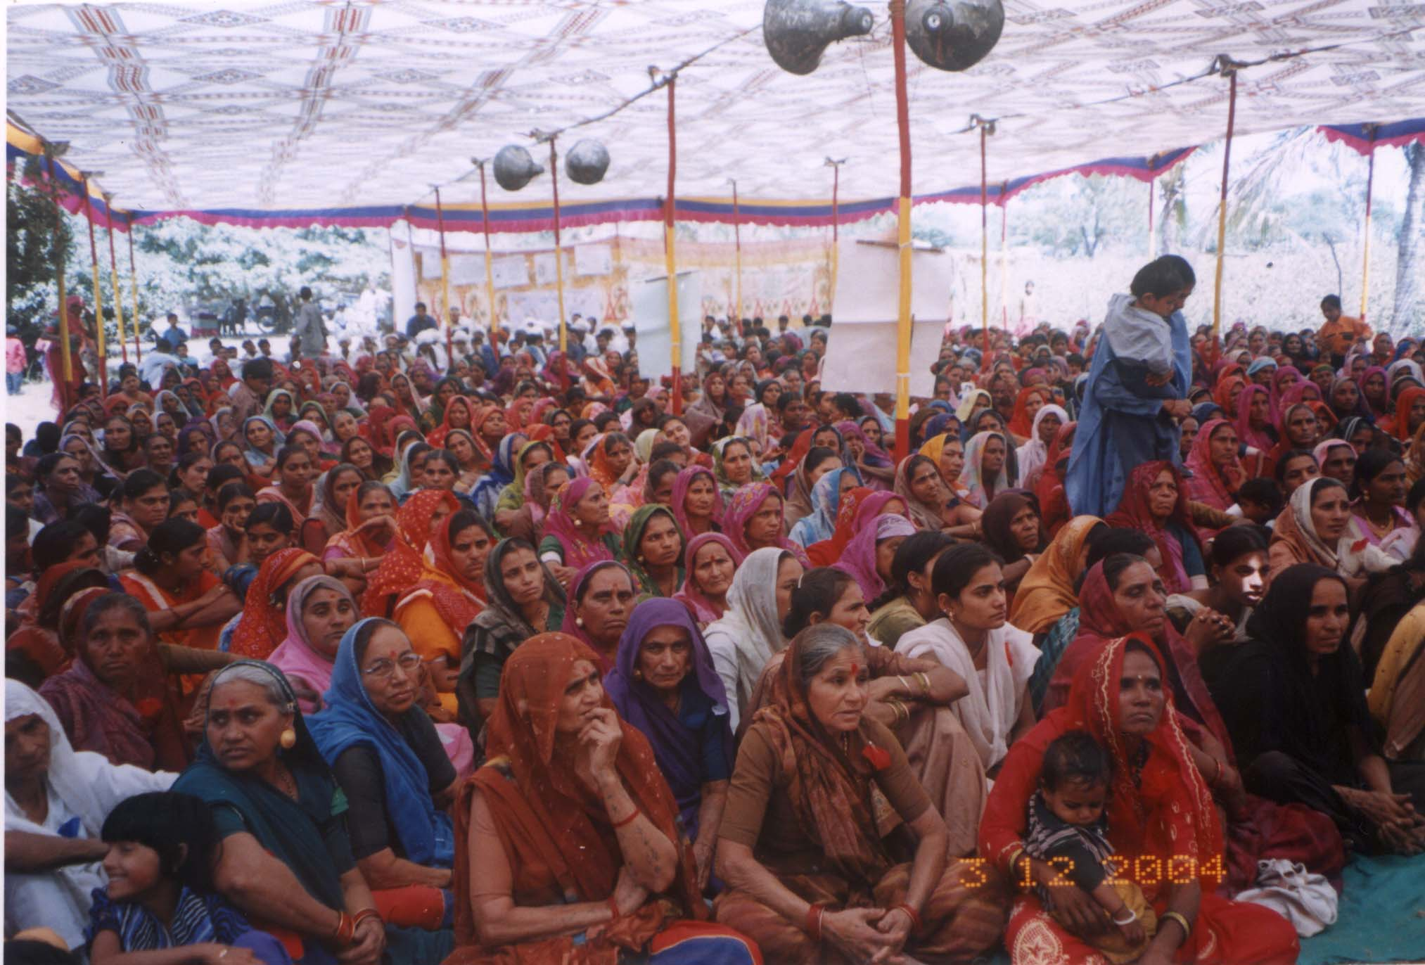
Interventions - Pre-requisites
Organizing women, separate space
1/3 representation, voice
Breaking barriers of caste/class
Savings & credit systems (SHGs)
Livelihood security
Challenging patriarchy
Evolving their own action plan
Demanding change from the government / society

