Slide 1
Family-friendly Policies and Programs in the Philippines: Initiatives and Challenges
Emmeline L Verzosa
Executive Director
1st ASEM Meeting on Women’s Economic Empowerment : Creating Equal Opportunities in the World of Work
May 26, 2017 Vilnius, Lithuania

Slide 2
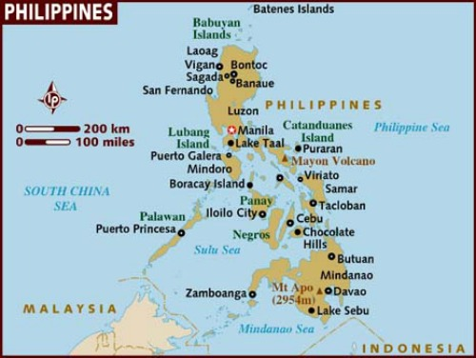

Slide 3
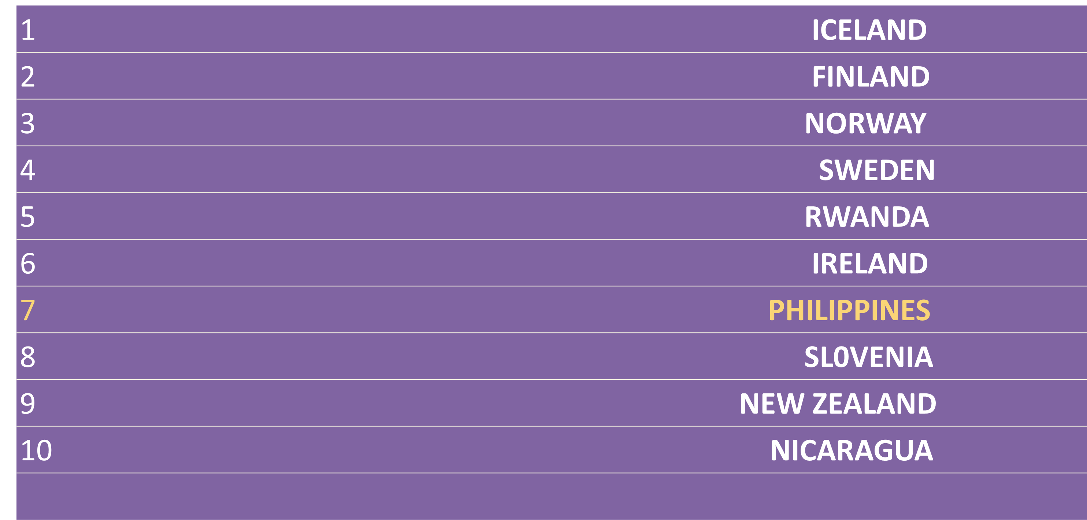
Global Gender Gap Report,
WEF 2016

Slide 4
Family-friendly Policies
Supporting women to perform their reproductive roles
Changing social norms and encouraging men to participate in care work

Slide 5
Family Code of 1987
the spouses are jointly responsible for the support of the family.
parental authority and responsibility shall include the caring for and rearing children for civic consciousness and efficiency and the development of their moral, mental and physical character and well-being

Slide 6
Women in Development and Nation-building Act of 1992
voluntary social security at the private or public system and contribution to provident funds for married person devoting full time in household management and family affairs
contributions from working spouse

Slide 7
Leaves
60-day maternity leave >>> 100 - 120 days (even for unmarried)
7-day leave for solo parents in addition to the 60-day
7-day paternity leave (only for married men)

Slide 8
Special Leaves
3-day special leave for government workers for major family events
10-day paid leave for women victim-survivors of intimate partner abuse, for when they need to attend to their psychological, medical or legal needs (VAWC Act, 2004)
60-day special leave for women who undergo surgery due to gynecological disorders (Magna Carta of Women, 2009)

Slide 9
Expanded Breastfeeding Act
Lactation stations in public places like offices, markets, shopping malls, airports, bus stations – monitored by labor department
Nursing breaks

Slide 10
Flexible work arrangements
Flexi-time
Flexi-place or work-from-home
Telecommuting

Slide 11
Day Care and Child-minding Centers
day care centers in all villages
encouraged in
  government agencies (use GAD budget)
  private offices

Slide 12
Domestic Workers Act of 2013
health insurance and social security coverag
minimum wages
written contracts
specified working hours
paid leaves among others

Slide 13
Education
gender-fair education, addressing gender stereotypes in textbooks
Technology and Home Economics for boys and girls

Slide 14
Male Involvement
Empowerment and Reaffirmation of Parental Abilities (ERPAT) by social welfare department and local offices
Men True to their Responsibility and Obligation to the Family/ Kalalakihang Tapat sa Responsibilidad at Obligasyon sa Pamilya (KATROPA) by Population Commission
Men Opposed to Violence Agaisnt Women Everywhere (MOVE)

Slide 15
Conditional Cash Transfer (4Ps)
Financial assistance
  Prenatal and maternal health check-ups
  3 Children in school up to age 18
  Rice subsidy
Family Development Sessions
  gender sensitivity
  responsible parenthood and family planning, adolescent reproductive health and sexuality
  violence in the family and gender-based violence
  child rearing
  water, sanitation and hygiene
  backyard gardening
  livelihood
  disaster preparedness, among others

Slide 16
Challenges
Heterosexual, nuclear, urban-based families
>>> other diverse forms of family formations
  >> extended families
  >> caring for elderly parents, siblings, relatives
  >> LGBT
  >> adoptive parents
  >> families with migrant parent / s
  >> rural and geographically isolated and depressed areas (GIDA)
  >> workers in the informal economy

Slide 17
Challenges
Family-friendly policies geared towards Redistributing, Reducing and Recognizing unpaid care work of women
  Shared care work
  Technologies to reduce care work (water, electricity, roads)
  Time-use survey to account for unpaid care work
Measuring impact of these policies on women’s economic empowerment

Slide 18
THANK YOU VERY MUCH!
philippine.commission.on.women
@PCWgovph
CommissionOnWomenPH
www.pcw.gov.ph
international.affairs@pcw.gov.ph

