Slide 1
Women digital Entrepreneurship challenges.
Women GoDigital Empowerment
Vilma Misiukonienė

Slide 2
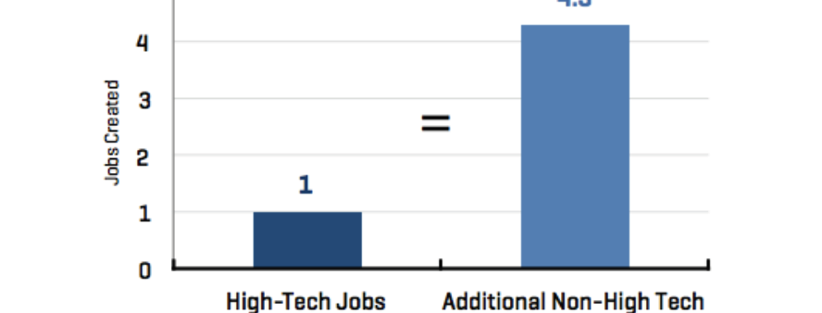
Importance of Digital Economy

Slide 3
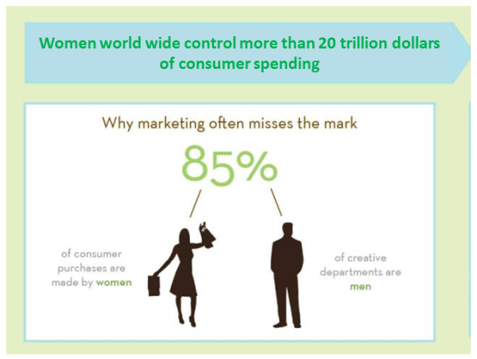
Womenomics
Women’s increased participation in the labour markets has been and continues to be one of the key sources of sustained economic growth
Notes:
If U.S. women business owners were their own country, it would be the 5th largest GDP in the world. The estimated 8 million majority women-owned businesses in the U.S. wield an economic impact of over $2.8 trillion annually and employ more than 23 million people .
52% of university graduates are women and among PhDs, 45%.
There is considerable research based evidence showing that having more girls in the ICT sector
• Expands the qualified talent pool
• Improves the bottom line
• Enhances innovation
• Promotes equality
• Both in the US and Europe companies with a diverse workforce and a high proportion of women in leadership position are more successful. In Europe, of 89 publicly traded companies with a market capitalization of over 168 million Euros, those with more women in senior management and on the board had, on average, more than 10 percent higher return on equity than those companies with the least percentage of women in leadership.
• Firms with female senior managers outperform those without women in leadership position11
• Women funded high-tec start-ups operate with less funding and fewer failures.
• The importance of gender diversity is also inextricably linked to the growing role of women as consumers. Women control roughly US$20 trillion of total consumer spending globally and that number is predicted to rise to US$28 trillion by 2014.12
In the United States alone, the number of women with six-figure incomes is rising at twice the rate of men, and in almost all urban areas, unmarried professional women have either caught up with or are out-earning men. Women‘s incomes are growing even faster in developing countries, where their earned income grew at a rate of 8.1 percent, compared to the 5.8 percent rate for men.

Slide 4
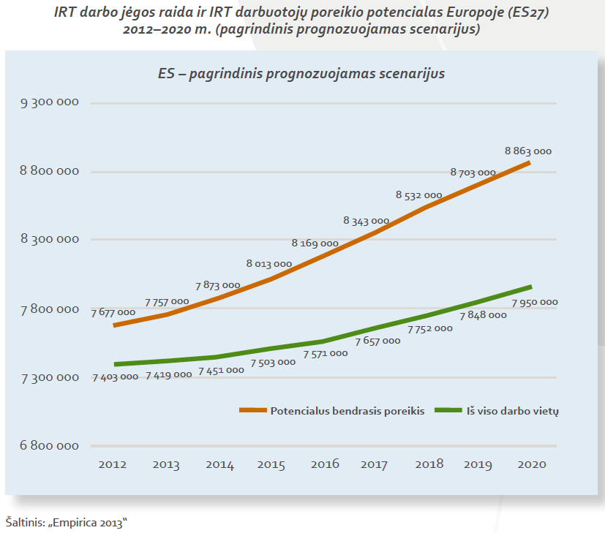
Workforce gap in digital sector in EU

Slide 5
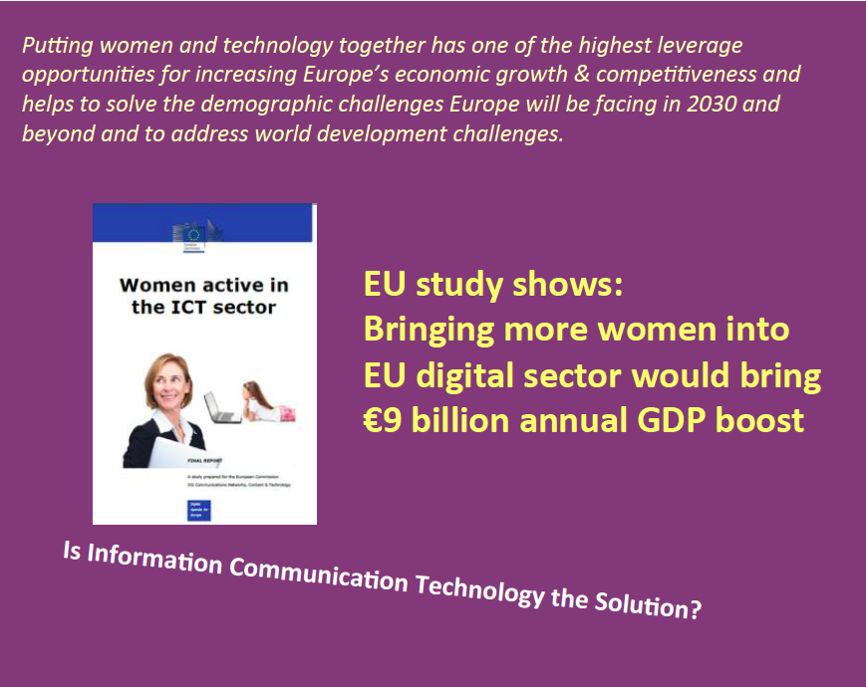

Slide 6
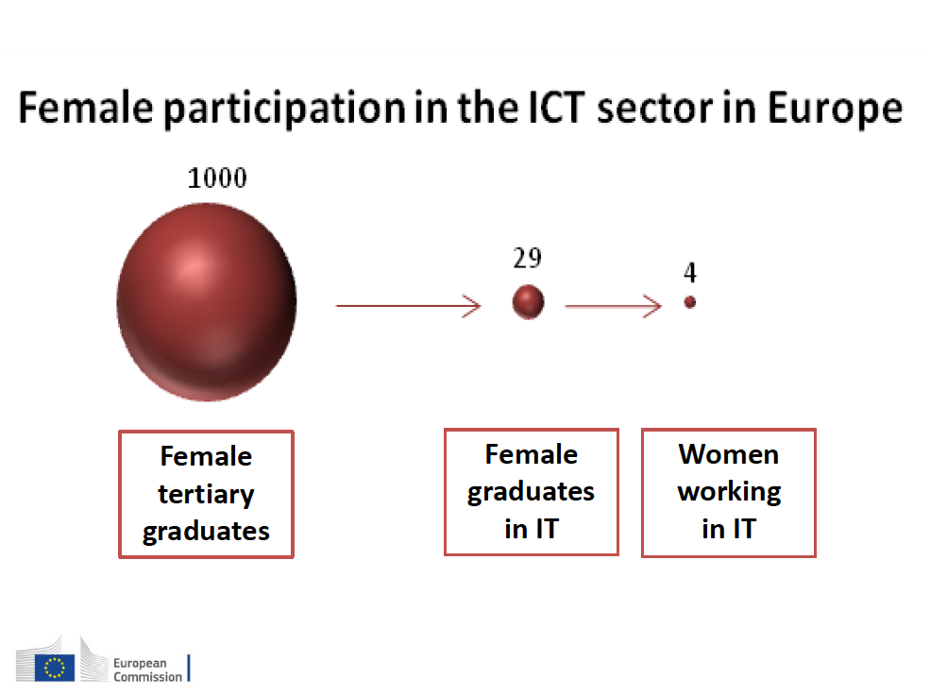

Slide 7
Importance of Digital Economy

Slide 8
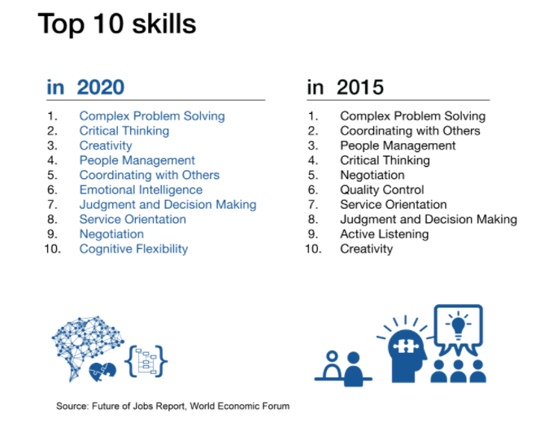

Slide 10
“
You have to take opportunities and make an opportunity fit for you, rather than the other way around.
I would be better at my job if I were technical.
Women don't take enough risks. Men are just 'foot on the gas pedal.' We're not going to close the achievement gap until we close the ambition gap.
  Sheryl Sandberg
    CEO, Facebook
”
Photo: Copyright 2010 Drew Altizer, Financial Times Source: http://drte.co/pz

Slide 11
Companies with more women on their boards have delivered a 36 % better return on equity than those lacking board diversity (MSCI data).

Slide 12
DQ, Skaitmeninis intelektas

Slide 13
DQ, Digital Intelligence

Slide 14
1st European Celebration of Women in Computing,
April 25-26, 2016.
Prof. Valentina Dagienė, Founder of BEBRAS Challenge, now running almost in 50-ty countries worldwide –
the winner of main Ada Lovelace Computing Excellence Award

Slide 15

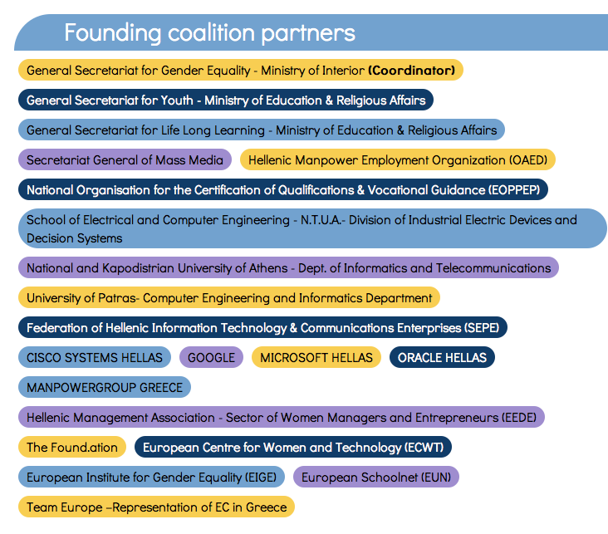
Greece: Women & Girls Go digital Coalition

