Slide 1
Women, Business and the Law: The Economic Costs of Gender Inequality
SARAH IQBAL
ASEM CONFERENCE
VILNIUS, THE REPUBLIC OF LITHUANIA
May 25, 2017

Slide 2
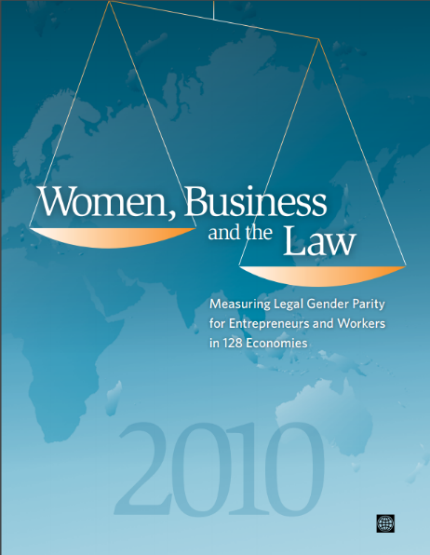
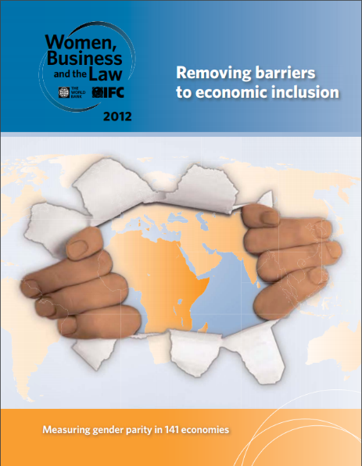


WHAT DOES WOMEN, BUSINESS AND THE LAW DO?
Women, Business and the Law examines laws that treat men and women differently in ways that affect women’s economic opportunities
It looks at legal disadvantages women face relative to men, as well as gender-neutral laws that may have a disproportionately negative affect on women
It publishes a global report every 2 years and maintains a online database with country-level data and links to primary legal sources

Slide 3
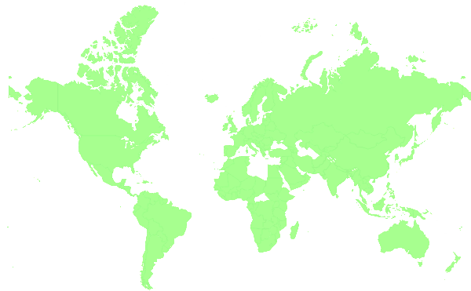







WHAT DOES WOMEN, BUSINESS AND THE LAW COVER?
Accessing Institutions
Getting a Job
Using
Property
Going to Court
Protecting Women from Violence
Building Credit
Providing Incentives to Work
173 economies across 7 indicators, examining:
Constitutional Law
Family Law
Labor Law
Property Law
Criminal Law
Domestic Violence Law
Tax Law
Social Security Law
Land Law
Education Law
Personal Status Law
Violence Against Women Legislation
Quotas
…and more

Slide 4
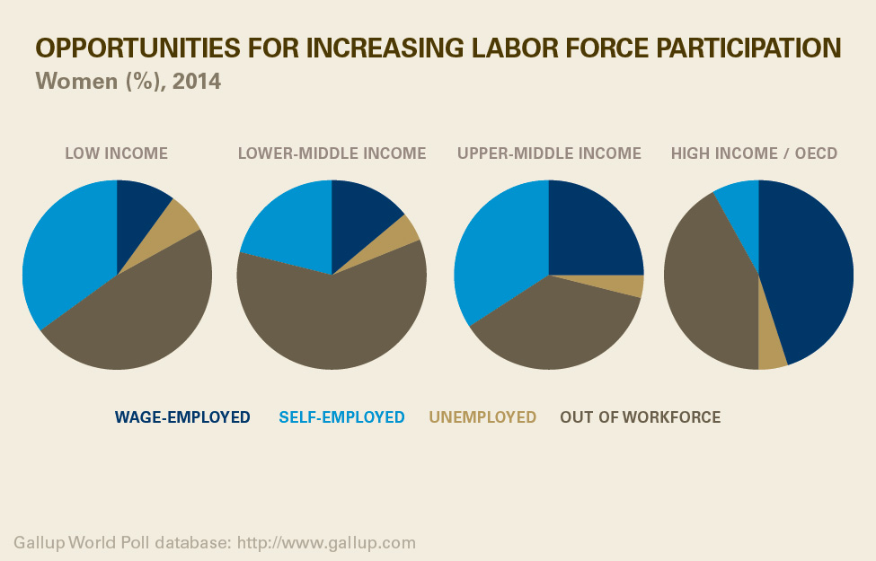
GENDER GAPS EXIST SEVERAL AREAS,
SUCH AS EMPLOYMENT
Globally, women’s employment to population ratio is under 50% compared to over 70% for men

Slide 5
AND IN FINANCIAL INCLUSION
ACCOUNT OWNERSHIP IS INCREASING, BUT GENDER GAPS REMAIN
Adults with an account (%), 2014
2011
2014
The gender gap (in black) persists at 9 percentage points on average
Source: Global Findex (2014)

Slide 6
SO WHY DOES GENDER EQUALITY MATTER?
Research by the World Bank, the IMF and others has shown that legal gender differences significantly decrease female labor force participation and undermine GDP growth
Legal gender equality is associated with lower gender gaps in labor force participation without any significant effect on male participation rates
Research estimates that eliminating barriers discriminating against women working in certain sectors or occupations could increase labor productivity by as much as 25% in some economies, simply by increasing women’s labor force participation
  Sources: Gonzales, Jain-Chandra, Kochhar and Newiak. 2015. “Fair Play: More Equal Laws Boost Female Labor Force Participation.” IMF Staff Discussion Note SDN/15/02, International Monetary Fund, Washington, DC; World Bank. 2011. World Development Report 2012: Gender Equality and Development. New York: Oxford University Press.

Slide 7
ESTIMATED INCOME LOSS DUE TO PARTICIPATION GAPS IN FEMALE ENTREPRENEURSHIP AND LABOR FORCE PARTICIPATION RATES RELATIVE TO MEN
total income loss
Globally, if all women were excluded from entrepreneurship, average output per worker would fall by almost 12%.
Globally, if all women were excluded from the labor force income per capita would be reduced by almost 40%.
Notes:
In the Middle East and North Africa, participation gaps in female entrepreneurship and labor force participation rates relative to that of men accounts for a total income loss of 27%.
In South Asia, the resulting income loss due to gender gaps in 19%.
In Latin America and the Caribbean the resulting income loss is 14%.
In Europe the income loss is 10%.
Sub-Saharan Africa is the region with the lowest total income loss due to gender gaps at 8.5%.

Slide 8
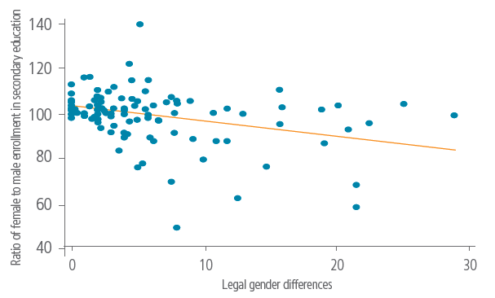
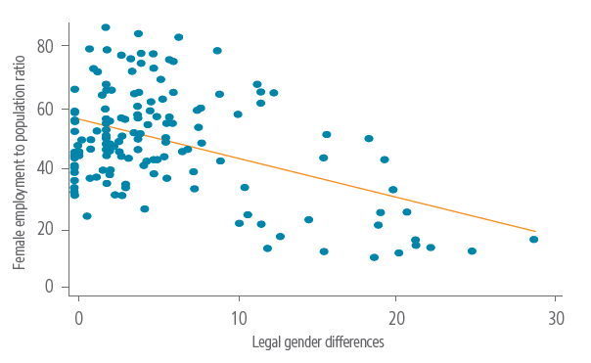
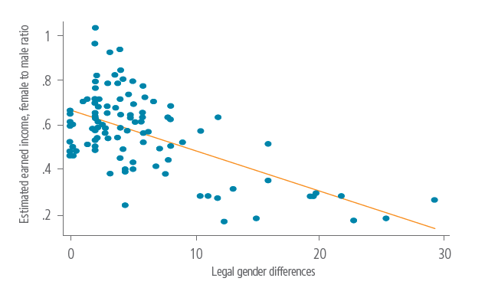
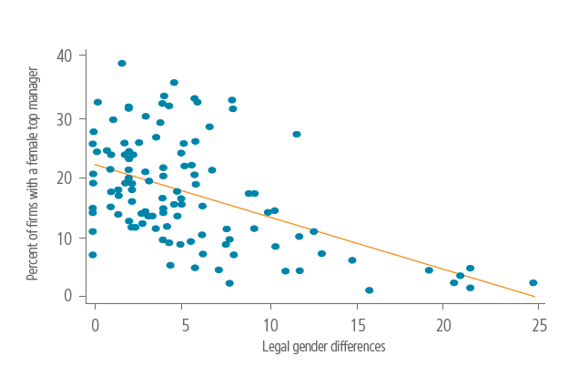
Lower Legal gender equality is associated with fewer girls attending secondary school, fewer women working or running businesses, and a wider gender wage gap
Ratio of female to male enrollment in secondary education
Female employment to population ratio
Percent of firms with a female top manager
Estimated earned income, female to male ratio
Source: Women, Business and the Law, Enterprise Surveys and World Bank World Development Indicators databases.

Slide 9
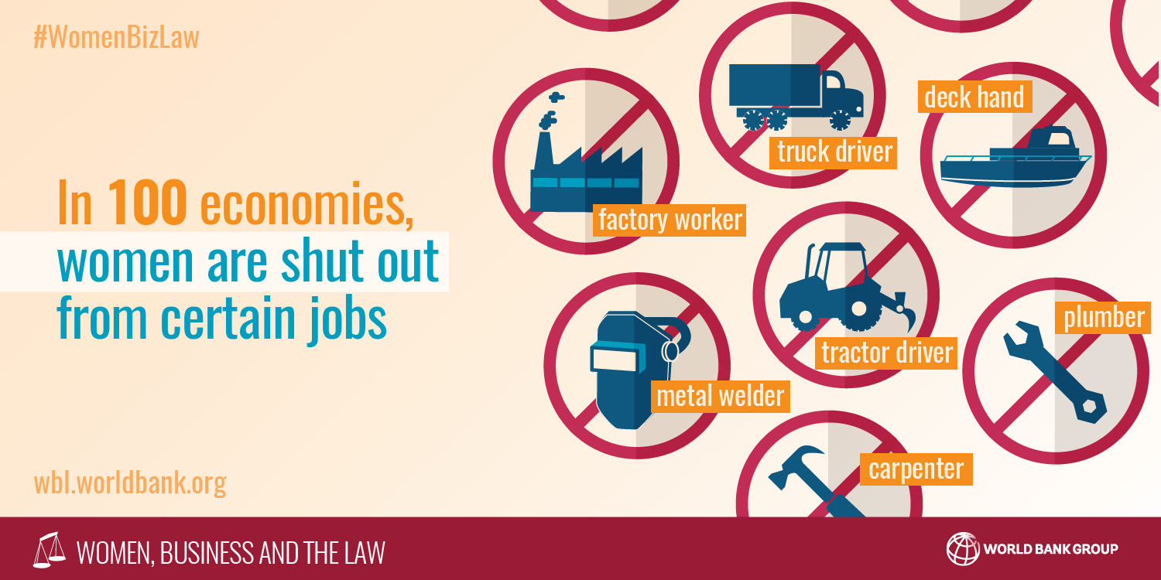
JOB RESTRICTIONS ON WOMEN’S EMPLOYMENT
ARE WIDESPREAD
Source: Women, Business and the Law

Slide 10
THE GENDER WAGE GAP IS LIKELY TO BE LARGER WHERE THERE ARE JOB RESTRICTIONS ON WOMEN’S WORK
Restrictions on women’s work decrease women’s earning potential relative to men’s
Source: Women, Business and the Law and World Bank World Development Indicators databases;
World Economic Forum Global Gender Gap Report 2014

Slide 11
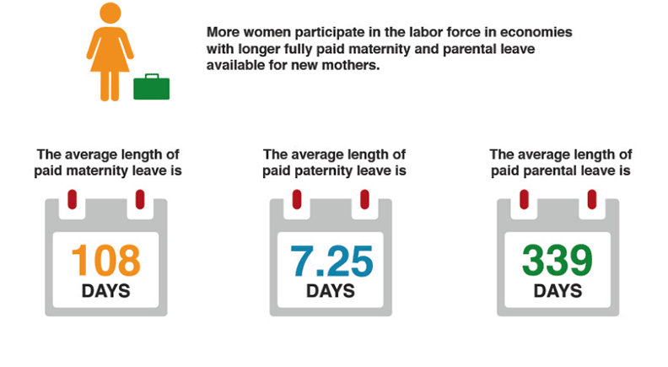
THE LENGTH OF PAID LEAVE
More women participate in the labor force in economies with fully paid maternity and parental leave available for new mothers
106 DAYS
7
DAYS
410
DAYS
In ASEM economies, the average length of paid leave is:
126 DAYS
MATERNITY LEAVE
10 DAYS
PATERNITY LEAVE
362 DAYS
PARENTAL LEAVE
Source: Women, Business and the Law
Notes:
Note: These figures are an average of countries that have paid leave. Countries where only unpaid leave is provided are excluded.
Maternity leave:
Note: Sweden, Australia and Portugal only have paid parental
Average is 126; median is 112.
14 days is minimum (United Kingdom, because they converted to parental leave). Malaysia and the Philippines both have only 60 days of paid maternity leave (though note Philippines has current bill to increase length).
410 is the maximum length of paid maternity leave (Bulgaria).
Paternity leave:
Only 27 ASEM countries have paid paternity leave.
Average & median is 10
Minimum is Malta and Italy, with only 1 day
Maximum is Lithuania with 10 days
Parental leave:
25 ASEM countries have paid parental leave
Average is 363; median is 302
Least is Singapore with only 7 paid days
Most is Czech republic, with 1095 days (3 years)

Slide 12
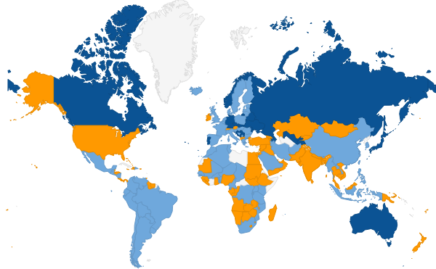
PAID PATERNITY LEAVE
Women's employment among private firms is significantly higher in economies that mandate paternity leave versus those that do not
Paid paternity leave exists
No paid paternity nor parental leave
No paternity leave exists but there is paid parental leave
No data
Source: Amin, Islam and Sakhonchik, "Does Paternity Leave Matter for Female Employment in Developing Economies? Evidence from Firm Level Data" Applied Economic Letters, Vol. 23, 2016 Issue 16
Notes:
The average length of paid paternity leave is 7 days. Minimum is 1 day and maximum is 90 days (Iceland).
1 day paid paternity leave (9):
Bahrain Chad Italy Malta Mozambique Niger Saudi Arabia Senegal Tunisia
2 days paid paternity leave (12):
Argentina Congo, Dem. Rep. Côte d'Ivoire Dominican Republic Greece Guatemala Indonesia Kosovo Luxembourg Netherlands Paraguay Togo
3 days paid paternity leave (17):
Algeria Benin Bolivia Burkina Faso Cameroon China Djibouti El Salvador Equatorial Guinea Hong Kong SAR, China Korea, Rep. Lao PDR Maldives Mali Morocco South Africa Tanzania
4 days paid paternity leave (4):
Burundi Peru Rwanda Uganda
5-7 days paid paternity leave (13):
Bhutan Bosnia and Herzegovina Brazil Chile Hungary Mauritius Mexico Nicaragua Philippines Singapore Taiwan, China Timor-Leste Uruguay
10-14 days paid paternity leave (18):
Afghanistan Belgium Bulgaria Colombia Denmark Ecuador Estonia France Iran, Islamic Rep. Kenya Latvia Myanmar Poland Romania Spain Sweden United Kingdom Venezuela, RB
15-30 days (6)
Bulgaria Myanmar Romania Finland Lithuania Slovenia
90 days (1)
Iceland
Fathers receive 100% of wages during paternity leave in 66 of the 77 economies that establish paid paternity leave (86%):
Afghanistan Algeria Argentina Bahrain Benin Bhutan Bolivia Bosnia and Herzegovina Brazil Burkina Faso Burundi Cameroon Chad Chile China Colombia Congo, Dem. Rep. Côte d'Ivoire Djibouti Dominican Republic Ecuador El Salvador Equatorial Guinea Estonia Greece Guatemala Hungary Indonesia Iran, Islamic Rep. Italy Kenya Korea, Rep. Kosovo Lao PDR Lithuania Luxembourg Maldives Mali Malta Mauritius Mexico Morocco Mozambique Netherlands Nicaragua Niger Paraguay Peru Philippines Poland Romania Rwanda Saudi Arabia Senegal Singapore Slovenia South Africa Spain Taiwan, China Tanzania Timor-Leste Togo Tunisia Uganda Uruguay Venezuela, RB
Fathers receive less than 100% wages in 11 economies that establish paid paternity leave, but note this is because a formula applies under WBL methodology:*
United Kingdom Iceland Denmark Sweden Finland Myanmar France Belgium Hong Kong SAR, China Latvia Bulgaria
If the law sets a maximum amount of maternity benefits that can be paid or does not stipulate an exact percentage, it is assumed that the woman earns the equivalent of the average value-added per worker. Average value-added per worker is the ratio of an economy's GNI per capita to the working-age population as a percentage of the total population.

Slide 13
WOMEN ARE MORE LIKELY TO RECEIVE WAGES FROM AN EMPLOYER WHERE GOVERNMENTS SUPPORT CHILDCARE
Increased availability of childcare may create opportunities for women to participate in the paid employment, because women are often the primary care-givers for children

Slide 14
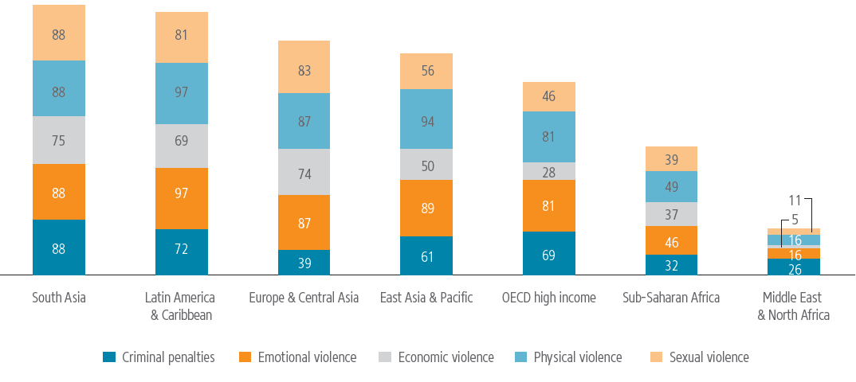
46 ECONOMIES WORLDWIDE HAVE NO SPECIFIC
LAWS ON DOMESTIC VIOLENCE
Coverage and scope of domestic violence laws,
by percentage of economies and in a region
Source: Women, Business and the Law database.

Slide 15
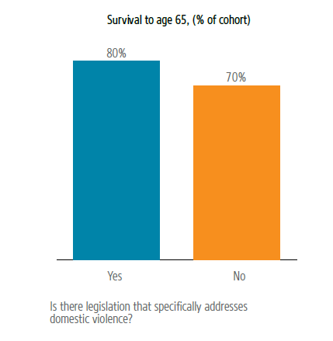
WOMEN’S LIFE EXPECTANCY IS LIKELY TO BE HIGHER WHERE THEY ARE LEGALLY PROTECTED FROM DOMESTIC VIOLENCE
Source: Women, Business and the Law and World Bank World Development Indicators databases.

Slide 16
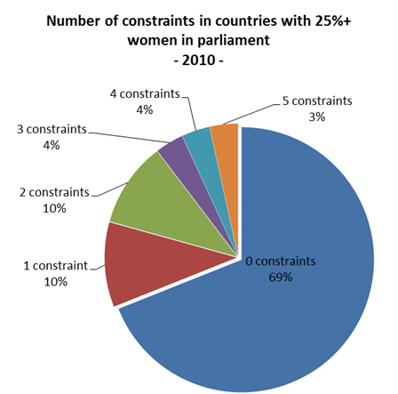
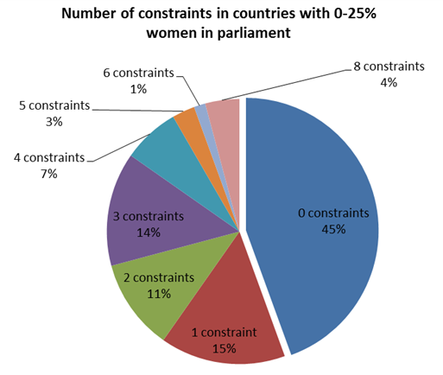
WOMEN LEGISLATORS RAISE THE PROBABILITY OF REFORM

Slide 17
CEDAW HELPED CATALYZE REFORMS
Rates of reform doubled within 5 years of ratifying CEDAW
Source: Hallward-Driemeier, Hasan and Rusu, 2013a

Slide 18
INCORPORATING GENDER LEGAL DIFFERENCES IN
DOING BUSINESS INDICATORS
Building on the information collected by Women, Business and the Law, Doing Business now includes:
Starting a Business – is the process of starting a business different if the entrepreneur is a woman?
    Approval from spouse required to own a business or leave the house.
    Documents or permission required by only one gender for company registration and operation, opening a bank account or obtaining a national ID (since showing proof of ID is a normal requirement in business registration).
  Registering Property – can a woman own, use and transfer property the same way as a man?
    Do unmarried men and women have equal ownership rights to property?
    Do married men and women have equal ownership rights to property?
  Enforcing Contracts – does a woman’s testimony carry the same evidentiary weight in court as man’s?
Notes:
Why it matters?
Equal access to business opportunities is important given that around half of the world’s population is female.
Starting a Business
Two types of local liability companies are considered under the Starting a Business methodology. They are identical in all aspects, except that one company is owned by 5 married women and the other by 5 married men.
The distance to frontier score for each indicator (procedures, time, cost) represents the average of the scores obtained for each of the scenarios.
Documents or permission required by only one gender for:
Company registration
Obtaining a national ID card
Opening a bank account
Approval from spouses to own a business or leave the home are considered a procedure if required by law or if by failing to obtain it the person will suffer consequences under the law (e.g., loss of right to financial maintenance).
Registering property
Equal access to property rights allows to integrate women more rapidly into the workforce, and facilitates women to become entrepreneurs. For instance, property can be used to access finance.
A new component (“Equal access to property rights”) was added to the Quality of land administration index. It covers two questions:
Unequal ownership rights to property between unmarried men and women
Unequal ownership rights to property between married men and women
Restrictions on equal access to property rights are measured by subtracting up to 2 points (one point per question) from the quality of the land administration score.
Enforcing contracts
A question was added under the “Court structure and proceedings” component of the Quality of Judicial Processes index. This new question measures whether testimonies rendered by men and women have the same evidentiary weight in court.
Restrictions on equal testimony are measured by subtracting 1 point from the Court structure and proceedings score.

Slide 19
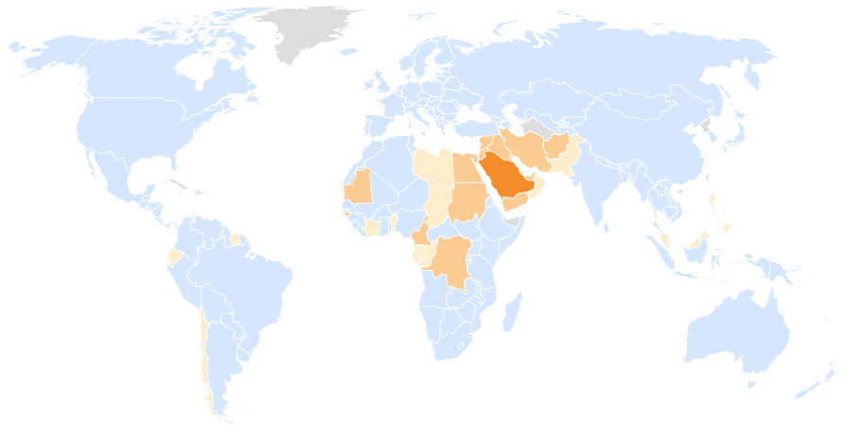

Doing Business recorded 60 gender disparities in 38 economies
Number of recorded
gender restrictions:
0
1
2
3
4
Source: Doing Business database.
Notes:
By gender disparities it is intended any occasion when different rules apply for women. For example, to start a business in Saudi Arabia, a married women is required to undertake 3 additional procedures compared to men: (1) Obtain husband's national identification card for national identification card, (2) Hire a driver and obtain husband's permission to leave the house. (3) Hire a man to manage the business. These are counted as 3 separate disparities for the purpose of this slide, although they are all captured by the same indicator set – Starting a Business.

Slide 20


WHAT’S NEXT FOR
WOMEN, BUSINESS AND THE LAW?
The 2030 Agenda sets out 17 Goals and 169 targets to be achieved over the next 15 years, and will use measurable indicators to examine progress and encourage positive change
Goal 5: Achieve gender equality and empower all women and girls
Target 5.1: End all forms of discrimination against women and girls everywhere
Indicator 5.1.1: Whether or not legal frameworks are in place to promote, enforce and monitor equality and non-discrimination on the basis of sex
Women Business and the Law is working with UN Women and the OECD on the development of SDG indicator 5.1.1 to monitoring progress on Target 5.1
For the first time, Women Business and the Law will cover issues of implementation by examining legal frameworks enforcing and monitoring gender equality and nondiscrimination

Slide 21


CONNECT WITH US
#WomenBizLaw
www.facebook.com/womenbusinesslaw

